Slide 1
INTERNAL PICK-DECK GUIDE
FOR INTERNAL USE
How to use this pick deck
THIS IS A LIBRARY
SELECT THE RIGHT MATERIAL
BUILD THE STORY
This is not a linear presentation. Select only the slides that match the buyer, catalyst, lifecycle moment and desired depth. Build a client-ready story for the conversation.
01
Buyer
1.
Start with the buyer and catalyst.
Who is making the decision?
2.
Follow the narrative spine.
02
Catalyst
3.
Choose only the relevant depth.
Why does modernization matter now?
4.
End with proof and a next step.
03
Lifecycle moment
Rationalize, Build or Sustain
04
Depth
Choose the relevant level of detail
05
Proof + next step
End with relevant evidence and an action
INTERNAL ONLY — REMOVE THIS SLIDE AND ALL INTERNAL SECTION GUIDES BEFORE EXTERNAL SHARING.
1
Notes:
Source deck: Software Modernization Walking Deck_04132026.pptx.
Insert source slides 9 through 11, 13 through 14, and 15 through 31 unchanged after this divider.
Omit source slide 12 because it is the old contact call to action.
Preserve source order, formatting, metrics, client descriptors, caveats, and notes.
The source is internal and verify-before-external-reuse.
Some outcomes may be modeled or identified rather than realized, and notes may contain names not visible on slides.
Transition: After a selected proof example, bring the audience back to one specific account action.
ORIGINAL SOURCE — COMPLETE VISIBLE COPY
INTERNAL ONLY
How to Use This Pick Deck
This deck is a library, not a linear presentation. Build a client-ready story by selecting only the slides that match the buyer, catalyst, lifecycle moment, and desired depth.
BUILD THE STORY
01
Start with buyer + catalyst
02
Follow the narrative spine
03
Choose only relevant depth
04
End with proof + next step
INTERNAL ONLY — Remove this slide and any internal section guides before sharing externally.
© 2026 West Monroe Partners | Reproduction and/or distribution without West Monroe Partners’ prior consent is prohibited.
Original source SHA256: c732e693a6370a0abdf3b54f34ff456304a4a25025303c508a48559f1bee73e6
WMDS bound template. Content classification: supplied_content. Frozen source and binding provenance are recorded in layout-report.json and binding-report.json.

Slide 2
INTERNAL PICK-DECK GUIDE
Modernization economics in the AI age
01
Economics shift
02
Business value
03
Use cases & catalysts
04
Ecosystem scope
3–5: AI changes cost and the strategic buy-versus-build choice.
6, 9: Delivery, continuity, effort and possible value directions.
10–11: What changes, why now and how value is measured.
12: See the applications, data, workflows and human handoffs.
2
Notes:
Source deck: Software Modernization Walking Deck_04132026.pptx.
Insert source slides 9 through 11, 13 through 14, and 15 through 31 unchanged after this divider.
Omit source slide 12 because it is the old contact call to action.
Preserve source order, formatting, metrics, client descriptors, caveats, and notes.
The source is internal and verify-before-external-reuse.
Some outcomes may be modeled or identified rather than realized, and notes may contain names not visible on slides.
Transition: After a selected proof example, bring the audience back to one specific account action.
ORIGINAL SOURCE — COMPLETE VISIBLE COPY
INTERNAL PICK-DECK GUIDE
Modernization Economics in the AI Age
Set the stage by showing why modernization has historically been difficult, how AI changes the work, and what new choices that creates.
IN THIS SECTION
01
Economics shift
02
Business value unlocked
03
Use cases + catalysts
04
Ecosystem example
Recommended use: select 3–6 slides based on the buyer's urgency and familiarity with modernization.
© 2026 West Monroe Partners | Reproduction and/or distribution without West Monroe Partners’ prior consent is prohibited.
Original source SHA256: c732e693a6370a0abdf3b54f34ff456304a4a25025303c508a48559f1bee73e6
WMDS bound template. Content classification: supplied_content. Frozen source and binding provenance are recorded in layout-report.json and binding-report.json.

Slide 3
MODERNIZATION ECONOMICS
The script has flipped on application modernization
AI reduces time and cost across analysis, design, build, testing and transition.
How are legacy systems holding your business back?
If modernization cost one-tenth of what you expect, what could that unlock?
AI-NATIVE READINESS
GROWTH VELOCITY
COST EFFICIENCY
CUSTOMER MOAT
How could you become AI-native?
Where do release delays limit growth?
Where could fewer handoffs cut cost?
How could connected journeys deepen loyalty?
3
Notes:
SPEAKER BEATS
The historical choice often looked poor in every direction: continue carrying legacy risk, reorganize the business around a packaged platform, or accept a large custom rebuild.
Paint a future the business wants. Modernization can unify an acquired platform, unlock a market, redesign a consequential process, or create the foundation for agent-enabled work.
“One-tenth of what you expect” is a conditional thought experiment. It invites the audience to reconsider deferred opportunities; it is not a claim that every program now costs one-tenth as much.
The strategic claim is expanded choice. Business-fit modernization can deserve consideration more often.
TRANSITION
The first consequence of changed economics is strategic choice. The business no longer has to assume that its only practical future is to preserve legacy systems or conform to a broad packaged platform.
EVIDENCE / GUARDRAIL
Treat “the script has flipped” as the campaign thesis. Slide 1A explains the strategic implication, and slide 2 shows the workstreams and cases behind it. Do not attach a universal percentage or claim that every modernization is now inexpensive.
ORIGINAL SOURCE — COMPLETE VISIBLE COPY
© 2026 West Monroe Partners | Reproduction and/or distribution without West Monroe Partners’ prior consent is prohibited.
3
MODERNIZATION ECONOMICS
The script has flipped on application modernization
AI is significantly reducing the time and cost of complex modernization by changing how teams analyze, design, build, test, and transition systems.
How are your legacy systems holding your business back?
If modernizing your legacy software cost one-tenth of what you expect, what would that unlock for your business?
AI-NATIVE READINESS
How can you make your business ready to become an AI-native enterprise?
GROWTH VELOCITY
What products could you launch—or which markets could you enter—without legacy release-cycle delays?
CUSTOMER MOAT
How could you strengthen your customer moat by giving them a more integrated experience?
COST EFFICIENCY
Where would streamlined integrations and fewer handoffs unlock efficiencies across your business?
Original source SHA256: c732e693a6370a0abdf3b54f34ff456304a4a25025303c508a48559f1bee73e6
WMDS bound template. Content classification: supplied_content. Frozen source and binding provenance are recorded in layout-report.json and binding-report.json.

Slide 4
BUY VERSUS BUILD
AI shifts buy versus build toward strategic fit
BUY
BUILD
MODERNIZATION ECONOMICS
Accelerate standard capabilities
Own differentiated capabilities
AI lowers cost at every stage
PLAN & UNDERSTAND
Faster discovery, mapping and requirements
BEST WHEN
BEST WHEN
Validate cost and change burden for each client.
Standard market needs
Workflows differentiate
Speed to value matters
Control data and experience
IMPLEMENT & BUILD
Customization is secondary
Own the product roadmap
Accelerate coding, testing and migration
Revisit prior assumptions on cost and speed.
TRADE-OFFS
TRADE-OFFS
Process compromise
Durable product team
MAINTAIN LEGACY
Licensing constraints
Durable engineering team
Reduce run cost and reliance on scarce skills
Vendor roadmap constraints
Ongoing maintenance
Ownership still includes maintenance.
As AI lowers planning, build and run costs, choose by strategic fit, differentiation and ownership.
4
Notes:
CORE MESSAGE
The business is no longer forced to reshape itself around a single software model. Organizations can make a more informed capability-by-capability choice about where off-the-shelf enterprise software should lead and where technology should be built around the business.
OFF-THE-SHELF ENTERPRISE SOFTWARE
Large enterprise platforms such as CRM and ERP bring the expertise of a product company that may spend years refining workflows, data models and operating patterns for a function or industry.
The buyer benefits from that outside expertise and avoids building the core product. The tradeoff is that the platform normally must be configured, trimmed, integrated and tailored—and the organization often adapts its people, language, processes and data to the technology selected.
BUSINESS-FIT CUSTOM SOFTWARE
A business-fit solution starts with the expertise inside the organization: the processes, practices, controls, customer experience and ways of working that have proved effective for that business.
Technology can be designed around the organization’s people and process rather than requiring the organization to adopt a vendor’s model. This does not mean preserving every current process; modernization should still improve work that creates friction or limits performance.
WHY REVISIT THE DECISION
Earlier buy-versus-build decisions were made when custom modernization required more time, specialized labor and cost. If AI-assisted analysis, prototyping, engineering, testing and maintenance materially reduce those costs, the economic threshold for a business-fit build changes.
For CRM, ERP and other large enterprise capabilities, re-evaluate prior assumptions using current implementation cost, speed to value, organizational-change burden, lifecycle operations, risk and strategic value. Do not assume that yesterday’s answer remains the right answer.
EVIDENCE POSTURE
The message is expanded buyer choice—not the demise of SaaS and not a universal preference for custom development. Off-the-shelf software remains compelling where vendor expertise, ecosystem scale, regulatory standards or common processes create value. Lower custom-build cost and lower change burden remain hypotheses to validate for each client and capability.
TRANSITION
The strategic choice becomes credible only if the underlying modernization work can now be performed at a different cost, speed and quality. The next section should demonstrate that evidence.
ORIGINAL SOURCE — COMPLETE VISIBLE COPY
4
AI is lowering modernization costs – and shifting the traditional equation on buy vs build decision-making.
© 2026 West Monroe Partners | Reproduction and/or distribution without West Monroe Partners’ prior consent is prohibited.
Planning, implementation, and legacy maintenance are all getting cheaper, making strategic fit—not technical feasibility—the defining choice.
As AI lowers planning, build and legacy run costs, choose buy versus build based on strategic fit, differentiation and ownership.
BUY
Accelerate standard capabilities
BEST WHEN
Needs are common across the market
Time-to-value outweighs customization
TRADE-OFFS
Fit gaps can force process compromise
Licensing and vendor roadmaps constrain change
BUILD
Own differentiated capabilities
BEST WHEN
Workflows create competitive advantage
Control of data, experience and roadmap matters
TRADE-OFFS
Requires durable product and engineering capability
Ownership includes ongoing maintenance
MODERNIZATION ECONOMICS
AI lowers cost at every stage of the modernization journey
PLAN & UNDERSTAND
Faster discovery, mapping and requirements
IMPLEMENT & BUILD
Accelerate coding, testing and migration
MAINTAIN LEGACY
Reduce run cost and reliance on scarce legacy skills
Original source SHA256: c732e693a6370a0abdf3b54f34ff456304a4a25025303c508a48559f1bee73e6
WMDS bound template. Content classification: supplied_content. Frozen source and binding provenance are recorded in layout-report.json and binding-report.json.

Slide 5

BUSINESS-FIT CUSTOM SOFTWARE
Custom software scales what makes you unique
WHY BUILD
ADVANTAGE 01 | DIFFERENTIATION
Make software conform to the business
Scale what makes you unique
CHANGE ON YOUR TERMS
Less translation; focused retraining.
Turn distinctive capabilities into repeatable, software-enabled operations.
01
Unique processes
Encode unique workflows and decisions.
02
Familiar language
Keep the language people already use.
ADVANTAGE 02 | CHANGE IMPACT
Modernize without upheaval
03
Selective modernization
Change selectively; keep what works.
Preserve familiar processes, roles and vocabulary that still create value.
Build when differentiation matters and you want to choose where the business changes—and where software adapts.
5
Notes:
CORE MESSAGE
The business is no longer forced to reshape itself around a single software model. Organizations can make a more informed capability-by-capability choice about where off-the-shelf enterprise software should lead and where technology should be built around the business.
OFF-THE-SHELF ENTERPRISE SOFTWARE
Large enterprise platforms such as CRM and ERP bring the expertise of a product company that may spend years refining workflows, data models and operating patterns for a function or industry.
The buyer benefits from that outside expertise and avoids building the core product. The tradeoff is that the platform normally must be configured, trimmed, integrated and tailored—and the organization often adapts its people, language, processes and data to the technology selected.
BUSINESS-FIT CUSTOM SOFTWARE
A business-fit solution starts with the expertise inside the organization: the processes, practices, controls, customer experience and ways of working that have proved effective for that business.
Technology can be designed around the organization’s people and process rather than requiring the organization to adopt a vendor’s model. This does not mean preserving every current process; modernization should still improve work that creates friction or limits performance.
WHY REVISIT THE DECISION
Earlier buy-versus-build decisions were made when custom modernization required more time, specialized labor and cost. If AI-assisted analysis, prototyping, engineering, testing and maintenance materially reduce those costs, the economic threshold for a business-fit build changes.
For CRM, ERP and other large enterprise capabilities, re-evaluate prior assumptions using current implementation cost, speed to value, organizational-change burden, lifecycle operations, risk and strategic value. Do not assume that yesterday’s answer remains the right answer.
EVIDENCE POSTURE
The message is expanded buyer choice—not the demise of SaaS and not a universal preference for custom development. Off-the-shelf software remains compelling where vendor expertise, ecosystem scale, regulatory standards or common processes create value. Lower custom-build cost and lower change burden remain hypotheses to validate for each client and capability.
TRANSITION
The strategic choice becomes credible only if the underlying modernization work can now be performed at a different cost, speed and quality. The next section should demonstrate that evidence.
ORIGINAL SOURCE — COMPLETE VISIBLE COPY
Lower-cost custom software scales what makes you unique—while minimizing workflow, role and vocabulary disruption
Unlike off-the-shelf platforms, a bespoke build can preserve the processes and language that work—while changing only what modernization needs to improve.
WHY BUILD
Make software conform to the business—not the reverse
01 UNIQUE PROCESSES
Encode the workflows, controls and decisions that make the business distinct.
02 FAMILIAR LANGUAGE
Retain the vocabulary people use to understand and run the business.
03 SELECTIVE MODERNIZATION
Change selectively; preserve proven ways of working.
CHANGE
ON YOUR TERMS
Less process translation • Less vocabulary shift
Focused retraining
ADVANTAGE 01 | OPERATIONAL DIFFERENTIATION
Scale what makes the business unique
Turn distinctive processes and capabilities into repeatable, software-enabled operations.
ADVANTAGE 02 | LOWER CHANGE IMPACT
Modernize without forcing wholesale reinvention
Preserve familiar processes, roles and vocabulary where they still create value.
BUILD WHEN: Differentiation matters and you want to choose deliberately where the business changes—and where the software adapts.
@Rachel is going to wordsmith/expand
Original source SHA256: c732e693a6370a0abdf3b54f34ff456304a4a25025303c508a48559f1bee73e6
WMDS bound template. Content classification: supplied_content. Frozen source and binding provenance are recorded in layout-report.json and binding-report.json.

Slide 6
WEST MONROE MODERNIZATION IMPACT
Three programs turn modernization into business value
HEALTHCARE ASSOCIATION
INVESTOR-OWNED UTILITY
HR COMPLIANCE PROVIDER
01
Application rewrite
02
Interconnection platform
03
Compliance reporting
A critical customer application was assessed and rewritten in less than half the traditional timeline.
A legacy platform was redesigned for faster customer reports and lower operating cost.
A critical platform was modernized across six operating companies without disrupting service.
12 → 5
58%
6
~700K
65%
$30K
months
faster delivery
companies
lines modernized
faster reports
avg./client
BUSINESS VALUE
BUSINESS VALUE
BUSINESS VALUE
Security, maintainable delivery and lower release risk.
Lower cutover risk; scalable interconnection.
Faster reports and lower client cost.
Source: Illustrative client outcomes; the 12-month baseline is directional. Validate before external use.
6
Notes:
SPEAKER BEATS
The technical measures matter only when they connect to a business outcome. These sources support three value pools: meeting an urgent deadline, protecting continuity during a high-scale transition, and lowering recurring operating effort.
ACCELERATE DELIVERY — HEALTHCARE PROFESSIONAL ASSOCIATION
A critical customer-facing application faced an urgent AngularJS end-of-life deadline. West Monroe assessed and rewrote the application within five months, strengthened security, and created repeatable patterns for future enhancements. The business value is deadline certainty and a maintainable base for continued change. The source does not provide project cost, a before-AI duration, or evidence that AI caused the five-month result.
PROTECT CONTINUITY — LARGE INVESTOR-OWNED UTILITY
The client needed to modernize a decade-old solar interconnection solution supporting workflows across six operating companies. The program migrated more than 675,000 lines of code and modified more than 800 files. Business stakeholders validated feature parity, and the old and new interfaces ran side by side in production before final cutover. The value is protection of critical operations, improved maintainability and development efficiency, and reduced transition risk. The source does not report duration, program cost, cost savings, or a before-AI baseline.
LOWER OPERATING EFFORT — HR COMPLIANCE SOFTWARE PROVIDER
The legacy on-premise platform had lengthy report-processing times, limited third-party integration, duplicated functionality, complex workflows, and security vulnerabilities. The redesigned cloud platform used AI/ML-enabled automation to simplify highly manual tasks. The reported result was a 65% reduction in total report-generation duration and more than $30,000 in average savings per customer based on consultant time saved. This is the strongest quantified business-value proof on the slide.
EVIDENCE DISCIPLINE
Do not imply a before-versus-after AI comparison that the sources do not contain. The source material does not provide the cost or timeline of a traditional non-AI alternative. The first two cases demonstrate modernization value pools, not isolated AI causality. Revalidate every metric immediately before release.
Transition: The next slide should make the historical sources of modernization cost, delay, and risk explicit, then show where AI can plausibly change the work with appropriate engineering and governance controls.
Working sources: West Monroe software modernization examples slide 9; large investor-owned utility client story slide 15; HR compliance software provider client story slide 25.
ORIGINAL SOURCE — COMPLETE VISIBLE COPY
WEST MONROE MODERNIZATION IMPACT
West Monroe modernization programs accelerate delivery, protect continuity, and lower operating effort
Three client stories show how focused modernization converts technical execution into measurable business outcomes.
01
CUSTOMER APPLICATION REWRITE
Healthcare professional association
A critical customer-facing application was assessed and rewritten in less than half the traditional timeline.
12 → 5
MONTHS
58%
FASTER DELIVERY
BUSINESS VALUE
Strengthened security and restored a maintainable delivery path while reducing deadline and release risk.
02
INTERCONNECTION PLATFORM
Large investor-owned utility
A mission-critical interconnection platform was modernized across six operating companies without disrupting service.
6
OPERATING COS.
~700K
LINES MODERNIZED
BUSINESS VALUE
Protected critical workflows, reduced cutover risk, and created a scalable foundation for future interconnection demand.
03
COMPLIANCE REPORTING PLATFORM
HR compliance software provider
A legacy compliance platform was redesigned to deliver customer reports faster and at lower operating cost.
65%
FASTER REPORTS
$30K
AVG. SAVINGS / CLIENT
BUSINESS VALUE
Reduced consultant effort, accelerated customer reporting, and established a scalable cloud platform for growth.
Illustrative West Monroe client outcomes; the 12-month comparison baseline is directional and should be validated before external use.
© 2026 West Monroe Partners | Reproduction and/or distribution without West Monroe Partners’ prior consent is prohibited.
4
Original source SHA256: c732e693a6370a0abdf3b54f34ff456304a4a25025303c508a48559f1bee73e6
WMDS bound template. Content classification: supplied_content. Frozen source and binding provenance are recorded in layout-report.json and binding-report.json.

Slide 7
INTERNAL METRICS PLACEHOLDER
Three points with data / metrics callout
Topic 1 • Topic 2 • Topic 3 | XX% • XX • XXXX — Placeholder copy and sources pending.
7
Notes:
ORIGINAL SOURCE — COMPLETE VISIBLE COPY
CALLOUT HEADLINE
© 2026 West Monroe Partners | Reproduction and/or distribution without West Monroe Partners’ prior consent is prohibited.
7
Three Points with Data/Metrics Callout
data point
XX%
data point
XX
data point
XX
data point
XXXX
Placeholder copy here
…
…
…
Placeholder copy here
…
…
…
data point
XX
XX
data point
See more results at westmonroe.com/clientstories
*enter sources here
Placeholder subhead
Placeholder copy here
…
…
…
Topic 1
Topic 2
Topic 3
Original source SHA256: c732e693a6370a0abdf3b54f34ff456304a4a25025303c508a48559f1bee73e6
WMDS bound template. Content classification: supplied_content. Frozen source and binding provenance are recorded in layout-report.json and binding-report.json.

Slide 8
WHY MODERNIZATION IS HARD
Why modernization has been slow and costly
Coding is one part. The harder work is rediscovering, deciding, aligning and transitioning safely.
DISCOVER AND DEFINE
01
Reconstruct business behavior
02
Decide what to retain
03
Align business and technology
Capture processes, rules, exceptions, workarounds and controls.
Keep essential work; remove defects, duplication and obsolete features.
Translate operator intent into shared designs, requirements and tests.
DELIVER AND TRANSITION
04
Untangle dependencies
05
Validate during cutover
06
Execute a safe cutover
Map integrations and shared data; clean inconsistent records.
Reconcile and test end-to-end behavior while old and new coexist.
Sequence data and users; protect operations with rollback and controls.
8
Notes:
Poor documentation and concentrated expertise make discovery slow.
Context can disappear when business intent moves into process designs, technical requirements, tests, training, and operating procedures.
Hidden dependencies cause late rework.
Validation and transition remain expensive because the business must continue operating while the system changes.
These challenges affect custom rebuilds, packaged platform changes, replatforming, and portfolio consolidation in different proportions.
Lower-cost analysis, building, and validation make a wider set of business outcomes economically credible.
ORIGINAL SOURCE — COMPLETE VISIBLE COPY
Why complex modernization has historically been slow and expensive
Coding is only one part. The harder work is rediscovering how the business runs, deciding what should change, aligning operators and technical teams, cleaning and migrating data, validating the target, and executing a safe cutover.
DISCOVER AND DEFINE
DELIVER AND TRANSITION
01
RECONSTRUCT BUSINESS BEHAVIOR
Document current processes, rules, exceptions, and workarounds—and the business outcomes and controls they support.
02
DECIDE WHAT TO RETAIN OR REIMAGINE
Separate essential processes and controls from obsolete features, defects, duplication, and workarounds.
03
ALIGN BUSINESS AND TECHNICAL TEAMS
Translate operator intent into shared process designs, requirements, architecture, tests, training, and operating procedures.
04
UNTANGLE DEPENDENCIES AND CLEAN DATA
Map integrations and shared data, then resolve dirty, duplicate, incomplete, and inconsistent records before migration.
05
VALIDATE DURING PARTIAL CUTOVER
Run UAT while legacy and modern modules coexist, reconciling results and validating end-to-end behavior across both environments.
06
EXECUTE A SAFE CUTOVER
Sequence data and user migration, manage rollback and controls, and protect ongoing operations through the transition.
© 2026 West Monroe Partners | Reproduction and/or distribution without West Monroe Partners’ prior consent is prohibited.
6
Original source SHA256: c732e693a6370a0abdf3b54f34ff456304a4a25025303c508a48559f1bee73e6
WMDS bound template. Content classification: supplied_content. Frozen source and binding provenance are recorded in layout-report.json and binding-report.json.

Slide 9
POSSIBLE VALUE DIRECTIONS
What modernization can unlock for the business
WHY IT MATTERS
Grow, operate and serve people better
01
Growth
02
Operating performance
03
Experience
New markets, products, channels and acquired customers.
Connected journeys, self-service and faster decisions for customers and employees.
Less manual work, fewer errors and shorter cycles.
Select outcomes that fit your business. Connect each to a measure and a specific capability.
04
Resilience
05
Flexibility
06
Economics
Lower risk: supported technology, stronger controls and less fragility.
Faster integration, governed APIs and data, AI readiness.
Retire licenses, duplicate platforms, infrastructure and legacy support.
Source: Possible value directions; choose outcomes that fit the business context.
9
Notes:
Choose the two or three outcomes that fit the audience.
Connect each outcome to a measure and a specific application or business process.
These are possible value directions. The relevant outcomes depend on the business context and modernization scope.
These outcomes become concrete through specific modernization use cases.
ORIGINAL SOURCE — COMPLETE VISIBLE COPY
What modernization can unlock for the business
POSSIBLE VALUE DIRECTIONS
Modernization can change how the business grows, operates, and serves people.
GROWTH
New markets, products, channels, and acquired customers
OPERATING PERFORMANCE
Less manual work, fewer errors, shorter cycles
CUSTOMER AND EMPLOYEE EXPERIENCE
Connected journeys, self-service, faster decisions
RISK AND RESILIENCE
Supported technology, stronger controls, less fragility
STRATEGIC FLEXIBILITY
Faster integration, governed APIs and data, AI readiness
LONG-TERM ECONOMICS
Retire licenses, duplicated platforms, infrastructure, and legacy support burden
Select the outcomes that fit the business context, then connect each to a measure and a specific capability.
© 2026 West Monroe Partners | Reproduction and/or distribution without West Monroe Partners’ prior consent is prohibited.
6
01
02
03
04
05
06
Original source SHA256: c732e693a6370a0abdf3b54f34ff456304a4a25025303c508a48559f1bee73e6
WMDS bound template. Content classification: supplied_content. Frozen source and binding provenance are recorded in layout-report.json and binding-report.json.

Slide 10
SOFTWARE MODERNIZATION USE CASES
Six common software modernization use cases
INTENTIONAL CHANGE
Change software and work
01
Legacy exit
02
ERP change
03
Custom build
Move essential behavior off unsupported or fragile technology.
Replace or reshape a system of record and custom extensions.
Rebuild around current rules, controls, needs and experiences.
Modernize an app, platform or capability across software, architecture, data and workflow.
04
Acquisition
05
Portfolio
06
AI readiness
Connect acquired systems, data and workflows to operate as one company.
Rationalize applications: remove duplication and sequence investment.
Govern APIs, data, event flows, permissions and controls for agents.
Source: Business intent: security, performance, growth, integration, AI readiness, expertise risk and cost.
10
Notes:
Use case describes what may change.
Catalyst describes why to act now.
The modernization scope may be one application, a packaged platform, or an end-to-end capability with systems and human handoffs.
A use case identifies what may change. The catalyst explains why the organization should act now.
ORIGINAL SOURCE — COMPLETE VISIBLE COPY
Common software modernization use cases
Intentional change to software, architecture, data, and the work around them—across one application, a packaged platform, or an end-to-end capability—to reduce constraint, manage risk, or create new capability.
01
LEGACY PLATFORM EXIT
Move essential business behavior off a mainframe, unsupported language, aging runtime, or fragile application.
02
CORE PLATFORM AND ERP CHANGE
Replace, replatform, or reshape a system of record and its custom extensions.
03
CUSTOM APPLICATION MODERNIZATION
Rebuild differentiated software around current business needs, rules, controls, and experiences.
04
POST-ACQUISITION INTEGRATION
Connect or consolidate acquired systems, data, and workflows so the combined company can operate as one.
05
APPLICATION PORTFOLIO RATIONALIZATION
Remove duplication and sequence investment across the portfolio.
06
AI-NATIVE BUSINESS READINESS
Create governed APIs, data, event flows, permissions, and controls for internal, customer, and partner agents.
EXAMPLE BUSINESS INTENT Security Process friction Growth Acquisition integration AI readiness Expertise risk Lifecycle cost
© 2026 West Monroe Partners | Reproduction and/or distribution without West Monroe Partners’ prior consent is prohibited.
7
Original source SHA256: c732e693a6370a0abdf3b54f34ff456304a4a25025303c508a48559f1bee73e6
WMDS bound template. Content classification: supplied_content. Frozen source and binding provenance are recorded in layout-report.json and binding-report.json.

Slide 11
MODERNIZATION CATALYSTS
The catalyst determines why modernization matters now
CATALYST | WHAT YOU HEAR | WHAT TO MEASURE
Security or end of life | Unsupported tech, vulnerabilities, audits, vendor deadline | Exposure, incidents, recovery risk, support horizon
Process friction | Manual work, duplicate entry, queues, workarounds | Cycle time, touches, exceptions, errors
Growth constraint | Slow launches, limited channels, acquisition complexity | Time to market, delayed revenue, conversion, capacity
AI readiness gap | Data, interfaces, rules or controls block AI workflows | Blocked use cases, manual decisions, control gaps
Expertise concentration | Critical rules and support knowledge sit with few people | Concentration risk, retirement horizon, recovery time
License or platform event | Renewal, forced upgrade, customization, vendor change | Five-year cost, renewal exposure, break-even
Unsustainable support cost | Scarce skills, expensive contracts, incident burden | Support labor, contract cost, incidents, enhancement cost
What happens if nothing changes in 12–24 months? The use case defines change; the catalyst creates urgency; outcomes define measurement.
11
Notes:
Several catalysts may coexist, but one usually provides the clearest opening and first measure.
The numbers support navigation and do not indicate priority.
A catalyst creates urgency. The next slide shows how one business capability can span a mixed and fragmented application ecosystem.
ORIGINAL SOURCE — COMPLETE VISIBLE COPY
The catalyst determines why modernization matters now
01
SECURITY EXPOSURE OR AN END-OF-LIFE DEADLINE
Hear: unsupported technology, vulnerabilities, audit findings, vendor deadline
Measure: exposure, incidents, recovery risk, support horizon
02
PROCESS FRICTION LIMITS PERFORMANCE
Hear: manual work, duplicate entry, long queues, workarounds
Measure: cycle time, touches, exceptions, errors
03
CURRENT SYSTEMS CONSTRAIN GROWTH
Hear: slow launches, limited channels, acquisition complexity
Measure: time to market, delayed revenue, conversion, capacity
04
AI AMBITIONS EXCEED CURRENT READINESS
Hear: data, interfaces, rules, or controls block AI-enabled workflows
Measure: blocked use cases, manual decision load, control gaps
05
CRITICAL EXPERTISE IS CONCENTRATED
Hear: critical rules and support knowledge sit with a few people
Measure: concentration risk, retirement horizon, recovery time
06
A LICENSE OR PLATFORM EVENT FORCES A DECISION
Hear: renewal, forced upgrade, expensive customization, vendor product change
Measure: five-year cost, renewal exposure, break-even
07
SUPPORT COST IS BECOMING UNSUSTAINABLE
Hear: scarce legacy skills, expensive contracts, heavy incident burden
Measure: support labor, contract cost, incidents, enhancement cost
What happens if nothing changes in the next 12 to 24 months?
© 2026 West Monroe Partners | Reproduction and/or distribution without West Monroe Partners’ prior consent is prohibited.
8
08
WHAT'S THE CATALYST FOR YOU?
The use case defines what may change; the catalyst creates urgency; outcomes show how value will be measured.
Original source SHA256: c732e693a6370a0abdf3b54f34ff456304a4a25025303c508a48559f1bee73e6
WMDS foundation reference; synthetic labels. Source files and exact font identities are in layout-report.json. This Go layout profile requires PowerPoint qualification.

Slide 12
MODERNIZATION SCOPE
Modernize the full quote-to-cash ecosystem
Account setup
Quote
Price & approve
Order
Fulfill
Invoice & service
Illustrative post-acquisition current state
Connection types: API • Batch • EDI • Manual
CRM
Custom pricing engine
Partner & EDI gateway
Customer hierarchy conflicts with both ERPs.
Contract, bundle, discount and approval rules.
Partner-specific mappings bypass the workflow.
Legacy ERP A
Custom order workbench
Acquired ERP B
Customer, product, order, inventory and invoice model.
Operators route exceptions and repair failed orders.
Different identifiers, tax rules and fulfillment states.
Customer portal & service app
Warehouse & reporting tools
Spreadsheets, email & knowledge
Duplicated entitlement; incomplete order visibility.
Conflicting measures; delayed exception visibility.
Operators approve, match, correct and reconcile.
Scope spans applications, platforms, integrations, data, business process and human handoffs.
Shared vocabulary • Connected workflow • Retain unique pricing • Standardize basics • Retire duplication • Sequence by capability
12
Notes:
Start with the business capability and its ecosystem. Then choose the right modernization path for each part.
The answer may combine custom software, packaged platforms, integration, retirement, and retained components.
The current state is intentionally fragmented. Operators often provide the missing integration through manual review, correction, and reconciliation.
West Monroe begins with the business outcome and capability, then selects the right path for each part of the ecosystem.
ORIGINAL SOURCE — COMPLETE VISIBLE COPY
Example: quote-to-cash modernization requires untangling the full ecosystem
Account setup
Quote
Price and approve
Order
Fulfill
Invoice and service
ILLUSTRATIVE CURRENT STATE — FRAGMENTED POST-ACQUISITION QUOTE-TO-CASH
Connection types
API
Batch
EDI
Manual
CRM
Customer hierarchy does not match either ERP
CUSTOM PRICING ENGINE
Differentiated contract, bundle, discount, and approval logic
PARTNER AND EDI GATEWAY
Partner-specific mappings bypass the nominal workflow
LEGACY ERP A
Original customer, product, order, inventory, and invoice model
CUSTOM ORDER WORKBENCH
Operators route exceptions and repair failed orders
ACQUIRED ERP B
Different identifiers, tax logic, and fulfillment states
CUSTOMER PORTAL AND SERVICE APP
Duplicated entitlement and incomplete order visibility
WAREHOUSE AND REPORTING TOOLS
Inconsistent measures and delayed exception visibility
SPREADSHEETS, EMAIL, AND OPERATOR KNOWLEDGE
Approvals, matching, corrections, and reconciliation. Operators often serve as the missing integration layer.
WHAT MODERNIZATION COULD CHANGE
Modernization scope includes applications, platforms, integrations, data, business process, and human handoffs.
The same business capability is split across platforms, custom logic, point integrations, manual workarounds, and inconsistent data.
Shared business vocabulary Connected workflow Retain differentiated pricing
Standardize commodity capabilities Retire duplication Sequence migration by capability
© 2026 West Monroe Partners | Reproduction and/or distribution without West Monroe Partners’ prior consent is prohibited.
9
This slide is still a mess. Rachel thinks she has a good replacement slide.
Original source SHA256: c732e693a6370a0abdf3b54f34ff456304a4a25025303c508a48559f1bee73e6
WMDS foundation reference; synthetic labels. Source files and exact font identities are in layout-report.json. This Go layout profile requires PowerPoint qualification.

Slide 13
INTERNAL PICK-DECK GUIDE
West Monroe's modernization perspective
01
AI-age imperative
02
Value-first model
03
People, process & tech
04
Co-build & scale
14–16: Why act now, and why understanding the work matters.
17–18: Connect business priorities to the modernization approach.
19: Advance the three dimensions together.
18, 20: Use an adaptable model and develop client capability.
13
Notes:
Source deck: Software Modernization Walking Deck_04132026.pptx.
Insert source slides 9 through 11, 13 through 14, and 15 through 31 unchanged after this divider.
Omit source slide 12 because it is the old contact call to action.
Preserve source order, formatting, metrics, client descriptors, caveats, and notes.
The source is internal and verify-before-external-reuse.
Some outcomes may be modeled or identified rather than realized, and notes may contain names not visible on slides.
Transition: After a selected proof example, bring the audience back to one specific account action.
ORIGINAL SOURCE — COMPLETE VISIBLE COPY
INTERNAL PICK-DECK GUIDE
West Monroe's Perspective on Modernization
Anchor the conversation in holistic modernization: align business value, people, process, and technology—then deliver with an AI-accelerated, adaptable model.
IN THIS SECTION
01
AI-age imperative
02
Value-first model
03
People + process + technology
04
Co-build + scale
Use this section to explain how West Monroe approaches modernization differently—not just what work gets done.
© 2026 West Monroe Partners | Reproduction and/or distribution without West Monroe Partners’ prior consent is prohibited.
Original source SHA256: c732e693a6370a0abdf3b54f34ff456304a4a25025303c508a48559f1bee73e6
WMDS bound template. Content classification: supplied_content. Frozen source and binding provenance are recorded in layout-report.json and binding-report.json.

Slide 14
SOFTWARE MODERNIZATION
Modernization is an AI-age imperative
WHY ACT NOW
AI changes the work—and raises the cost of delay
01
Agentic readiness
02
Value thesis
Prepare for AI-native competitors and agent-led ecosystems. Build readiness before structural disadvantages compound.
Tie the investment to strategic advantage, measurable outcomes, lifecycle economics, resilience and the cost of inaction.
Faster analysis and delivery expand the choices. Delay compounds moat erosion, cost disadvantage, slower innovation and exclusion from agent-led ecosystems.
03
Understand first
04
Selective change
Expose undocumented code, dependencies, knowledge gaps and business–technology misalignment before choosing a path.
Avoid lift-and-shift. Sequence by value and risk; redesign business, process and technology together; measure adoption and retirement.
14
Notes:
A technical refresh can create real business value when it addresses security, resilience, supportability, or a fixed end-of-life event.
Value-first includes risk, total cost, and technical viability.
Reproducing every legacy workflow can miss the opportunity to simplify work.
Modernization continues after deployment.
That point of view becomes practical when business value governs connected process, people, and technology work.
ORIGINAL SOURCE — COMPLETE VISIBLE COPY
Software modernization is an AI-age imperative
Constant AI innovation is making modernization faster, easier, cheaper, and more necessary than ever — raising the cost of delay and the premium on agentic readiness.
1
Prepare for the agentic future—or fall behind
Delay creates four compounding risks: moat erosion by AI-native disruptors; structural cost disadvantage as competitors automate operations; slower innovation; and loss of relevance in agent-led ecosystems.
2
Start with the value thesis, not the technology path
Treat modernization as an investment thesis tied to strategic advantage, measurable outcomes, lifecycle economics, resilience, and the cost of inaction.
3
Compress understanding before committing the path
Surface undocumented code, hidden dependencies, knowledge gaps, and business–technology misalignment to decide what to modernize, how, and in what order.
© 2026 West Monroe Partners | Reproduction and/or distribution without West Monroe Partners’ prior consent is prohibited.
10
4
Rearchitect selectively and realize value continuously
Avoid lift-and-shift. Sequence by value and risk; redesign business, process, and technology together; measure through adoption and decommissioning.
Original source SHA256: c732e693a6370a0abdf3b54f34ff456304a4a25025303c508a48559f1bee73e6
WMDS bound template. Content classification: supplied_content. Frozen source and binding provenance are recorded in layout-report.json and binding-report.json.

Slide 15


SOFTWARE MODERNIZATION
AI changes modernization—but organizations must change the approach
Most organizations do not yet know how to capture AI's value across the modernization lifecycle.
Legacy holds the business back
Lift-and-shift repeats the past
SOURCE CLAIM — VALIDATE BEFORE REUSE
Expensive, vulnerable environments slow innovation, time-to-market and developer productivity.
Replicating existing systems misses the chance to reimagine work for AI and create future value.
60–75%
of efforts exceed budget or time, are scaled back, or deliver less value than promised.
AI CHANGES THE OPPORTUNITY
Use AI across analysis, design, build, test and transition.
15
Notes:
47% of respondents to Gartner’s latest CIO and Technology Executive Survey selected “integrate, innovate, and modernize enterprise applications” as a focus for the next year, the third highest priority overall1
Monolithic systems reduce time-to-market for new features. CTOs and engineering leaders struggle to adapt, grow, and scale when constrained by legacy tech, straining ability to capture new market opportunities.
Software portfolios can sprawl, and many are riddled with technical debt with 20-40% of technology value locked up in that debt2. CIOs and IT leaders want to rationalize and reduce the sprawl and keep debt in check.
Security testing leader Black Duck found 84% of codebases contained vulnerabilities, and 49% included components with no activity for 2 years3. CISOs want to modernize to drive more secure software supply chains.
1 Use Continuous Modernization to Optimize Legacy Applications. Gartner. 10 January 2024
2 Tech Debt: Reclaiming Tech Equity. McKinsey. 2020
3 Open Source Security and Risk Analysis. Black Duck. 2024
15
ORIGINAL SOURCE — COMPLETE VISIBLE COPY
© 2026 West Monroe Partners | Reproduction and/or distribution without West Monroe Partners’ prior consent is prohibited.
15
SOFTWARE MODERNIZATION
With constant AI innovations, software modernization is faster, easier, cheaper, and more necessary than ever before.
But most organizations don’t understand how to capitalize on AI’s value in the modernization lifecycle.
Legacy Systems Are
Holding the Business Back
Legacy architecture and environments are expensive to maintain, increasingly vulnerable, slowing innovation and time-to-market, and a drag on developer productivity.
MOST MODERNIZATIONS FAIL
60-75%
of software modernization efforts go over budget or exceed timeline, are partially abandoned or scaled back, and/or deliver less business value than promised.
Most Orgs Don’t Know How to Optimize What They Have
The majority of modernization efforts become “lift-and-shift” exercises that replicate the past instead of reimaging systems for AI and rearchitecting them to create future value.
MOST MODERNIZATIONS FAIL
60-75%
of software modernization efforts go over budget or exceed timeline, are partially abandoned or scaled back, and/or deliver less business value than promised.
Original source SHA256: c732e693a6370a0abdf3b54f34ff456304a4a25025303c508a48559f1bee73e6
WMDS foundation reference; synthetic labels. Source files and exact font identities are in layout-report.json. This Go layout profile requires PowerPoint qualification.

Slide 16




SOFTWARE MODERNIZATION
FOUR COMPLICATING FACTORS
Understand what to modernize, how and in what order
Massive, undocumented codebases
Lost institutional knowledge
Without bandwidth or AI expertise, teams spend months analyzing the current state, then choose conservative paths. The result is slow, expensive change with limited business impact.
Hidden dependencies and risks
Business and technology misalignment
The right partner compresses and improves understanding—unlocking speed, confidence and better decisions throughout modernization.
16
Notes:
ORIGINAL SOURCE — COMPLETE VISIBLE COPY
© 2026 West Monroe Partners | Reproduction and/or distribution without West Monroe Partners’ prior consent is prohibited.
16
The longest, riskiest step is understanding what to modernize, how to do it, and in what order.
Organizations who don’t have the bandwidth or AI expertise often spend months analyzing the current state and then make conservative, suboptimal decisions to avoid risk. The result is a slow, expensive program with limited business impact.
SOFTWARE MODERNIZATION
MOST COMMON COMPLICATING FACTORS
Massive, undocumented codebases
Lack of institutional knowledge or understanding
of legacy systems
Hidden dependencies and risks
Misalignment between those setting business priorities and those making technical decisions
THE KEY TO SUCCESS
That’s why you need the right partner—one that can help you compress and improve understanding to unlock speed, confidence, and better decision-making across the modernization lifecycle.
Needs some business language
Original source SHA256: c732e693a6370a0abdf3b54f34ff456304a4a25025303c508a48559f1bee73e6
WMDS bound template. Content classification: supplied_content. Frozen source and binding provenance are recorded in layout-report.json and binding-report.json.

Slide 17





SOFTWARE MODERNIZATION
Choose a business transformation partner
The right partner will help you:
Understand the current state quickly and accurately
Prioritize business value, not only technical debt
Move iteratively, balancing speed with control
Modernize and build new value together
Use an adaptable approach rather than a one-size-fits-all methodology.
17
Notes:
ORIGINAL SOURCE — COMPLETE VISIBLE COPY
And critically, the right partner will leverage an adaptable approach, not a one-size-fits-all methodology.
© 2026 West Monroe Partners | Reproduction and/or distribution without West Monroe Partners’ prior consent is prohibited.
17
You don’t need another re-platforming vendor. You need a partner that understands this effort is more than an IT renovation.
It’s a business transformation.
SOFTWARE MODERNIZATION
The right partner for you will be able to:
Help you understand your current state quickly and accurately
Prioritize based on business value, not just tech debt
Move iteratively, balancing speed with control to reduce risk
Modernize and build new value simultaneously
Original source SHA256: c732e693a6370a0abdf3b54f34ff456304a4a25025303c508a48559f1bee73e6
WMDS foundation reference; synthetic labels. Source files and exact font identities are in layout-report.json. This Go layout profile requires PowerPoint qualification.

Slide 18





WEST MONROE'S APPROACH
Modernization that accelerates delivery and sustains value
Value first
Purpose built
AI accelerated
Co-build & scale
Prioritize value and complexity.
Choose the right disposition.
Evolve maps code at scale.
Preserve what performs well.
Connect evidence to tools.
Embed teams with stakeholders.
Balance return and risk.
Use coexistence and flags.
Apply AI across the lifecycle.
Reduce debt continuously.
Flex onshore and nearshore.
Coach and transfer knowledge.
WHY THIS MATTERS
WHY THIS MATTERS
WHY THIS MATTERS
WHY THIS MATTERS
Business outcomes guide investment and lifecycle delivery.
Keep what works; change where it drives value.
Faster insight; less tribal knowledge and manual review.
Build capacity now and capability for sustained delivery.
18
Notes:
ORIGINAL SOURCE — COMPLETE VISIBLE COPY
© 2026 West Monroe Partners | Reproduction and/or distribution without West Monroe Partners’ prior consent is prohibited.
18
Software Modernization
That’s where West Monroe comes in. We offer an AI-powered modernization model that compresses timelines, reduces risk, and increases value.
Value-First, Not Tech-First
We prioritize business value, not just technical elegance.
All decisions are made through a value vs. complexity lens. We invest where ROI is highest and risk is manageable.
Our model is built around a Rationalize → Modernize → Sustain loop, not a one-time program.
We embed technical debt reduction
into ongoing delivery, ensuring modernization continues alongside feature development
AI-Accelerated Delivery
Our proprietary asset, Intellio® Evolve, uses agentic AI to scan, interpret, and contextualize codebases at scale.
Intellio® Evolve centralizes evidence, analysis, and planning—and integrates with developer tools (e.g., GitHub, Jira, CI/CD) to connect insight directly to execution.
We embed AI across the full lifecycle
to accelerate discovery and planning, optimize build, and sustain value.
Co-Build & Scale
We embed co-sourced teams to work directly with your stakeholders, operating as a true extension of your team, not a separate delivery arm.
We blend onshore and nearshore talent and scale up or down based on program phase and demand
We build in knowledge transfer, coaching, and enablement at every stage, so you get long-term capability, not just a delivered solution.
Purpose-Built Approach
We don’t default to “rip-and-replace”
or “lift-and-shift.” We apply the right disposition strategy—retain, retire, rehost, re-platform, rewrite, or reimagine—based on the best fit.
We preserve stable, high-performing components while targeting modernization where it unlocks the most impact, supporting side-by-side deployment and feature flagging while minimizing disruption to the business.
WHY THIS MATTERS
Anchoring your software modernization efforts in outcomes means that we ensure you truly achieve the business value that’s been promised.
WHY THIS MATTERS
Most firms force a predefined approach. We engineer the approach around your portfolio and business goals—keeping what works and modernizing what drives value.
WHY THIS MATTERS
We accelerate insights by completing in days analysis that typically takes months. And we dramatically reduce reliance on tribal knowledge and manual code review.
WHY THIS MATTERS
We provide the capacity and skill sets needed to modernize without disrupting operations. And we intentionally build toward client self-sufficiency and sustained velocity.
Original source SHA256: c732e693a6370a0abdf3b54f34ff456304a4a25025303c508a48559f1bee73e6
WMDS bound template. Content classification: supplied_content. Frozen source and binding provenance are recorded in layout-report.json and binding-report.json.

Slide 19

SOFTWARE MODERNIZATION
People, process and technology advance together
PEOPLE
PROCESS
TECHNOLOGY
Enable adoption
Reimagine the work
Keep pace with change
Bring employees and leaders into the journey. Assess readiness and change impacts early; build roles, skills, training and ownership into delivery.
Assess workflows, handoffs, controls and friction before changing systems. Design simpler processes around measurable business outcomes.
Choose the right modernization path and sequence. Build secure, resilient, maintainable platforms that can evolve continuously.
WEST MONROE BRINGS — Change assessment and support from design through adoption.
WEST MONROE BRINGS — Process reimagination grounded in business outcomes.
WEST MONROE BRINGS — A future-ready architecture and delivery posture.
19
Notes:
Business value governs architecture and engineering choices while quality, security, and operational risk remain nonnegotiable.
Change management begins during Rationalize.
A CFO should see the investment thesis and lifecycle economics.
A COO should see process performance, continuity, controls, adoption, and ownership.
A CIO should see evidence, feasibility, security, delivery, and maintainability.
The lifecycle shows how these connected streams progress from an investable decision through delivery, operation, improvement, and retirement.
ORIGINAL SOURCE — COMPLETE VISIBLE COPY
SOFTWARE MODERNIZATION
Modernization succeeds when people, process, and technology advance together.
West Monroe integrates all three lenses—supporting adoption, reimagining the work, and preparing a technology posture that can keep pace with accelerating change.
Process
Reimagine how work gets done before changing the systems that support it.
• Assess workflows, handoffs, controls, and friction
• Design simpler processes around measurable business outcomes
WEST MONROE BRINGS
Process reimagination grounded in business outcomes.
People
Bring employees and leaders into the journey so the new capability is adopted and sustained.
• Assess change impacts and readiness early
• Build roles, skills, training, ownership, and adoption into delivery
WEST MONROE BRINGS
Change assessment and support from design through adoption.
Technology
Create the architecture and delivery posture to keep pace with accelerating change.
• Choose the right modernization path and sequence
• Build secure, resilient, maintainable platforms
WEST MONROE BRINGS
A future-ready technology posture built for continuous evolution.
© 2026 West Monroe Partners | Reproduction and/or distribution without West Monroe Partners’ prior consent is prohibited.
16
Original source SHA256: c732e693a6370a0abdf3b54f34ff456304a4a25025303c508a48559f1bee73e6
WMDS bound template. Content classification: supplied_content. Frozen source and binding provenance are recorded in layout-report.json and binding-report.json.

Slide 20

SOFTWARE MODERNIZATION
Start with strategy or execution
Choose the entry point that matches your current progress. Rationalize the portfolio or begin execution with an approved backlog and direction.
START HERE — ~4–8 WEEKS
OR HERE — 2-WEEK SPRINTS
Rationalization & strategy
Execution & sustainment
Prioritize applications, costs and roadmaps; assess value, health, risks and architecture. Interview owners, define dispositions, identify targets and sequence modernization. For priority apps, define target architecture and interim phases to de-risk the business case.
OUTPUTS — Candidate assessment, application dispositions, modernization roadmap and conceptual architecture.
Define backlog; iteratively design, build and test with GenAI. Facilitate UAT and controlled releases, using legacy–modern coexistence where needed. Transfer codebase, toolchain and operating knowledge to the client through coaching and an Enablement Playbook.
OUTPUTS — Iterative modernized releases, Enablement Playbook, continuous modernization and DevSecOps capability. Duration depends on scope.
Evolve carries context across Rationalize, Modernize and Sustain: inventory and dependencies → reports, target direction and waves → validated agent-ready context and acceptance criteria.
20
Notes:
20
ORIGINAL SOURCE — COMPLETE VISIBLE COPY
Modernization Execution & Sustainment Timeline: 2-Week Sprints
(duration depends on scope)
Rationalization & Modernization Strategy Timeline:
~4-8 Weeks
© 2026 West Monroe Partners | Reproduction and/or distribution without West Monroe Partners’ prior consent is prohibited.
20
Based on your current progress, we can rationalize applications and define the modernization strategy or get started directly with execution.
SOFTWARE MODERNIZATION
START HERE…
…OR HERE
OBJECTIVES
Prioritize application list and understand costs, roadmaps, and planned changes
Determine initial understanding of business value, technical health, and risks per application, and the enterprise architectural strategy
Interview application owners, evaluate app technologies for pain points and risks, create and socialize initial dispositions
Prioritize key modernization targets and document modernization roadmap
For priority apps, define future-state architecture with interim phases as necessary, contributing to product business case and plans that de-risk business impact.
OUTPUTS
App Disposition, Modernization Roadmap, Conceptual Architecture
Modernization Candidate Assessment
Application Dispositions
Modernization Strategy
OBJECTIVES
For priority applications to be modernized, document backlog of requirements
Plan and execute iterative design & build sprints accelerated by GenAI to upgrade/rebuild features using the modern tech stack
Conduct QA and facilitate UAT of the modernized software
Conduct releases of the modernized application per release plan, prioritizing side-by-side releases of the legacy and modern experiences where needed
Continuously transfer knowledge to client team about the new codebase and supporting tools/processes; document in Enablement Playbook.
OUTPUTS
Iterative releases of modernized software, Developer Enablement Playbook
Monolithic Application Decomposition
Iterative Modernization Sprints
Release Management & Experience
Continuous Modernization
DevSecOps Enablement
Enable Next Gen Product Roadmaps
Scan the codebase and generate system-wide structural and semantic understanding
System Inventory, Dependency Mapping, Business Semantics
Convert evidence into modernization reports, target-state direction, and execution planning.
First-Pass Report, North Star HLD,
Wave Planning
Carry forward validated context, guardrails, and acceptance criteria into implementation.
Agent-Ready Context, Validation Criteria, Tool Integration
03 Sustain
02 Modernize
01 Rationalize
Original source SHA256: c732e693a6370a0abdf3b54f34ff456304a4a25025303c508a48559f1bee73e6
WMDS foundation reference; synthetic labels. Source files and exact font identities are in layout-report.json. This Go layout profile requires PowerPoint qualification.

Slide 21
INTERNAL PICK-DECK GUIDE
The modernization lifecycle
01
Starting points
02
Connected lifecycle
03
AI across phases
04
Teaming & sustainment
20, 23: Choose an entry point and consider Rationalization first.
22: Show the phases, subphases and four shared decision threads.
24–25: Explain how AI helps and where human judgment stays.
26–27: Show capability transfer, roles and relative capacity.
21
Notes:
Source deck: Software Modernization Walking Deck_04132026.pptx.
Insert source slides 9 through 11, 13 through 14, and 15 through 31 unchanged after this divider.
Omit source slide 12 because it is the old contact call to action.
Preserve source order, formatting, metrics, client descriptors, caveats, and notes.
The source is internal and verify-before-external-reuse.
Some outcomes may be modeled or identified rather than realized, and notes may contain names not visible on slides.
Transition: After a selected proof example, bring the audience back to one specific account action.
ORIGINAL SOURCE — COMPLETE VISIBLE COPY
INTERNAL PICK-DECK GUIDE
The Modernization Lifecycle
Introduce Rationalize, Modernize / Build, and Sustain as an integrated lifecycle, and show how AI accelerates work across every phase.
IN THIS SECTION
01
Engagement starting points
02
End-to-end lifecycle
03
AI across the lifecycle
04
Teaming + sustainment
Use the lifecycle overview before selecting a deeper phase-specific section.
© 2026 West Monroe Partners | Reproduction and/or distribution without West Monroe Partners’ prior consent is prohibited.
Original source SHA256: c732e693a6370a0abdf3b54f34ff456304a4a25025303c508a48559f1bee73e6
WMDS bound template. Content classification: supplied_content. Frozen source and binding provenance are recorded in layout-report.json and binding-report.json.

Slide 22
MODERNIZATION LIFECYCLE
Modernization follows a connected lifecycle
1 Rationalize
2 Build
3 Sustain
Decide what should change and why
Deliver capability in controlled waves
Operate, evolve and retire legacy
01 Thesis alignment
01 Design
01 Operate
Define outcomes and decision questions.
Processes, architecture, prototypes.
Service, security, monitoring and cost.
02 Assessment
02 Build
02 Evolve
Map work, systems, risks, dependencies.
Bounded work from approved decisions.
Keep knowledge and backlog current.
03 Reimagine
03 Validate
03 Decommission
Test future process and experience.
Parity, controls, performance, acceptance.
Retire legacy after clearing dependencies.
04 Plan
04 Transition
Dispositions, economics, roadmap, wave.
Move data, operations, people in waves.
Four threads at every gate: Business value & economics • Process & experience • People & change • Technology & delivery
22
Notes:
The phases overlap as teams learn.
Business value, process, people, and technology continue through each phase.
Plan closes Rationalize with dispositions, economics, roadmap, and initial wave.
Validation includes functional parity, security, performance, controls, data reconciliation, and business acceptance.
Decommissioning is required to remove old cost and risk.
The lifecycle defines when decisions and delivery occur. The Seven Rs define the path each application or capability should take.
ORIGINAL SOURCE — COMPLETE VISIBLE COPY
Modernization follows a standard lifecycle from strategy through sustained value.
Rationalize, Build, and Sustain organize connected subphases, each with a clear purpose and value contribution.
RATIONALIZE
Decide what should change and why
BUILD
Deliver capability in controlled waves
SUSTAIN
Operate, evolve, and retire legacy
01
THESIS ALIGNMENT
Define the business outcome and questions that justify action.
02
ASSESSMENT
Establish how work, systems, risks, and dependencies operate today.
03
REIMAGINE
Test future process and experience options before target design hardens.
04
PLAN
Select dispositions, economics, roadmap, and the first investable wave.
01
DESIGN
Turn high-level plans into target processes, architecture, and working prototypes.
02
BUILD
Create bounded software and integration increments from approved rules and decisions.
03
VALIDATE
Prove parity, controls, performance, and acceptance with traceable evidence.
04
TRANSITION
Move data, operations, and people through controlled release waves.
01
OPERATE
Establish ownership, service levels, observability, security, and cost control.
02
EVOLVE
Keep knowledge and the product backlog current so the capability improves with measured performance.
FOUR THREADS SHAPE EVERY PHASE GATE AND DELIVERY DECISION
Business value & economics • Process & experience • People & change • Technology & delivery
© 2026 West Monroe Partners | Reproduction and/or distribution without West Monroe Partners’ prior consent is prohibited.
12
03
DECOMMISSION
Clear remaining dependencies, then retire legacy code, data paths, controls, contracts, and cost.
Original source SHA256: c732e693a6370a0abdf3b54f34ff456304a4a25025303c508a48559f1bee73e6
WMDS foundation reference; synthetic labels. Source files and exact font identities are in layout-report.json. This Go layout profile requires PowerPoint qualification.

Slide 23
SOFTWARE MODERNIZATION LIFECYCLE
Start with Rationalization to prepare the phases that follow
01
02
03
Rationalize
Build
Sustain
Typical timing: ~4–12 weeks; scope determines the plan.
Delivery cadence: 2-week sprints; duration depends on scope.
Ongoing: operate, improve and complete legacy retirement.
Assess value, technical health and risk.
Define backlog and future-state design.
Track business value and adoption.
Interview owners; define dispositions.
Build, test and validate with users.
Monitor reliability and security.
Prioritize targets and the roadmap.
Release and transition without disruption.
Maintain product and platform roadmaps.
Define target architecture and business case.
Transfer knowledge and the toolchain.
Retire legacy systems and costs.
OUTPUTS
OUTPUTS
OUTPUTS
Application dispositions, modernization roadmap and conceptual architecture.
Modernized releases, validation evidence, transition plan and Enablement Playbook.
Benefits tracking, operating model, improvement backlog and decommission plan.
23
Notes:
23
ORIGINAL SOURCE — COMPLETE VISIBLE COPY
Build
Rationalization
© 2026 West Monroe Partners | Reproduction and/or distribution without West Monroe Partners’ prior consent is prohibited.
23
West Monroe recommends starting your modernization initiative with an effective Rationalization phase that lays the groundwork for what follows.
SOFTWARE MODERNIZATION
OBJECTIVES
Prioritize application list and understand costs, roadmaps, and planned changes
Determine initial understanding of business value, technical health, and risks per application, and the enterprise architectural strategy
Interview application owners, evaluate app technologies for pain points and risks, create and socialize initial dispositions
Prioritize key modernization targets and document modernization roadmap
For priority apps, define future-state architecture with interim phases as necessary, contributing to product business case and plans that de-risk business impact.
OUTPUTS
App Disposition, Modernization Roadmap, Conceptual Architecture
Modernization Candidate Assessment
Application Dispositions
Modernization Strategy
OBJECTIVES
Define the priority backlog and future-state design
Execute iterative build, QA, UAT, and controlled releases
Transition users, operations, and ownership without disrupting the business
Transfer knowledge and establish the modern delivery toolchain
OUTPUTS
Modernized releases, validation evidence, transition plan, Developer Enablement Playbook
Monolithic Application Decomposition
Iterative Modernization Sprints
Release Management & Transition
Continuous Improvement
DevSecOps & Operations
Legacy Decommissioning
Scan the codebase and generate system-wide structural and semantic understanding
System Inventory, Dependency Mapping, Business Semantics
Convert evidence into modernization reports, target-state direction, and execution planning.
First-Pass Report, North Star HLD,
Wave Planning
Carry forward validated context, guardrails, and acceptance criteria into implementation.
Agent-Ready Context, Validation Criteria, Tool Integration
03 Sustain
02 Modernize
01 Rationalize
Sustain
OBJECTIVES
Track business value, reliability, security, and adoption
Operate and improve the modern capability through product and platform roadmaps
Retire legacy systems, contracts, and operating cost
OUTPUTS
Benefits tracking, operating model, improvement backlog, decommission plan
Timeline: ~4–12 weeks
Timeline: 2-week sprints
Timeline: ongoing
START HERE…
NEEDS CONTENT
Original source SHA256: c732e693a6370a0abdf3b54f34ff456304a4a25025303c508a48559f1bee73e6
WMDS bound template. Content classification: supplied_content. Frozen source and binding provenance are recorded in layout-report.json and binding-report.json.

Slide 24
AI ACROSS THE LIFECYCLE
AI transforms the work; leaders retain accountability
HUMAN-LED MODERNIZATION
Reconstruct, explore, prove and preserve
01
Reconstruct reality
02
Explore futures
Observe operators; map workflows, decisions and exceptions. Link business context, controls and dependencies to systems.
Generate workflow and architecture options. Prototype and simulate trade-offs; users validate before major investment.
AI can observe work, generate alternatives, accelerate testing and manage routine maintenance. Leaders decide what changes, validate outcomes and retain operational accountability.
03
Build and prove
04
Preserve and improve
Draft code, documentation and tests. Prepare migration data; deliver bounded increments and compare old and new behavior.
Preserve context. Assist routine maintenance and incident investigation with human oversight; learn from operation.
24
Notes:
AI accelerates evidence creation, carries context across handoffs, expands validation, and supports operating teams.
Human judgment remains responsible for intent, architecture, risk, and acceptance.
Create four moments of recognition rather than an exhaustive list.
Start with the phase where uncertainty and expert dependency are often highest.
ORIGINAL SOURCE — COMPLETE VISIBLE COPY
AI is transforming work across the entire life cycle.
Rationalize
Build
Sustain
1
Reconstruct the current
Observe business operators and capture how work is actually performed
Reconstruct processes, decisions, handoffs, and exceptions
Connect business context to applications, data, integrations, and code
Surface pain points, controls, dependencies, and modernization priorities
2
Explore possible futures
Generate alternative workflows, experiences, and target architectures
Create rapid prototypes that make options tangible
Simulate process changes and compare trade-offs before committing
Enable users and leaders to validate direction before major investment
3
Build and prove
Agents write code, documentation, and change records
Accelerate test design and automated test creation
Clean, transform, and analyze data for migration and validation
Build bounded increments and compare legacy and modern behavior
4
Preserve and improve
Preserve process, technical, test, and decision context
Automate low-level maintenance, dependency updates, and routine remediation
Monitor production signals and investigate incidents with human oversight
Carry operational learning into continuous improvement and the next change
AI agents can observe how work happens, generate and build alternatives, automate testing, and manage routine maintenance—while leaders retain accountability.
© 2026 West Monroe Partners | Reproduction and/or distribution without West Monroe Partners’ prior consent is prohibited.
20
Original source SHA256: c732e693a6370a0abdf3b54f34ff456304a4a25025303c508a48559f1bee73e6
WMDS bound template. Content classification: supplied_content. Frozen source and binding provenance are recorded in layout-report.json and binding-report.json.

Slide 25





HUMAN-LED AI PROGRESSION
Operational evidence becomes durable capability
FOCUS | WHAT AI HELPS DO | HUMAN JUDGMENT THAT MATTERS
Capture expertise | Structure interviews; surface knowledge gaps without drafting every artifact from scratch | Experts validate context, nuance and meaning.
Observe the work | Use consented recordings and artifacts to map steps, handoffs, exceptions and workarounds | Teams explain why work happens that way.
Analyze systems | Examine source, architecture, data, integrations, risk and cost to reveal constraints | Technology leaders confirm trade-offs and boundaries.
Co-design and validate | Create process alternatives and working prototypes; test them with users and leaders | People decide what should change and what will work.
Transfer capability | Preserve operating knowledge, prepare roles and retain technical context | Leaders own adoption, readiness and accountability.
AI prepares evidence and first drafts. People decide what is true, what should change and when the business is ready.
25
Notes:
Use slide 14 for lifecycle-oriented audiences.
Use this version for company-wide transformation, operations, and change audiences.
The two versions use the same evidence and accountability model and should not appear together in a shorter composed deck.
Start with Rationalize, where expertise, process behavior, and technical structure must become a shared evidence base.
ORIGINAL SOURCE — COMPLETE VISIBLE COPY
AI turns operational evidence into durable capability.
A human-led progression from capturing expertise to shared understanding and lasting capability.
© 2026 West Monroe Partners | Reproduction and/or distribution without West Monroe Partners’ prior consent is prohibited.
15
Focus
What AI helps do
Human judgment that matters
Capture expertise
Structure interviews and surface knowledge gaps without asking experts to write every artifact from scratch.
Experts validate context, nuance, and meaning.
Observe the work
Use consented recordings and work artifacts to map steps, handoffs, exceptions, and workarounds.
Teams explain why the work happens that way.
Analyze the systems
Examine source, architecture, data, integrations, risk, and cost to reveal constraints.
Technology leaders confirm trade-offs and boundaries.
Co-design and validate
Create process alternatives and working prototypes, then test them with users and leaders.
People decide what should change and what will work.
Transfer durable capability
Preserve operating knowledge, prepare people for new roles, and retain technical context.
Leaders own adoption, readiness, and accountability.
AI prepares evidence and first drafts; people decide what is true, what should change, and when the business is ready.
Original source SHA256: c732e693a6370a0abdf3b54f34ff456304a4a25025303c508a48559f1bee73e6
WMDS foundation reference; synthetic labels. Source files and exact font identities are in layout-report.json. This Go layout profile requires PowerPoint qualification.

Slide 26
CO-BUILD AND CAPABILITY TRANSFER
Build together, then step back
West Monroe
Your team
Forming
Norming & performing
Optimizing & sustaining
Establish processes, architecture and technology together.
Your team leads; add capacity and coach engineers.
Your team sustains; plan West Monroe roll-off.
Illustrative relative capacity: scale onshore and nearshore support to need; revisit the balance at each planning horizon.
26
Notes:
ORIGINAL SOURCE — COMPLETE VISIBLE COPY
© 2026 West Monroe Partners | Reproduction and/or distribution without West Monroe Partners’ prior consent is prohibited.
26
We build together alongside your teams and can scale up or down with both onshore and near-shore talent, based on your needs.
We slowly step back over time as we enable your teams to move forward with and sustain your modernization program.
Software Modernization
We meet you wherever you’re at. We often take a lead role in standing up the modern architecture and technology stack aligned to best practices, leaning on our onshore resources for deeper engagement with your team members.
Once the foundation and structure is in place, we begin to step back into a supporting role as your teams take the lead, often augmenting with
near-shore resources to scale up and build faster at an attractive price point while coaching and mentoring your team members on the modern platform.
As your team gains a level of comfort and assurance in maintaining the effort, we fade into the background, often moving on to new problems to solve within the organization.
West Monroe
We will fill gaps in your team and take a leadership role in establishing processes, architecture, and technologies—getting the modernization effort off to solid start.
As we continue to partner with you on the modernization roadmap—measuring progress and reprioritizing at each planning horizon—we continually evaluate the balance of assistance required to successfully provide value.
As your teams grow confident in handling modernization efforts, we plan the roll off strategy based on your goals, while you
take on long-term sustainment of the modernized software.
NORMING & PERFORMING
FORMING
OPTIMIZING & SUSTAINING
Your Team
Original source SHA256: c732e693a6370a0abdf3b54f34ff456304a4a25025303c508a48559f1bee73e6
WMDS foundation reference; synthetic labels. Source files and exact font identities are in layout-report.json. This Go layout profile requires PowerPoint qualification.

Slide 27
SOFTWARE MODERNIZATION
Roles shift across Rationalize, Build and Sustain
Your team provides the business context and validates outcomes throughout the journey.
RATIONALIZE
BUILD
SUSTAIN
West Monroe
Portfolio and architecture review
Business case and roadmap
Onshore + nearshore + offshore
Design, build, test and release
Part-time expert support
AI oversight and validation
Your team
Priorities and target outcomes
Process and data context
Validates workflows and decisions
Owns business trade-offs
Owns the product roadmap
Accepts enhancements
AI agents
Code and dependency analysis
Candidate scoring
Code generation and testing
Documentation at speed
Routine sustainment automated
On call, expert-validated
Dot scale indicates relative team size at each phase.
27
Notes:
ORIGINAL SOURCE — COMPLETE VISIBLE COPY
© 2026 West Monroe Partners | Reproduction and/or distribution without West Monroe Partners’ prior consent is prohibited.
4
West Monroe leads the modernization build—then transitions into an AI-enabled sustainment partner.
Your team provides the business context and validates outcomes throughout the journey.
Software Modernization
RATIONALIZE
BUILD
SUSTAIN
West Monroe
Portfolio and architecture review
Business case and roadmap
Onshore + nearshore + offshore
Design, build, test and release
Part-time expert support
AI oversight and validation
Your team
Priorities and target outcomes
Process and data context
Validates workflows and decisions
Owns business trade-offs
Owns the product roadmap
Accepts enhancements
AI agents
Code and dependency analysis
Candidate scoring
Code generation and testing
Documentation at speed
Routine sustainment automated
On call, expert-validated
Dot scale indicates relative team size at each phase.
Original source SHA256: c732e693a6370a0abdf3b54f34ff456304a4a25025303c508a48559f1bee73e6
WMDS foundation reference; synthetic labels. Source files and exact font identities are in layout-report.json. This Go layout profile requires PowerPoint qualification.

Slide 28
INTERNAL PICK-DECK GUIDE
Double-click: Rationalize
01
Phase & outputs
02
Seven Rs
03
Process evidence
04
First-wave roadmap
30: Choose a disposition; these are neutral options, not stages.
29: Align the thesis, reconstruct reality and define the package.
31: Combine evidence with expert review into a validated model.
29: Plan dispositions, economics and an investable first wave.
28
Notes:
Source deck: Software Modernization Walking Deck_04132026.pptx.
Insert source slides 9 through 11, 13 through 14, and 15 through 31 unchanged after this divider.
Omit source slide 12 because it is the old contact call to action.
Preserve source order, formatting, metrics, client descriptors, caveats, and notes.
The source is internal and verify-before-external-reuse.
Some outcomes may be modeled or identified rather than realized, and notes may contain names not visible on slides.
Transition: After a selected proof example, bring the audience back to one specific account action.
ORIGINAL SOURCE — COMPLETE VISIBLE COPY
INTERNAL PICK-DECK GUIDE
Double-Click: Rationalize
Show how teams align the value thesis, reconstruct reality, reimagine the capability, and plan an investable modernization path.
IN THIS SECTION
01
Phase + outputs
02
7Rs decision framework
03
Process + system evidence
04
Roadmap + first wave
Best for buyers deciding what to modernize, which path to take, and where to start.
© 2026 West Monroe Partners | Reproduction and/or distribution without West Monroe Partners’ prior consent is prohibited.
Original source SHA256: c732e693a6370a0abdf3b54f34ff456304a4a25025303c508a48559f1bee73e6
WMDS bound template. Content classification: supplied_content. Frozen source and binding provenance are recorded in layout-report.json and binding-report.json.

Slide 29
RATIONALIZATION
Four steps make the modernization path actionable
RATIONALIZE
Build reusable context at portfolio, application, capability or module level
STEP 01
STEP 02
STEP 03
STEP 04
Align the thesis
Reconstruct reality
Reimagine capability
Plan the path
KEY QUESTION
KEY QUESTION
KEY QUESTION
KEY QUESTION
What outcome would justify action?
How do work and systems operate today?
What should the future capability become?
Which disposition and first wave make sense?
PRODUCES
PRODUCES
PRODUCES
PRODUCES
Decision thesis and assessment questions
Process, logic, risk and cost baseline
Testable process and experience alternatives
Disposition, economics and roadmap
DECISION PACKAGE
Baseline • target process • choices • economics • roadmap • first wave • reusable context
29
Notes:
Rationalization operates at portfolio and application levels.
Thesis alignment prevents a predetermined-platform start.
Assessment combines business and technical evidence.
The result is an investable decision with baseline, target process, disposition, economics, change impacts, roadmap, and first wave.
The hardest assessment problem often involves connecting what people do with what the software actually enforces.
ORIGINAL SOURCE — COMPLETE VISIBLE COPY
© 2026 West Monroe Partners | Reproduction and/or distribution without West Monroe Partners’ prior consent is prohibited.
16
Rationalization makes the portfolio clear, the modernization path actionable, and delivery ready to accelerate.
It aligns outcomes, reconstructs how work and systems operate, tests the future state, and captures context that teams and AI agents can use through build.
RATIONALIZATION
Build the shared context that makes modernization actionable
Decide at the right level: portfolio, application, capability, or module
01
ALIGN THE THESIS
What outcome would justify action?
Decision thesis + assessment questions
02
RECONSTRUCT REALITY
How do work and systems operate today?
Current-state process, logic, risk, and cost baseline
03
REIMAGINE THE CAPABILITY
What should the future capability become?
Testable process and experience alternatives
04
PLAN THE PATH
Which disposition and first wave make sense?
Disposition, economics, roadmap, and first wave
DECISION PACKAGE
Shared baseline • target process • disposition choices • economics • roadmap • first wave • reusable context for teams and AI agents
Original source SHA256: c732e693a6370a0abdf3b54f34ff456304a4a25025303c508a48559f1bee73e6
WMDS bound template. Content classification: supplied_content. Frozen source and binding provenance are recorded in layout-report.json and binding-report.json.

Slide 30
MODERNIZATION OPTIONS — NEUTRAL CHOICE SET
Seven Rs give leaders a common decision language
REMOVE OR REPLACE
PRESERVE OR MOVE
REBUILD OR REIMAGINE
2 · Retire
3 · Repurchase
1 · Retain
4 · Rehost
5 · Replatform
6 · Rewrite /
rearchitect
7 · Reimagine
Remove obsolete software or work
Repurchase packaged software
Keep and manage deliberately
Move infrastructure; limit change
Replatform; preserve behavior
Rearchitect or rebuild software
Redesign capability and experience
AI ACCELERATES EVIDENCE AND DELIVERY
Expose dependencies before retirement.
Compare business fit and delivery options.
Map behavior, rules and dependencies.
Generate migration assets and tests.
Expand regression coverage before release.
Draft designs, code and documentation.
Prototype alternatives and expose risk.
Apply at application, capability or module level. AI broadens the feasible set; leaders remain accountable for the choice.
30
Notes:
The decision can apply at portfolio, system, domain, or component level.
One disposition for a whole monolith can hide better options.
Industry 7R labels vary, and this working set aligns to the internal West Monroe disposition model.
The historical method and decision set remain. AI changes how teams perform the work across Rationalize, Build, and Sustain.
ORIGINAL SOURCE — COMPLETE VISIBLE COPY
© 2026 West Monroe Partners | Reproduction and/or distribution without West Monroe Partners’ prior consent is prohibited.
13
The 7Rs provide a common decision language—and AI makes deeper modernization paths more affordable.
Apply the framework at the application, capability, or module level; it is a neutral choice set, not a sequence or maturity model.
PRESERVE OR MOVE
REMOVE OR REPLACE
REBUILD OR REIMAGINE
1
RETAIN
Keep and manage deliberately
4
REHOST
Move infrastructure; limit functional change
5
REPLATFORM
Change runtime; preserve most behavior
2
RETIRE
Remove obsolete software or work
3
REPURCHASE
Move the capability to packaged software
6
REWRITE / REARCHITECT
Rebuild software or materially change structure
7
REIMAGINE
Redesign the capability and experience
AI CHANGES THE ECONOMICS
AI accelerates the evidence and delivery work that historically made high-change paths slow and expensive.
UNDERSTAND
Map code, dependencies, process evidence, and business rules faster.
GENERATE
Draft target designs, code, tests, migration assets, and documentation.
VALIDATE
Compare options, expose risk, and expand regression coverage before release.
The framework still guides the decision; AI broadens the feasible set. Business and technology leaders remain accountable for the choice.
Original source SHA256: c732e693a6370a0abdf3b54f34ff456304a4a25025303c508a48559f1bee73e6
WMDS foundation reference; synthetic labels. Source files and exact font identities are in layout-report.json. This Go layout profile requires PowerPoint qualification.

Slide 31
RATIONALIZATION — BUSINESS PROCESS EVIDENCE
Three evidence streams become one validated model
1
Gather evidence
2
Synthesize
3
Validate
4
Activate
OBSERVED WORK ¹
AI builds a candidate process and logic model
VALIDATED MODEL
Consented traces: steps, handoffs and exceptions.
EXPERT REVIEW
Operators and business + technology experts identify what is accurate, obsolete, material or missing.
Current-state process
ENCODED BEHAVIOR
Source-linked
Business rules and exceptions
Code, data, jobs and interfaces; rules and dependencies.
Confidence-scored
Dependencies and risks
Gaps flagged
Open decisions for target design
Human judgment governs the model.
EXPERT CONTEXT
Interviews and policies; intent, variation and judgment.
HANDOFF TO TARGET DESIGN, PROTOTYPES, BACKLOG AND TESTS
1 Observation requires consent and privacy, security, access, retention and workforce controls.
31
Notes:
Each evidence source has blind spots. AI accelerates extraction and synthesis.
Experts establish meaning and decide which legacy behavior belongs in the future.
Evolve contributes source-backed code, component, integration, dependency, and selected functional evidence.
The wider delivery method supplies consented observation, interview synthesis, and business validation.
Guardrail: Do not imply that Evolve watches employees. Any observation method requires consent plus privacy, security, access, retention, and workforce controls.
Treat AI findings as candidates until qualified experts validate them.
Once the organization approves a direction, the evidence should move directly into design and delivery.
ORIGINAL SOURCE — COMPLETE VISIBLE COPY
© 2026 West Monroe Partners | Reproduction and/or distribution without West Monroe Partners’ prior consent is prohibited.
17
AI reconstructs business processes by tracing work, encoded logic, and expert intent into one validated model.
Each evidence stream has blind spots; the value comes from linking sources, surfacing contradictions, and keeping experts in the validation loop.
1 GATHER EVIDENCE
2 SYNTHESIZE
3 VALIDATE
4 ACTIVATE
OBSERVED WORK
Consented recordings, traces, artifacts
Steps • handoffs • exceptions • workarounds
ENCODED BEHAVIOR
Source, configuration, data, jobs, interfaces
Rules • states • validations • dependencies
EXPERT CONTEXT
Interviews, policies, procedures, documents
Intent • vocabulary • variation • judgment
AI builds a candidate process + business-logic model
Source-linked • confidence-scored • gaps flagged
EXPERT REVIEW
Operators and business + technology experts decide what is:
accurate • obsolete
material • missing
Human judgment governs the model
VALIDATED MODEL
Current-state process
Business rules + exceptions
Dependencies + risks
Open decisions for target design
DESIGN HANDOFF
Evidence moves directly into target-process design, experience prototyping, backlog creation, and test planning.
Guardrail: observation requires consent and appropriate privacy, security, access, retention, and workforce controls.
Original source SHA256: c732e693a6370a0abdf3b54f34ff456304a4a25025303c508a48559f1bee73e6
WMDS bound template. Content classification: supplied_content. Frozen source and binding provenance are recorded in layout-report.json and binding-report.json.

Slide 32
INTERNAL PICK-DECK GUIDE
Double-click: Modernize / Build
01
Four subphases
02
Agent-ready context
03
Phased cutover
04
Human gates
33: Design, Build, Validate and Transition.
35: Sequence capability waves and monitor coexistence.
33–35: Keep approval, testing and go/no-go authority explicit.
34: Carry evidence, approved decisions and traceable context.
32
Notes:
Source deck: Software Modernization Walking Deck_04132026.pptx.
Insert source slides 9 through 11, 13 through 14, and 15 through 31 unchanged after this divider.
Omit source slide 12 because it is the old contact call to action.
Preserve source order, formatting, metrics, client descriptors, caveats, and notes.
The source is internal and verify-before-external-reuse.
Some outcomes may be modeled or identified rather than realized, and notes may contain names not visible on slides.
Transition: After a selected proof example, bring the audience back to one specific account action.
ORIGINAL SOURCE — COMPLETE VISIBLE COPY
INTERNAL PICK-DECK GUIDE
Double-Click: Modernize / Build
Show how approved outcomes and evidence become working capability through design, build, validation, transition, and controlled cutover.
IN THIS SECTION
01
Four subphases
02
Agent-ready context
03
Phased cutover
04
Human decision gates
Best for buyers focused on execution speed, delivery risk, validation, and transition.
© 2026 West Monroe Partners | Reproduction and/or distribution without West Monroe Partners’ prior consent is prohibited.
Original source SHA256: c732e693a6370a0abdf3b54f34ff456304a4a25025303c508a48559f1bee73e6
WMDS bound template. Content classification: supplied_content. Frozen source and binding provenance are recorded in layout-report.json and binding-report.json.

Slide 33
BUILD — REPEAT IN CONTROLLED WAVES
Design, build, validate and transition working capability
01
PROTOTYPES
02
INCREMENTS
03
EVIDENCE
04
WAVES
Design
Build
Validate
Transition
Test target designs with users.
Create bounded capability.
Compare outcomes; close gaps.
Release a ready capability slice.
ACTIVITIES
ACTIVITIES
ACTIVITIES
ACTIVITIES
Journeys and architecture
Software, integration and data
Test rules, controls and edge cases
Data, runbooks and learning
User feedback
Reviewable delivery increments
Phased cutover and support
Compare old and new behavior
DELIVERABLES
DELIVERABLES
DELIVERABLES
Target design
Working capability
DELIVERABLES
Adopted capability slice
Acceptance evidence
DESIGN APPROVAL
QUALITY APPROVAL
ACCEPTANCE
GO / NO-GO
33
Notes:
AI-assisted building still requires production engineering, security, quality, and architecture discipline.
Validation begins during design and build.
Transition includes data, operating procedures, users, controls, and release work.
The unit of progress should be a viable process or capability slice the business can use and validate.
Transition: Reusing the evidence from rationalization can eliminate a large amount of rediscovery during build.
ORIGINAL SOURCE — COMPLETE VISIBLE COPY
TESTABLE PROTOTYPES
DESIGN
Translate approved outcomes, process evidence, and constraints into target journeys, architecture choices, and prototypes users can test.
BOUNDED INCREMENTS
BUILD
Give delivery teams and agents bounded requirements, rules, dependencies, and decisions to create software, integration, and data increments.
TRACEABLE EVIDENCE
VALIDATE
Convert legacy behavior, controls, and edge cases into tests; compare old and new outcomes; resolve gaps with traceable evidence.
CONTROLLED WAVES
TRANSITION
Move viable capability slices into use through phased cutover, data preparation, runbooks, learning, support, and monitored release.
DECISION GATES
Leaders approve architecture, security, quality, acceptance, release, and fallback decisions at the appropriate point in each wave.
© 2026 West Monroe Partners | Reproduction and/or distribution without West Monroe Partners’ prior consent is prohibited.
18
1
2
3
4
User feedback shapes the target before change becomes expensive.
Work is delivered in bounded, reviewable capability increments.
Known rules and edge cases become traceable acceptance evidence.
Each viable slice moves through readiness, release, and support.
Build converts rationalization outputs and evidence into working capability through four connected subphases.
Design, build, validate, and transition repeat in waves—while leaders retain authority over architecture, quality, release, and fallback.
Original source SHA256: c732e693a6370a0abdf3b54f34ff456304a4a25025303c508a48559f1bee73e6
WMDS bound template. Content classification: supplied_content. Frozen source and binding provenance are recorded in layout-report.json and binding-report.json.

Slide 34
BUILD ACCELERATION
Agent-ready context reduces rediscovery from prototype to production
CONTEXT CARRIED FORWARD
BUILD WORK ACCELERATED
CONNECTED CONTEXT
1
Prototype
Evidence database
FASTER FEEDBACK
Code, data, integrations, controls and dependencies; confidence recorded.
Options grounded in current behavior
PROCESS
business activity
2
Specify
LESS REDISCOVERY
Business process map
RULE
what must stay true
Traceable stories and edge cases
Steps, rules, exceptions, users and outcomes linked to technology.
where behavior lives
Implement
COMPONENT
3
FIRST-PASS RELEVANCE
Relevant rules and design decisions
Decision trail
REQUIREMENT
what must change
Approved outcomes, architecture choices, questions and expert rationale.
4
Validation
EARLIER DEFECTS
TEST
how it is proven
Known states and controls become tests
GOVERN THE CONTEXT
Bounded retrieval • source links • versions • approvals • permissions • uncertainty. Human review and testing remain authoritative.
34
Notes:
Unified context is the strategic idea.
A knowledge graph is one possible implementation pattern and is not a claim of a fully delivered product.
Context needs provenance, versioning, permissions, and clear separation of evidence from inference.
Stale context can accelerate the wrong work.
Human review and testing determine correctness.
Transition: Cutover is a high-value use of connected context because planning, preparation, and monitoring depend on business, data, control, and technology evidence.
ORIGINAL SOURCE — COMPLETE VISIBLE COPY
Persistent, agent-ready context from rationalization can compress the path from prototype to production during build.
A governed evidence base and business process map reduce rediscovery by giving teams and AI agents bounded, source-linked context for each delivery task.
© 2026 West Monroe Partners | Reproduction and/or distribution without West Monroe Partners’ prior consent is prohibited.
19
CONTEXT CARRIED FORWARD
Evidence database
Source code, components, data, integrations, controls, dependencies, and confidence.
Business process map
Process steps, rules, exceptions, users, outcomes, and pain points linked to technology.
Decision trail
Approved outcomes, architecture choices, open questions, and expert rationale with provenance.
AGENT-READY CONTEXT LAYER
Connect the evidence so an agent can traverse the work:
PROCESS
what the business does
RULE
what must remain true
COMPONENT
where behavior lives
REQUIREMENT
what must change
TEST
how correctness is proven
Bounded retrieval • source links • versions • approvals • permissions • uncertainty
BUILD WORK ACCELERATED
1
PROTOTYPE
Generate options grounded in current behavior, constraints, and target outcomes.
Faster user feedback
2
REQUIREMENTS
Draft traceable stories, acceptance criteria, and edge cases from known evidence.
Less rediscovery
3
IMPLEMENTATION
Provide teams and agents the relevant rules, dependencies, and design decisions.
Higher first-pass relevance
4
VALIDATION
Turn known states, controls, and exceptions into tests and comparison evidence.
Earlier defect discovery
THE SHIFT
Move from rediscovering context for every task to retrieving the right context for the next task—while human review and testing remain authoritative.
Original source SHA256: c732e693a6370a0abdf3b54f34ff456304a4a25025303c508a48559f1bee73e6
WMDS bound template. Content classification: supplied_content. Frozen source and binding provenance are recorded in layout-report.json and binding-report.json.

Slide 35
PHASED CUTOVER
AI supports the waves; people control cutover decisions
1
Sequence
2
Prepare
3
Monitor
Find viable slices, expose dependencies and simulate fallback paths.
Map data; draft UAT, runbooks, communications, learning and support.
Compare outcomes, flag exceptions and trace anomalies to dependencies.
ILLUSTRATIVE PHASED CUTOVER
CURRENT STATE
WAVE 1
WAVE 2
WAVE 3
CAPABILITY SLICE A
Legacy
Coexistence
Modern
Modern
CAPABILITY SLICE B
Legacy
Legacy
Coexistence
Modern
CAPABILITY SLICE C
Legacy
Legacy
Legacy
Coexistence
Source: Illustrative business-viable slices. People control go/no-go, fallback, data changes, risk acceptance and retirement.
35
Notes:
A clean technical boundary may not be a viable end-to-end process.
Planning covers edge cases, dependencies, fallback, and decision evidence.
Preparation includes data quality and operational readiness.
Monitoring covers business outcomes and data health alongside technical signals.
AI surfaces evidence and recommendations. People decide release and fallback.
Transition: Once the first slice goes live, sustainment begins and decommissioning becomes part of the value case.
ORIGINAL SOURCE — COMPLETE VISIBLE COPY
AI can orchestrate phased cutover by sequencing capability slices, preparing each wave, and monitoring legacy–modern coexistence.
Because modernization rarely happens in one big bang, cutover decisions must combine process, data, control, user, and technical evidence across every wave.
© 2026 West Monroe Partners | Reproduction and/or distribution without West Monroe Partners’ prior consent is prohibited.
20
AI SUPPORT ACROSS EVERY WAVE
1
SEQUENCE
Identify viable capability slices, expose hidden dependencies, and simulate fallback paths.
2
PREPARE
Profile and map data; generate UAT scenarios, runbooks, communications, learning, and support drafts.
3
MONITOR
Compare transactions and outcomes, flag exceptions, and trace anomalies to known dependencies.
ILLUSTRATIVE PHASED CUTOVER
CURRENT STATE
WAVE 1
WAVE 2
WAVE 3
CAPABILITY SLICE A
LEGACY
COEXISTENCE
MODERN
MODERN
CAPABILITY SLICE B
LEGACY
LEGACY
COEXISTENCE
MODERN
CAPABILITY SLICE C
LEGACY
LEGACY
LEGACY
COEXISTENCE
PEOPLE CONTROL GO / NO-GO, FALLBACK, DATA CHANGES, RISK ACCEPTANCE, AND RETIREMENT; AI SURFACES EVIDENCE AND RECOMMENDATIONS.
The migration unit is a business-viable capability slice—not simply a technical component.
Original source SHA256: c732e693a6370a0abdf3b54f34ff456304a4a25025303c508a48559f1bee73e6
WMDS bound template. Content classification: supplied_content. Frozen source and binding provenance are recorded in layout-report.json and binding-report.json.

Slide 36
INTERNAL PICK-DECK GUIDE
Double-click: Sustain
01
Operate & evolve
02
Living knowledge
03
Legacy retirement
04
Full economics
38: Compare maintain, buy and build with a shared decision lens.
37: Maintain ownership, service levels and measured improvement.
37: Keep product knowledge and the backlog current.
37: Verify dependencies are clear before retiring cost and risk.
36
Notes:
Source deck: Software Modernization Walking Deck_04132026.pptx.
Insert source slides 9 through 11, 13 through 14, and 15 through 31 unchanged after this divider.
Omit source slide 12 because it is the old contact call to action.
Preserve source order, formatting, metrics, client descriptors, caveats, and notes.
The source is internal and verify-before-external-reuse.
Some outcomes may be modeled or identified rather than realized, and notes may contain names not visible on slides.
Transition: After a selected proof example, bring the audience back to one specific account action.
ORIGINAL SOURCE — COMPLETE VISIBLE COPY
INTERNAL PICK-DECK GUIDE
Double-Click: Sustain
Show how modernization value is sustained through operating discipline, continuous evolution, knowledge retention, and verified decommissioning.
IN THIS SECTION
01
Operate + evolve
02
Living knowledge base
03
Decommission legacy
04
Realize full economics
Best for buyers concerned with long-term ownership, support cost, resilience, and continuous improvement.
© 2026 West Monroe Partners | Reproduction and/or distribution without West Monroe Partners’ prior consent is prohibited.
Original source SHA256: c732e693a6370a0abdf3b54f34ff456304a4a25025303c508a48559f1bee73e6
WMDS bound template. Content classification: supplied_content. Frozen source and binding provenance are recorded in layout-report.json and binding-report.json.

Slide 37
SUSTAIN
Operate, evolve and complete decommissioning
OPERATE AND EVOLVE
LIVING KNOWLEDGE
DECOMMISSION
Improve the capability
Preserve what matters
Verify retirement
Establish ownership, service levels, observability, security, cost management and a product backlog. AI assists triage, impact analysis and backlog development with governed context.
Keep process, rules, architecture, decisions, tests, runbooks and operating knowledge current. Reduce dependence on a few experts and give the next change a stronger starting point.
Find consumers and dependencies before removing old code, infrastructure, data paths, interfaces, jobs, licenses and support. Transfer business, control and operating knowledge that must survive.
OUTPUT — Operating model, roadmap, measured service and business performance.
AI assists documentation and test maintenance; people govern the knowledge.
OUTPUT — Verified retirement, closed controls, ended dual run and realized savings.
37
Notes:
Sustainment turns a project into a product capability.
Rich documented context prevents tribal knowledge from reappearing, lowers critical-person risk, and accelerates future change.
Agentic maintenance may change long-term labor economics, but that requires measured pilots and defined controls.
Transition: The cost case must include every phase, especially dual run, operation, and decommissioning.
ORIGINAL SOURCE — COMPLETE VISIBLE COPY
Sustain: operate, evolve, and finish decommissioning
A living knowledge base reduces dependence on a few experts and gives the next change a stronger starting point.
OPERATE AND EVOLVE
CORE WORK
Establish ownership, service levels, observability, security, cost management, and a product backlog.
Keep process, rule, architecture, decision, test, runbook, and operating knowledge current.
AI CONTRIBUTION
Assist incident triage, impact analysis, documentation, test maintenance, and backlog development using governed context.
OUTPUT
Operating model, product roadmap, and measured service and business performance
DECOMMISSION
CORE WORK
Remove old code, infrastructure, data paths, interfaces, jobs, licenses, support arrangements, and manual controls.
Find remaining dependencies and consumers before retirement decisions.
AI CONTRIBUTION
Trace dependencies and transfer the business, control, data, and support knowledge that must survive.
OUTPUT
Verified retirement, closed controls, ended dual run, and realized savings
Full value requires both improvement and verified retirement.
© 2026 West Monroe Partners | Reproduction and/or distribution without West Monroe Partners’ prior consent is prohibited.
21
Original source SHA256: c732e693a6370a0abdf3b54f34ff456304a4a25025303c508a48559f1bee73e6
WMDS bound template. Content classification: supplied_content. Frozen source and binding provenance are recorded in layout-report.json and binding-report.json.

Slide 38
MODERNIZATION ECONOMICS
Compare three paths through one economic lens
Maintain and repair
Buy and adapt
Build or rebuild
The legacy system
A packaged platform
Business-fit software
SHARED LENS | APPLY EVERY LENS TO ALL THREE PATHS
Delivery | Analysis, design, implementation and testing
Controls | Data migration, integrations, security, compliance and controls
Run costs | Licensing, infrastructure, labor, support and model/tooling costs
Change | Process change, customization, training, adoption and workarounds
Transition | Transition, dual run, risk, decommissioning and time to value
Lifecycle | Enhancements, maintenance, incidents, flexibility and opportunity cost
Apply measured AI gains to the workstreams they affect; compare full transition and operating economics, value and risk.
38
Notes:
Lower analysis, coding, testing, and maintenance cost can make business-fit build competitive across more capabilities.
Packaged software may remain best for standardized capabilities.
Business-fit software becomes more interesting when differentiation, customization, licensing, or integration burden is high.
Savings begin after transition and decommissioning.
Transition: The build-versus-buy calculus has changed, but the answer remains client-specific.
ORIGINAL SOURCE — COMPLETE VISIBLE COPY
Maintain, buy, and build economics
Three valid paths. One consistent view of transition cost, operating cost, value, and risk.
01
MAINTAIN AND REPAIR
THE LEGACY SYSTEM
02
BUY AND ADAPT
A PACKAGED PLATFORM
03
BUILD OR REBUILD
BUSINESS-FIT SOFTWARE
SHARED COST AND VALUE LENS
1
Analysis, design, implementation, and testing
2
Data migration, integrations, security, compliance, and controls
3
Licensing, infrastructure, labor, support, and model or tooling cost
4
Process change, customization, training, adoption, and workarounds
5
Transition, dual run, operational risk, decommissioning, and time to value
6
Enhancements, maintenance, incidents, flexibility, and opportunity cost
Apply measured AI gains to the workstreams they affect, then compare the full transition and operating economics.
© 2026 West Monroe Partners | Reproduction and/or distribution without West Monroe Partners’ prior consent is prohibited.
22
Original source SHA256: c732e693a6370a0abdf3b54f34ff456304a4a25025303c508a48559f1bee73e6
WMDS foundation reference; synthetic labels. Source files and exact font identities are in layout-report.json. This Go layout profile requires PowerPoint qualification.

Slide 39
INTERNAL PLACEHOLDER SECTION
Modernization accelerators & assets
01
OCM AI Studio
02
Intellio Hopper
03
Intellio Evolve
04
Supporting assets
40: Unfinished source placeholder; scope and approved claims pending.
41: Unfinished source placeholder; scope and approved claims pending.
43–50: Product, rationalization and delivery context.
Confirm inventory, owners, maturity and approved claims.
39
Notes:
Source deck: Software Modernization Walking Deck_04132026.pptx.
Insert source slides 9 through 11, 13 through 14, and 15 through 31 unchanged after this divider.
Omit source slide 12 because it is the old contact call to action.
Preserve source order, formatting, metrics, client descriptors, caveats, and notes.
The source is internal and verify-before-external-reuse.
Some outcomes may be modeled or identified rather than realized, and notes may contain names not visible on slides.
Transition: After a selected proof example, bring the audience back to one specific account action.
ORIGINAL SOURCE — COMPLETE VISIBLE COPY
INTERNAL PICK-DECK GUIDE
Modernization Accelerators & Assets
Provide one view of the methods, platforms, and reusable assets that accelerate modernization across people, process, technology, and delivery.
SECTION PLACEHOLDERS
01
OCM AI Studio
02
Intellio Hopper
03
Intellio Evolve
04
Supporting assets
PLACEHOLDER SECTION — Confirm the complete asset inventory, lifecycle fit, owners, maturity, and approved claims.
© 2026 West Monroe Partners | Reproduction and/or distribution without West Monroe Partners’ prior consent is prohibited.
Original source SHA256: c732e693a6370a0abdf3b54f34ff456304a4a25025303c508a48559f1bee73e6
WMDS bound template. Content classification: supplied_content. Frozen source and binding provenance are recorded in layout-report.json and binding-report.json.

Slide 40
INTERNAL PLACEHOLDER — CONTENT TO DEVELOP
OCM AI Studio
01
Change impacts
02
Role & readiness
03
Learning & comms
04
Adoption measures
TBD: Confirm product positioning and modernization use cases.
Confirm available insights, owner and product maturity.
Confirm communications, learning support and demo assets.
Confirm approved outcomes and evidence before reuse.
40
Notes:
Source deck: Software Modernization Walking Deck_04132026.pptx.
Insert source slides 9 through 11, 13 through 14, and 15 through 31 unchanged after this divider.
Omit source slide 12 because it is the old contact call to action.
Preserve source order, formatting, metrics, client descriptors, caveats, and notes.
The source is internal and verify-before-external-reuse.
Some outcomes may be modeled or identified rather than realized, and notes may contain names not visible on slides.
Transition: After a selected proof example, bring the audience back to one specific account action.
ORIGINAL SOURCE — COMPLETE VISIBLE COPY
INTERNAL PICK-DECK GUIDE
OCM AI Studio
Placeholder for how OCM AI Studio supports people and change outcomes within modernization programs.
CONTENT TO DEVELOP
01
Change impacts (TBD)
02
Role + readiness insights
03
Communications + learning
04
Adoption measures
PLACEHOLDER SECTION — Confirm product positioning, modernization use cases, demo assets, owner, maturity, and proof.
© 2026 West Monroe Partners | Reproduction and/or distribution without West Monroe Partners’ prior consent is prohibited.
Original source SHA256: c732e693a6370a0abdf3b54f34ff456304a4a25025303c508a48559f1bee73e6
WMDS bound template. Content classification: supplied_content. Frozen source and binding provenance are recorded in layout-report.json and binding-report.json.

Slide 41
INTERNAL PLACEHOLDER — CONTENT TO DEVELOP
Intellio Hopper
01
Positioning — TBD
02
Modernization uses
03
Lifecycle fit
04
Proof & owner
Confirm inputs, outputs and product maturity.
Confirm ownership and approved case evidence.
Confirm the role and relationship to other accelerators.
Add approved capabilities and buyer relevance.
41
Notes:
Source deck: Software Modernization Walking Deck_04132026.pptx.
Insert source slides 9 through 11, 13 through 14, and 15 through 31 unchanged after this divider.
Omit source slide 12 because it is the old contact call to action.
Preserve source order, formatting, metrics, client descriptors, caveats, and notes.
The source is internal and verify-before-external-reuse.
Some outcomes may be modeled or identified rather than realized, and notes may contain names not visible on slides.
Transition: After a selected proof example, bring the audience back to one specific account action.
ORIGINAL SOURCE — COMPLETE VISIBLE COPY
INTERNAL PICK-DECK GUIDE
Intellio Hopper
Placeholder for Intellio Hopper's role in modernization and how it complements other West Monroe accelerators.
CONTENT TO DEVELOP
01
Positioning (TBD)
02
Modernization use cases
03
Lifecycle fit
04
Proof + owner
PLACEHOLDER SECTION — Add approved capabilities, inputs / outputs, maturity, buyer relevance, and case evidence.
© 2026 West Monroe Partners | Reproduction and/or distribution without West Monroe Partners’ prior consent is prohibited.
Original source SHA256: c732e693a6370a0abdf3b54f34ff456304a4a25025303c508a48559f1bee73e6
WMDS bound template. Content classification: supplied_content. Frozen source and binding provenance are recorded in layout-report.json and binding-report.json.

Slide 42
INTERNAL CONTENT PLACEHOLDER
Modernization assets —
content to be developed
Prepare this section before using it in a client presentation.
42
Notes:
ORIGINAL SOURCE — COMPLETE VISIBLE COPY
© 2026 West Monroe Partners | Reproduction and/or distribution without West Monroe Partners’ prior consent is prohibited.
42
Original source SHA256: c732e693a6370a0abdf3b54f34ff456304a4a25025303c508a48559f1bee73e6
WMDS bound template. Content classification: supplied_content. Frozen source and binding provenance are recorded in layout-report.json and binding-report.json.

Slide 43
INTERNAL PICK-DECK GUIDE
Intellio Evolve
01
Platform overview
02
Business decisions
03
Guidance
04
Delivery context
46, 48: Options, sequencing and security triage.
44–45: Technical evidence and business-led decision intelligence.
47: Source-backed findings; business-owned decisions.
49: A shared foundation for delivery and operation.
43
Notes:
Source deck: Software Modernization Walking Deck_04132026.pptx.
Insert source slides 9 through 11, 13 through 14, and 15 through 31 unchanged after this divider.
Omit source slide 12 because it is the old contact call to action.
Preserve source order, formatting, metrics, client descriptors, caveats, and notes.
The source is internal and verify-before-external-reuse.
Some outcomes may be modeled or identified rather than realized, and notes may contain names not visible on slides.
Transition: After a selected proof example, bring the audience back to one specific account action.
ORIGINAL SOURCE — COMPLETE VISIBLE COPY
INTERNAL PICK-DECK GUIDE
Intellio Evolve
Explain how Evolve turns source-backed application evidence into modernization recommendations, sequencing, and reusable context for delivery.
IN THIS SECTION
01
Platform overview
02
Business-led rationalization
03
Evidence to recommendations
04
Build + Sustain context
Use this section when software rationalization, legacy understanding, sequencing, or agent-ready context is central.
© 2026 West Monroe Partners | Reproduction and/or distribution without West Monroe Partners’ prior consent is prohibited.
Original source SHA256: c732e693a6370a0abdf3b54f34ff456304a4a25025303c508a48559f1bee73e6
WMDS bound template. Content classification: supplied_content. Frozen source and binding provenance are recorded in layout-report.json and binding-report.json.

Slide 44





INTELLIO EVOLVE — TECHNICAL VIEW
Evolve links code evidence to delivery
ANALYSIS INPUTS
ANALYSIS CORE
INTEGRATIONS
PURPOSE-BUILT TO ACCELERATE
Source code OOABL/OpenEdge, C#/.NET, PowerHouse, Java, Python, COBOL
Agentic intelligence queries, enriches and updates evidence
Coding agents Claude, Codex, Cursor
Engagement modes
CLI, Hub UI, MCP, API
Agentic intelligence
Project trackers Jira, Azure DevOps
Query + update evidence
Documentation Specs, runbooks, wiki
Evidence database
SQLITE · POSTGRESQL · NEO4J
CI/CD GitHub Actions, Azure Pipelines
Flexible storage
Data dictionaries Schemas, ERDs, configs
Analysis
engine
Reports
& chat
Portable or scaled storage
Delivery teams
MCP
server
Planning
tools
Consultants + agents
SOURCE CLAIMS
<12 months
10+
Up to 80%
versus 3–5 years previously
pre-built AI workflows
migration / re-engineering effort
Source claims require scope, comparison-basis and external-use validation. Evolve converts tribal knowledge to structured insight and combines agentic delivery with client co-creation.
44
Notes:
Coding agents help developers write code faster (improve developer efficiency). Intellio Evolve helps enterprises modernize entire systems—faster, smarter, and with better business outcomes (40-50% faster modernization timelines).
Intellio Evolve includes prompt-engineered purpose-built workflows for modernization. Coding agents require users to design prompts, workflows, and guardrails manually.
Intellio Evolve helps modernize software based on current business needs, not just converting old code into new code. Coding agents primarily generate or refactor code based on prompts.
Intellio Evolve deepens legacy software understanding (context at scale). It uses AI to analyze legacy codebases (COBOL, .NET, AngularJS, etc.), map dependencies and business logic and converts “tribal knowledge” into structured insight. Coding agents are limited to what fits within a prompt/context window.
Software modernization is as much architecture + change + business alignment as code modernization. Intellio Evolve combines agentic workflow + AI in SDLC delivery approach + co-creation with client teams. Coding agents are pure tools with no embedded delivery approach.
44
ORIGINAL SOURCE — COMPLETE VISIBLE COPY
© 2026 West Monroe Partners | Reproduction and/or distribution without West Monroe Partners’ prior consent is prohibited.
44
SOFTWARE MODERNIZATION
Intellio® Evolve combines AI with advanced code analysis to guide modernization that not only rebuilds code but enhances the product itself.
ANALYSIS INPUTS
Source Code
OOABL / OpenEdge
C# / .NET
PowerHouse
Java  Python  COBOL
Documentation
Specs, runbooks, wiki
Data Dictionaries
Schemas, ERDs, configs
Agentic Intelligence: Queries, enriches, and updates evidence from user input and source analysis
Evidence Database
SQLite ⬅ PostgreSQL ⬅ Neo4j
Analysis engine
Reports & chat
MCP server
Planning tools
INTEGRATIONS
Coding Agents
Claude / Anthropic
Codex / OpenAI
Cursor
Project Trackers
Jira, Azure DevOps
CI / CD
GitHub Actions
Azure Pipelines
PURPOSE-BUILT TO ACCELERATE
Multiple Engagement Modes
CLI, Hub UI, MCP, and API—local
or cloud
Agentic Intelligence
Queries and updates evidence from
user input and code findings
Flexible Storage
SQLite for portability, PostgreSQL,
or Neo4j for scale
Built for Delivery Teams
Consultants, engineers, and coding agents working together
10+ pre-built workflows
leveraging AI for code understanding and rebuild
Up to 80% savings
in migration and re-engineering effort
Less than 12 months
to modernize, where it used to take 3–5 years
VALUE
DELIVERED
Unlike coding agents, Intellio® Evolve goes beyond just code modernization. It deepens legacy software understanding—converting “tribal knowledge” into structured insight. And it combines agentic workflows and an AI-powered SDLC delivery approach with co-creation alongside client teams to ensure a successful and sustained transformation.
Original source SHA256: c732e693a6370a0abdf3b54f34ff456304a4a25025303c508a48559f1bee73e6
WMDS foundation reference; synthetic labels. Source files and exact font identities are in layout-report.json. This Go layout profile requires PowerPoint qualification.

Slide 45



INTELLIO EVOLVE — BUSINESS-LED MODERNIZATION
Business priorities shape the roadmap
BUSINESS PRIORITIES
DECISION CORE
BUSINESS OUTPUTS
BUILT FOR OUTCOME-LED CHANGE
Service & experience Speed, access, accuracy
Connect priorities to evidence, trade-offs and choices
Roadmap Work packages, releases
Start with outcomes
Service, resilience, cost
Investment case Value, effort, risk
Explain the why
Operating performance Cycle time, productivity
Review the rationale
Shared view
Execution alignment Owners, decisions, milestones
PROCESS · SYSTEM · LINKS
Sequence the change
Risk & constraints Controls, regulation, budget
Process
insights
First, together, then later
Options
Align the teams
Risks
& links
Business + technology
Sequencing
VALUE OPPORTUNITY
Earlier
Stronger
Faster
visibility of dependencies
process + technology adoption
time to business value
Evolve connects priorities to processes, systems and dependencies, then proposes where to start, what to change and how to sequence. Leaders validate and own the modernization choices.
45
Notes:
Coding agents help developers write code faster (improve developer efficiency). Intellio Evolve helps enterprises modernize entire systems—faster, smarter, and with better business outcomes (40-50% faster modernization timelines).
Intellio Evolve includes prompt-engineered purpose-built workflows for modernization. Coding agents require users to design prompts, workflows, and guardrails manually.
Intellio Evolve helps modernize software based on current business needs, not just converting old code into new code. Coding agents primarily generate or refactor code based on prompts.
Intellio Evolve deepens legacy software understanding (context at scale). It uses AI to analyze legacy codebases (COBOL, .NET, AngularJS, etc.), map dependencies and business logic and converts “tribal knowledge” into structured insight. Coding agents are limited to what fits within a prompt/context window.
Software modernization is as much architecture + change + business alignment as code modernization. Intellio Evolve combines agentic workflow + AI in SDLC delivery approach + co-creation with client teams. Coding agents are pure tools with no embedded delivery approach.
45
ORIGINAL SOURCE — COMPLETE VISIBLE COPY
© 2026 West Monroe Partners | Reproduction and/or distribution without West Monroe Partners’ prior consent is prohibited.
45
BUSINESS-LED MODERNIZATION
Intellio® Evolve turns legacy-system complexity into a business-led modernization roadmap.
BUSINESS PRIORITIES
Service & experience
Speed, access, accuracy
Operational performance
Cycle time, productivity
Risk & constraints
Controls, regulation, budget
Decision Intelligence: Connects priorities to evidence, tradeoffs, and choices
Shared Modernization View
Processes | systems | dependencies
Process insights
Recommendations
Risk & dependencies
Sequencing tools
BUSINESS OUTPUTS
Roadmap
Prioritized work packages
Sequenced releases
Investment Case
Value, effort, risk
Execution Alignment
Owners, decisions, milestones
BUILT FOR OUTCOME-LED CHANGE
Start with outcomes
Anchor decisions in service, speed, accuracy, resilience, and cost
Explain the why
Make evidence, assumptions, tradeoffs, and rationale reviewable
Sequence the change
Show what moves first, what moves together, and what can follow
Align business & technology
Lower delivery risk
surface dependencies before execution
Stronger adoption
coordinate process and technology change
Faster time to value
focus investment on highest-value work
VALUE
DELIVERED
Evolve connects business priorities to the processes, systems, and dependencies behind them—then recommends where to start, what to change, and how to sequence the work. The result is a practical starting point for operational, finance, product, and technology leaders.
Original source SHA256: c732e693a6370a0abdf3b54f34ff456304a4a25025303c508a48559f1bee73e6
WMDS foundation reference; synthetic labels. Source files and exact font identities are in layout-report.json. This Go layout profile requires PowerPoint qualification.

Slide 46
INTELLIO EVOLVE — EVIDENCE TO GUIDED ACTION
Application evidence informs guidance and sequencing
01 — BUILD AN EVIDENCE BASE
02 — GENERATE RECOMMENDATIONS
03 — PROPOSE SEQUENCING
Understand the system
Make options reviewable
Let leaders choose the path
Inventory source, languages, frameworks, calls, data use, integrations, components and functional boundaries. Connect source code and application metadata to structural and dependency graphs.
Translate evidence into options, target states and candidate work packages. Expose risks, dependencies, assumptions and uncertainty.
Suggest where to start based on coupling, blast radius, feasibility and value. Product managers and architects validate context, weigh business priorities and constraints, and guide the final roadmap.
Evidence supports the options; it is more than a set of reports.
Transparent recommendations are reviewable starting points—not final decisions.
Evolve accelerates human judgment; it does not replace it.
46
Notes:
Evolve reduces uncertainty. It does not replace the method, delivery team, client experts, or governance.
Strong current workflows include workflow discovery, functional specification, QA extraction, workflow-to-wireframe, and integration rollup.
Security CVE triage is a pilot or scaffold, and several planning workflows are advisory.
Transition: Evolve's strongest and most direct role sits inside Rationalize, where it builds the source-backed evidence base for the modernization decision.
ORIGINAL SOURCE — COMPLETE VISIBLE COPY
Intellio Evolve turns application evidence into modernization guidance and sequencing
Evolve treats evidence as more than reports: source code, dependency and call graphs, data use, integrations, and functional boundaries. It uses that evidence to recommend modernization options and a sequenced starting point for human review.
EVIDENCE TO GUIDED ACTION
SOURCE CODE AND APPLICATION METADATA
STRUCTURAL + DEPENDENCY GRAPHS
MODERNIZATION RECOMMENDATIONS AND OPTIONS
SEQUENCED PLAN FOR HUMAN REVIEW
HOW EVOLVE SUPPORTS DECISIONS
BUILD AN EVIDENCE BASE
Inventory source code, languages, frameworks, files, calls, dependencies, data use, integrations, components, and functional boundaries.
GENERATE RECOMMENDATIONS
Translate evidence into modernization options, target-state considerations, risks, dependencies, and candidate work packages.
PROPOSE SEQUENCING
Suggest where to start and how initiatives may sequence based on coupling, blast radius, feasibility, and value—while preserving assumptions and uncertainty.
Recommendations are transparent, reviewable starting points—not final decisions.
HUMAN JUDGMENT REMAINS CENTRAL
Product managers and architects validate context, weigh business priorities and constraints, and guide the final modernization roadmap. Evolve accelerates judgment; it does not replace it.
© 2026 West Monroe Partners | Reproduction and/or distribution without West Monroe Partners’ prior consent is prohibited.
23
Original source SHA256: c732e693a6370a0abdf3b54f34ff456304a4a25025303c508a48559f1bee73e6
WMDS bound template. Content classification: supplied_content. Frozen source and binding provenance are recorded in layout-report.json and binding-report.json.

Slide 47
EVOLVE DURING RATIONALIZE
Source-backed findings lead to business-owned decisions
EVIDENCE → DECISIONS
Evolve builds the evidence and reusable context; business and technology leaders decide.
01
02
03
04
Thesis alignment
Assessment
Reimagine
Plan
EVOLVE EVIDENCE
EVOLVE EVIDENCE
EVOLVE EVIDENCE
EVOLVE EVIDENCE
Scope and signals
with uncertainty
Inventory and links
with ambiguity
Validated behavior
and constraints
Source-linked
planning artifacts
TEAM DECISION
TEAM DECISION
TEAM DECISION
TEAM DECISION
Catalyst, outcome, criteria and investment question
Validate process, business value, risk and cost
Preserve, remove, redesign, automate, buy or build
Dispositions, business case, roadmap and first wave
HUMAN-LED HANDOFF
West Monroe and client experts connect technical evidence to business intent and approve the path.
47
Notes:
Assessment is Evolve's strongest current product position.
Evolve can help reconstruct candidate functional behavior from source.
It does not observe employee work or determine business purpose by itself.
It supports decisions and does not autonomously choose architecture, disposition, investment, or roadmap.
Transition: A security scan provides one concrete example of how code evidence can make a large technical inventory more actionable.
ORIGINAL SOURCE — COMPLETE VISIBLE COPY
Evolve builds an evidence base during Rationalize, runs analysis workflows, and develops a context database used during the Build phase.
A connected journey from source-backed findings to business-owned decisions.
01
THESIS ALIGNMENT
EVOLVE EVIDENCE
Repository scope, technology signals, available evidence, known uncertainty.
WIDER-TEAM DECISION
Set catalyst, outcome, criteria, business scope, measures, and the investment question.
02
ASSESSMENT
EVOLVE EVIDENCE
Source inventory, structure, routines, calls, data use, dependencies, integrations, components, functional boundaries, coverage, and ambiguity.
WIDER-TEAM DECISION
Observe work, interview experts, assess process, business value, risk and cost, and validate what findings mean.
03
REIMAGINE
EVOLVE EVIDENCE
Validated current behavior and constraints available to selected functional specification and workflow or wireframe activities.
WIDER-TEAM DECISION
Choose what to preserve, remove, redesign, automate, buy, or build. Test target process, experience, architecture, and value hypotheses.
04
PLAN
EVOLVE EVIDENCE
Source references, dependency and impact evidence, reports, scenarios, and planning artifacts.
WIDER-TEAM DECISION
Select dispositions, build the business case, set roadmap and governance, and approve the first viable wave.
Evolve builds the technical and functional evidence layer. West Monroe and client experts connect that evidence to business intent and make the modernization decisions.
© 2026 West Monroe Partners | Reproduction and/or distribution without West Monroe Partners’ prior consent is prohibited.
24
Original source SHA256: c732e693a6370a0abdf3b54f34ff456304a4a25025303c508a48559f1bee73e6
WMDS bound template. Content classification: supplied_content. Frozen source and binding provenance are recorded in layout-report.json and binding-report.json.

Slide 48
SECURITY TRIAGE — PILOT OR SCAFFOLD
From scan findings to a reviewable remediation plan
STEP | EVIDENCE AND ASSISTANCE | REVIEWABLE OUTPUT
01 Normalize inventory | Organize CVEs, components, severity, scanner evidence and missing information | Structured findings inventory
02 Connect to the system | Map issues to source, dependencies, code paths, integrations and potential blast radius | Source-linked affected areas
03 Review applicability | Flag duplication, uncertain reachability, controls and false-positive questions | Questions for security specialists
04 Prioritize remediation | Consider severity, criticality, exposure, dependencies, operational risk and delay | Evidence-based candidate priorities
05 Prepare the plan | Package evidence, actions, sequence, validation tests, estimation questions and owners | Plan for specialist confirmation
PILOT: structured CVE inputs and triage artifacts exist; default production runner unavailable. Specialists confirm applicability, exploitability, remediation, testing and risk acceptance.
48
Notes:
The value hypothesis is contextual triage.
Do not claim that Evolve automatically proves false positives, establishes exploitability, or generates production-ready remediation.
The same pattern can support diligence, technical-debt planning, post-close remediation, or a security-led catalyst.
Transition: The source-backed context built during Rationalize can continue creating value during Build and Sustain.
ORIGINAL SOURCE — COMPLETE VISIBLE COPY
From security scan findings to a reviewable remediation plan
INPUTS
Structured CVE or scanner findings • relevant source repository and Evolve evidence store • component, dependency, integration, and business-criticality context
01
NORMALIZE THE INVENTORY
Organize findings, affected packages or components, severity, scanner evidence, and missing information.
02
CONNECT FINDINGS TO THE SYSTEM
Map candidate issues to source-linked components, dependencies, code paths, integrations, and potential blast radius where evidence supports it.
03
REVIEW APPLICABILITY
Flag supporting evidence, possible duplication, uncertain reachability, compensating controls, and false-positive questions for a security specialist.
04
PRIORITIZE REMEDIATION
Consider severity with business criticality, exposure, dependencies, operational risk, and cost of delay.
05
PREPARE THE PLAN
Produce a reviewable package with evidence links, affected areas, candidate actions, sequencing, validation tests, estimation questions, and owners.
HUMAN CONTROL
Security and engineering specialists confirm applicability, exploitability, remediation, testing, and risk acceptance.
PILOT OR SCAFFOLD
The audited product accepts structured CVE inputs and includes a triage handler and artifact outputs, but the default production runner is unavailable. Position as a pilot until the product owner confirms a production-ready execution path and evidence from real use.
© 2026 West Monroe Partners | Reproduction and/or distribution without West Monroe Partners’ prior consent is prohibited.
25
Original source SHA256: c732e693a6370a0abdf3b54f34ff456304a4a25025303c508a48559f1bee73e6
WMDS foundation reference; synthetic labels. Source files and exact font identities are in layout-report.json. This Go layout profile requires PowerPoint qualification.

Slide 49
EVOLVE CONTEXT
Shared context supports Build and Sustain
SHARED FOUNDATION
BUILD
Source-backed evidence from code and systems.
HOW CONTEXT IS USED
VALUE OPPORTUNITY
Retrieve process, rules, dependencies and tests for bounded design, code, migration and cutover.
Less rediscovery, faster prototypes, targeted prompts, stronger traceability and earlier visibility of gaps.
Validated process context owned by the business.
Approved decisions and current delivery artifacts.
Governed retrieval connects context to bounded work.
SUSTAIN
Distinguish current product, AI-enabled delivery method and future or pilot capability requiring proof.
HOW CONTEXT IS USED
VALUE OPPORTUNITY
Link bugs and requests to intent, architecture, decisions and tests. Support impact analysis, investigation and backlog refinement.
Faster investigation, preserved knowledge and potential reduction in maintenance and evolution labor.
Value compounds only while teams keep the context current, governed, source-linked and available through retrieval tools.
49
Notes:
Evolve currently stores source-backed evidence and exposes targeted context through Hub APIs, reports, and MCP-connected tools.
The broader context also needs interviews, consented observation, target designs, requirements, decisions, change artifacts, and operational records.
Build continuity is the strongest near-term story.
Avoid saying Evolve modernizes the application. Say it creates and exposes evidence that helps people and agents make and execute modernization decisions.
Transition: The same lifecycle appears through different business processes in each target industry.
ORIGINAL SOURCE — COMPLETE VISIBLE COPY
Evolve context supports Build and Sustain
Source-linked context can carry approved evidence forward when each task retrieves only what it needs.
SHARED FOUNDATION
Source-backed Evolve evidence
Validated business-process context
Approved decisions
Current delivery artifacts
Governed retrieval connects the foundation to bounded work.
BUILD
HOW CONTEXT IS USED
Retrieve relevant process, rules, requirements, source references, components, data, integrations, dependencies, acceptance criteria, and open questions for a bounded design, coding, testing, migration, or cutover task.
VALUE OPPORTUNITY
Warmer handoffs, less repeated discovery, faster prototyping, more targeted agent prompts, stronger traceability, earlier identification of impacts and gaps.
SUSTAIN
HOW CONTEXT IS USED
Connect bug reports and feature requests to documented intent, process behavior, architecture, dependencies, prior decisions, tests, and operating knowledge. Support impact analysis, code investigation, regression-test maintenance, documentation, and backlog refinement.
VALUE OPPORTUNITY
Faster investigation and change, better knowledge preservation, and a potential reduction in maintenance and evolution labor.
CURRENT EVOLVE CAPABILITY
AI-ENABLED WEST MONROE DELIVERY METHOD
FUTURE OR PILOT CAPABILITY REQUIRING PROOF
The context layer compounds in value only when teams keep it current, governed, source-linked, and available through retrieval tools.
© 2026 West Monroe Partners | Reproduction and/or distribution without West Monroe Partners’ prior consent is prohibited.
26
Original source SHA256: c732e693a6370a0abdf3b54f34ff456304a4a25025303c508a48559f1bee73e6
WMDS bound template. Content classification: supplied_content. Frozen source and binding provenance are recorded in layout-report.json and binding-report.json.

Slide 50
REPRESENTATIVE PATTERNS — QUALIFY THE ACCOUNT
Industry patterns make the opportunity concrete
INDUSTRY | REPRESENTATIVE PROCESS PATTERN | MODERNIZATION CATALYST
Healthcare delivery | Access, referral, scheduling; revenue-cycle and authorization queues | Friction, acquisition complexity, staffing, patient experience
Health plans | Claims, benefit rules, enrollment, billing, prior authorization, provider data | Product speed, regulation, exceptions, AI readiness
Traditional insurance | Policy and rating, underwriting, claims, commissions | Growth, product speed, expert dependency, end of life
Consumer products | Pricing, promotion, order allocation, returns, product data, labeling | Margin leakage, slow change, channels, ERP customization
Industrial products | CPQ, engineer-to-order, production, field service, quality and traceability | Expert concentration, downtime, service growth, plant complexity
Qualify consequential work + a catalyst + opaque logic or dependencies + source and expert access + a real choice among paths.
50
Notes:
These are opportunity hypotheses, not claims that every company has the problem.
Evolve fit is strongest where meaningful custom or custom-modified source is available.
Packaged-platform opportunities may focus on custom extensions, satellite applications, integrations, batch jobs, and surrounding workflows.
Tailor this module to the audience in a composed deck.
Transition: Select the most relevant proof story from the case-study appendix to make the lifecycle and economic shift tangible.
ORIGINAL SOURCE — COMPLETE VISIBLE COPY
Industry patterns make the opportunity concrete
Representative patterns help connect the lifecycle to real processes without assuming every company has the same need.
HEALTHCARE DELIVERY
PATTERN
Patient access, referral, and scheduling orchestration. Revenue-cycle and authorization work queues.
CATALYST
Process friction, acquisition complexity, staffing pressure, patient experience.
HEALTH PLANS
PATTERN
Claims and benefit-rule logic, enrollment and billing, prior authorization, provider data.
CATALYST
Product-change speed, regulatory change, manual exceptions, AI readiness.
TRADITIONAL INSURANCE
PATTERN
Policy administration and rating, underwriting workbench, claims orchestration, commissions.
CATALYST
Growth, product speed, expert dependency, platform end of life.
CONSUMER PRODUCTS
PATTERN
Pricing and trade promotion, order allocation and returns, product data and labeling.
CATALYST
Margin leakage, slow change, channel growth, ERP customization burden.
INDUSTRIAL PRODUCTS
PATTERN
Configure-price-quote and engineer-to-order, production planning, field service, quality and traceability.
CATALYST
Expert concentration, downtime, service growth, plant-system complexity.
Consequential process + modernization catalyst + opaque logic or dependencies + access to source and experts + a real choice among paths.
© 2026 West Monroe Partners | Reproduction and/or distribution without West Monroe Partners’ prior consent is prohibited.
27
Original source SHA256: c732e693a6370a0abdf3b54f34ff456304a4a25025303c508a48559f1bee73e6
WMDS foundation reference; synthetic labels. Source files and exact font identities are in layout-report.json. This Go layout profile requires PowerPoint qualification.

Slide 51
INTERNAL PICK-DECK APPENDIX
Select one or two relevant proof stories
01
Industry fit
02
Buyer catalyst
03
Lifecycle fit
04
Evidence status
Match the audience and the way their business works.
Match the urgency and the decision the buyer must make.
Select comparable technology and modernization work.
Verify facts, qualifiers and permission before external reuse.
51
Notes:
Source deck: Software Modernization Walking Deck_04132026.pptx.
Insert source slides 9 through 11, 13 through 14, and 15 through 31 unchanged after this divider.
Omit source slide 12 because it is the old contact call to action.
Preserve source order, formatting, metrics, client descriptors, caveats, and notes.
The source is internal and verify-before-external-reuse.
Some outcomes may be modeled or identified rather than realized, and notes may contain names not visible on slides.
Transition: After a selected proof example, bring the audience back to one specific account action.
ORIGINAL SOURCE — COMPLETE VISIBLE COPY
APPENDIX
Existing West Monroe modernization case-study library
Select the one or two proof stories that best match the audience, catalyst, and modernization pattern.
SELECTION CUES
01
Industry and operating model
02
Catalyst and decision window
03
Technology pattern and lifecycle stage
04
Evidence and reuse status
Internal pick-deck appendix. Verify every case before external reuse.
© 2026 West Monroe Partners | Reproduction and/or distribution without West Monroe Partners’ prior consent is prohibited.
28
Original source SHA256: c732e693a6370a0abdf3b54f34ff456304a4a25025303c508a48559f1bee73e6
WMDS bound template. Content classification: supplied_content. Frozen source and binding provenance are recorded in layout-report.json and binding-report.json.

Slide 52
RELEVANT EXPERIENCE — 1 OF 3
Strategy and build experience across industries
CLIENT DESCRIPTOR | MODERNIZATION WORK | DISTINCT RESULT OR CONTEXT
East Coast electric & gas utility | AngularJS → Angular; web servers, .NET APIs and DevOps CI/CD | Seven-year-old data staging administration app
Healthcare professional association | COBOL strategy, microservices design and decomposition plan | Core business app constrained innovation and agility
Fortune 200 electric & gas utility | AngularJS → Angular; Agile feature parity and stakeholder input | Parallel legacy/modern UI pilot for transition
Healthcare professional association | Assess and rewrite critical app; architecture, backlog and iterative build | Five-month rewrite before AngularJS end of life
Large airline | Reservation microservices; Cloud Foundry, GKE and Jenkins CI/CD | Blue/green deployment and scalable delivery practices
Lab & diagnostic testing provider | .NET MVC → .NET Core + Angular; customer success documentation | Transition plan for new UX and functionality
Internal proof selection: validate facts, context, qualifiers and permission before external reuse. Detailed source copy is retained in notes.
52
Notes:
Con Edison EDAP Admin modernization
Exelon Intellio Connect UI Modernization
American Airlines
CAP SCORES Strategy
CAP RFDE Rewrite
Renovo Modernization
52
ORIGINAL SOURCE — COMPLETE VISIBLE COPY
© 2026 West Monroe Partners | Reproduction and/or distribution without West Monroe Partners’ prior consent is prohibited.
29
SOFTWARE MODERNIZATION
Our team has executed dozens of software modernization strategy and build engagements across industries. (1 of 3)
East Coast Electric & Gas Utility: Energy & Utilities
Modernized client’s data staging platform administration app which was 7 years old. Rewrote core presentation layer from AngularJS to Angular, upgraded web servers, upgraded .NET API layer, and created DevOps CI/CD pipelines.
Healthcare Professional Association: Life Sciences
Created modernization strategy for decades-old COBOL application at the center of client’s business, which was hindering innovation and agility. Designed modern microservices architecture with implementation plan to decompose application and deploy services.
Fortune 200 Electric & Gas Utility: Energy & Utilities
Modernized a solar interconnection web app from AngularJS to Angular, improving maintainability and efficiency. Re-wrote pages using Agile methods, driving feature parity alongside stakeholder input. Executed a pilot phase with parallel legacy and modern UIs to ensure seamless business user transition.
Healthcare Professional Association: Life Sciences
Assessed and rewrote a critical customer-facing app ahead of an urgent AngularJS end-of-life deadline within five months. Conducted architecture reviews, built backlog, and led iterative development. Enhanced security and repeatable patterns with a modern codebase ready for future enhancements.
Large Airline: Aviation
Transformed client’s app dev practices by refactoring core reservation system into microservices. Improve scalability through IBM Garage methodologies, Cloud Foundry, and Google Kubernetes Engine. Established end-to-end CI/CD pipeline in Jenkins to achieve instant blue/green deployments.
Lab & Diagnostic Testing Provider: Life Sciences
Redesigned and converted large sections of legacy .NET MVC codebase to .NET Core and Angular. Worked with customer success team to provide supporting documentation and advised on transition plan to cutover to new UX and functionality.
Original source SHA256: c732e693a6370a0abdf3b54f34ff456304a4a25025303c508a48559f1bee73e6
WMDS foundation reference; synthetic labels. Source files and exact font identities are in layout-report.json. This Go layout profile requires PowerPoint qualification.

Slide 53
RELEVANT EXPERIENCE — 2 OF 3
Software platforms modernized for business outcomes
CLIENT DESCRIPTOR | MODERNIZATION WORK | DISTINCT RESULT OR CONTEXT
Video streaming platform provider | Billing/subscriptions domain model, architecture and API modernization | Centralized logic, stronger tests and communications
Construction software provider | PRO App strategy and AI-supported modernization priorities | $5M investment de-risked; productivity opportunities identified
Video streaming platform provider | iOS rewrite and simultaneous Apple TV app development | Rollout to millions of Apple TV users
Insurance management software provider | Prioritize features, streamline workflows and modernize technology | Improved operating capabilities and customer satisfaction
Identity & access management provider | Workshops/interviews and analysis of 1.2M+ code lines | 25 initiatives; two-year roadmap; 30K annual hours opportunity
HR compliance software provider | Azure + AI/ML modernization of reporting, integrations and security | Reduced technical debt and optimized costs
Internal proof selection: identified savings or capacity opportunities are not realized results. Verify evidence and external reuse status.
53
Notes:
Hulu Subscriptions
Hulu iOS
Exostar Tech Debt Remediation
SAFEBuilt
Vertafore Modernization
Outsolve
53
ORIGINAL SOURCE — COMPLETE VISIBLE COPY
© 2026 West Monroe Partners | Reproduction and/or distribution without West Monroe Partners’ prior consent is prohibited.
30
SOFTWARE MODERNIZATION
Our team has executed dozens of software modernization strategy and build engagements across industries. (2 of 3)
Large Video Streaming Platform Provider: High Tech & Software
Worked with Billing & Subscriptions team to simplify platform management. Established domain model to promote shared understanding, modernized the platform architecture, and updated APIs to centralize business logic, improve test coverage, and enhance communications.
Construction Company Software Provider: High Tech & Software
Modernized client's PRO App, integrating AI to enhance operational efficiency and cost savings. Prioritized features to reduce maintenance costs, increase usability, and improve user productivity. De-risked initial $5 million investment and identified opportunities for significant productivity improvement.
Large Video Streaming Platform Provider: High Tech & Software
Collaborated with client teams to develop both iOS and Apple TV apps. Re-wrote and modernized the iOS app while simultaneously building the Apple TV app resulting in a successful rollout to millions of Apple TV users, with quick and efficient updates.
Insurance Management Software Provider: High Tech & Software
Modernized client's software to enhance performance and user experience. Prioritized key features, streamlined workflows, and integrated advanced technologies to drive efficiency and innovation. Achieved significant improvements in operational capabilities and customer satisfaction.
Identity & Access Management Provider: High Tech & Software
Created product modernization strategy through collaborative workshops and interviews while analyzing 1.2M+ lines of code. Identified 25 tech debt reduction initiatives organized into a comprehensive 2-year roadmap, with opportunities to free up 30K hours of annual developer capacity.
HR Compliance Software Provider: High Tech & Software
Transformed a leading compliance solutions provider's legacy platform by addressing slow report processing, limited integrations, and security issues. Our agile team modernized the system using Azure and AI/ML to automate tasks and streamline workflows, reducing tech debt and optimizing costs.
Original source SHA256: c732e693a6370a0abdf3b54f34ff456304a4a25025303c508a48559f1bee73e6
WMDS foundation reference; synthetic labels. Source files and exact font identities are in layout-report.json. This Go layout profile requires PowerPoint qualification.

Slide 54
RELEVANT EXPERIENCE — 3 OF 3
Business-fit modernization spans industries
CLIENT DESCRIPTOR | MODERNIZATION WORK | DISTINCT RESULT OR CONTEXT
Packaging / shipping materials provider | Java Spring microservices integrated with new and legacy systems | Accelerated roadmap toward system retirement
Credit reporting agency | Modernized demographic-based offer management with embedded teams | Publishing: 6–8 weeks → under 24 hours
Golf club owner / operator | Booking remediation, reusable tests, LTS upgrades and CI/CD gates | 10X performance gains across 10 sprints
Community bank | Application rationalization, target architecture, roadmap and maturity model | Recommended analytics, governance and technology initiatives
Property & casualty insurance provider | Cloud-first rebuild; five Windows apps integrated into one solution | Unified experience and simpler access to support/pricing
Workplace safety & compliance provider | .NET Core microservice, Azure SQL and Agile delivery; React replacement underway | Reduced risk and faster release capability
Select one or two stories relevant to the buyer. Confirm qualifiers, current implementation status and permission before external reuse.
54
Notes:
Uline App Modernization
Troon Golf
First American
Experian Offers
NASB Community Bank
DISA
54
ORIGINAL SOURCE — COMPLETE VISIBLE COPY
© 2026 West Monroe Partners | Reproduction and/or distribution without West Monroe Partners’ prior consent is prohibited.
31
SOFTWARE MODERNIZATION
Our team has executed dozens of software modernization strategy and build engagements across industries. (3 of 3)
Large Packaging/Shipping Materials Provider: Consumer & Industrial Products
Identified key modernization targets, accelerating shift to modern services. Architected custom Java Spring microservices tier, integrating with new and legacy systems. Embedded teams quickly revamped development processes for efficiency. Accelerated client's roadmap, paving way for system retirement.
Large Credit Reporting Agency: High Tech & Software
Transformed client's offer management by modernizing their outdated system. Embedded product and development team members to design and build a system that personalizes offers using user demographics. This cut publishing and update times from 6-8 weeks to under 24 hours.
Golf Club Owner/Operator: Consumer & Industrial Products
Assessed and remediated key issues in caddie booking system. Established reusable tests and metrics to measure improvement effectiveness. Implemented fixes over 10 sprints, achieving 10X performance gains. Updated to long-term support versions and added CI/CD with gatekeeping.
Community Bank: Banking
Assessed client’s tech landscape, identifying risks and scalability issues. Rationalized applications; developed future state architecture and roadmap. Established maturity framework for digital. Recommended initiatives to enhance data analytics, IT governance, and technology solutions.
Large Property & Casualty Insurance Provider: Insurance
Re-platformed the client's legacy, Windows-only applications to a cloud-first tech stack. Unified the customer experience by modernizing workflows and integrated five applications into a single solution. Simplified processes and improved access to support and pricing specials.
Workplace Safety & Compliance Provider: Healthcare
Modernized outdated architecture to reduce risks and enable faster releases. Implemented Agile delivery process. Created .NET Core microservice and Azure-hosted SQL database to decouple occupational health domain. Replacing ASP.NET web pages with React for improved user experiences.
Original source SHA256: c732e693a6370a0abdf3b54f34ff456304a4a25025303c508a48559f1bee73e6
WMDS foundation reference; synthetic labels. Source files and exact font identities are in layout-report.json. This Go layout profile requires PowerPoint qualification.

Slide 55

APPENDIX — CLIENT STORIES
Detailed modernization client stories
55
Notes:
ORIGINAL SOURCE — COMPLETE VISIBLE COPY
Appendix:
Detailed Modernization Client Stories
01
© 2026 West Monroe Partners | Reproduction and/or distribution without West Monroe Partners’ prior consent is prohibited.
32
Original source SHA256: c732e693a6370a0abdf3b54f34ff456304a4a25025303c508a48559f1bee73e6
WMDS bound template. Content classification: supplied_content. Frozen source and binding provenance are recorded in layout-report.json and binding-report.json.

Slide 56
LARGE EAST COAST UTILITY
Reduce security risk across a data staging platform
RESULTS / SCOPE
CHALLENGE
57
AngularJS end of life and unsupported dependencies exposed the UI, API and data layers.
Features identified to prioritize
PLAN
Upgrade .NET and PostgreSQL; refactor and test APIs.
BUILD
Rewrite the UI in Angular through iterative client reviews.
TRANSITION
Complete UAT, knowledge transfer, security checks and production release.
Source: supplied West Monroe case study.
56
Notes:
Con Edison EDAP Modernization
56
ORIGINAL SOURCE — COMPLETE VISIBLE COPY
© 2026 West Monroe Partners | Reproduction and/or distribution without West Monroe Partners’ prior consent is prohibited.
33
Client identified the need for the data staging platform to be upgraded with modern and supportable technology given the end-of-life status of AngularJS, reducing technical debt and updating unsupported dependencies to modern supportable standards across the UI, API, and data layers.
LARGE EAST COAST UTILITY
How do we avoid security risk and reduce technical debt?
57
App Features Identified
Initial modernization inventory included 57 application features to be prioritized for modernization
CLIENT STORIES
Modernization Strategy & Build
Mobilized for the project to review existing application codebase, known issues, npgsql, and other dependencies; setup local development environments and source code repositories
Determined target .NET version for upgrade, migrated data from existing PostgreSQL instance to new one, and refactored API functionality based on data testing
Iteratively designed, built, and tested rewritten UI functionality in the new Angular code base, reviewing and deploying code for review with client along the way
Facilitated client acceptance testing and knowledge transfer, prepared and validated Production deployment checklist, and supported client with production release planning including internal security compliance and code scanning activities
Deployed new solution to PROD environment including Staging PostgreSQL migration to new instance, finalized client acceptance testing and retrospective
Original source SHA256: c732e693a6370a0abdf3b54f34ff456304a4a25025303c508a48559f1bee73e6
WMDS foundation reference; synthetic labels. Source files and exact font identities are in layout-report.json. This Go layout profile requires PowerPoint qualification.

Slide 57
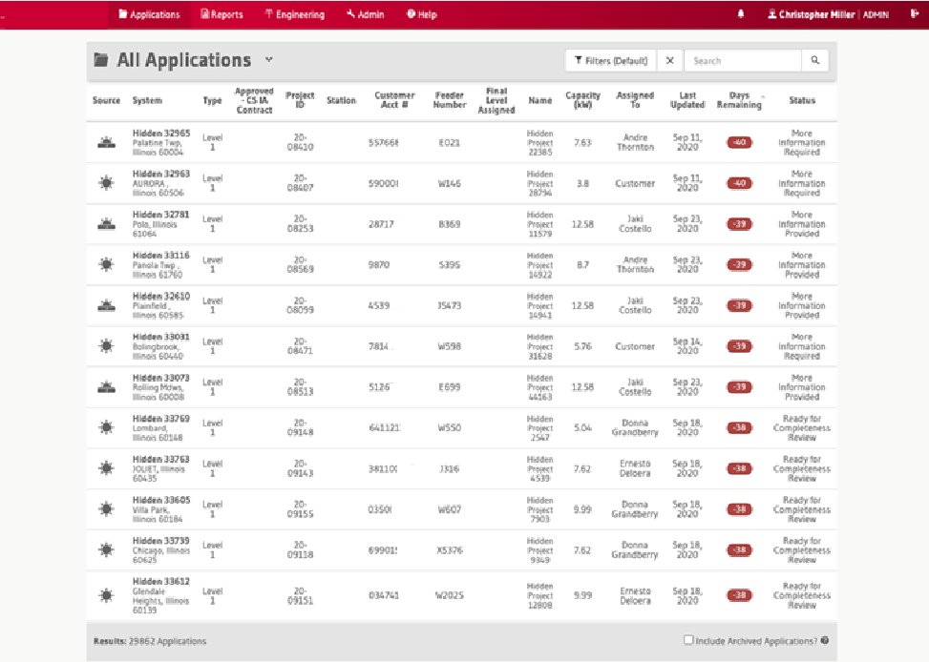
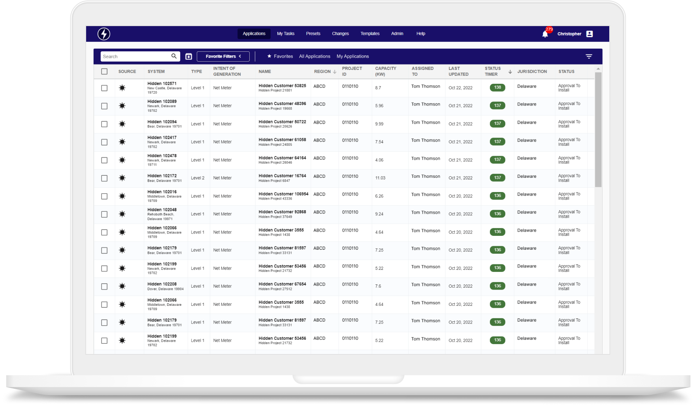
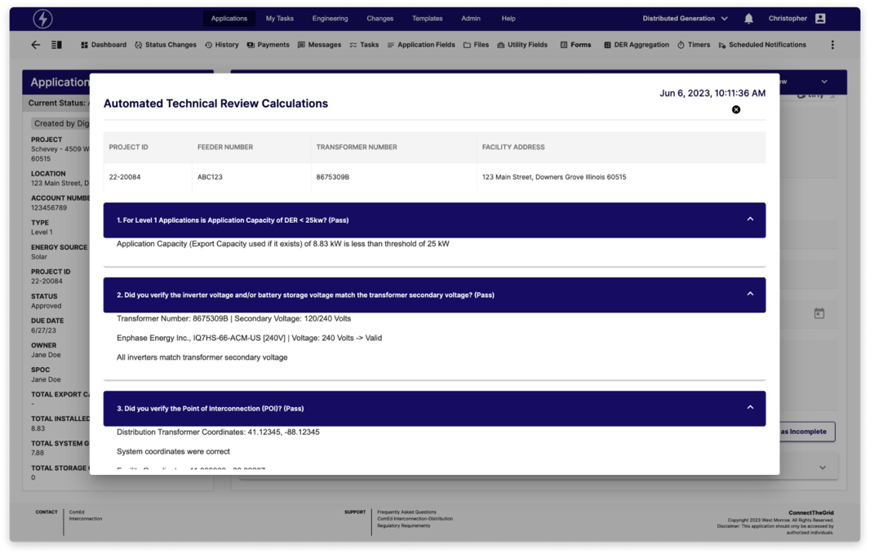
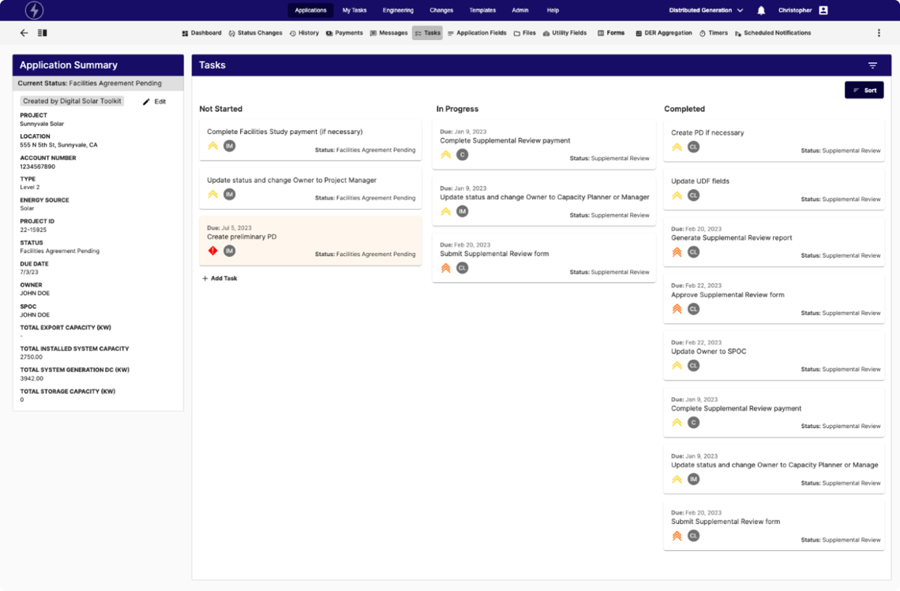
LARGE INVESTOR-OWNED UTILITY
Modernize solar workflows safely
CHALLENGE
A decade-old AngularJS application served six operating companies and slowed development.
675K+
Lines of code migrated
800+
WHAT WE DID
Select Angular for maintainability, theming and dynamic forms.
Inventory and rationalize pages; validate feature parity with business users.
Run old and new UIs side by side in a production pilot.
Files modified
Source: supplied West Monroe case study.
57
Notes:
Exelon Intellio UI Modernization
57
ORIGINAL SOURCE — COMPLETE VISIBLE COPY
© 2026 West Monroe Partners | Reproduction and/or distribution without West Monroe Partners’ prior consent is prohibited.
34
CLIENT STORIES
From this…
…to this
Client needed to modernize a decade-old solution that powers workflows for solar interconnection across their six operating companies. The application’s AngularJS front-end technology was nearing end-of-life and slowing down development team efficiency.
LARGE INVESTOR-OWNED UTILITY
How can we accelerate innovation and increase security maturity on our solar interconnection solution?
Modernization Strategy & Build
Assessed leading frameworks and recommended Angular based on key business priorities of maintainability, theming, and dynamic forms. Angular enhances maintainability with its opinionated defaults, facilitating quick project initiation and simplifying new developer onboarding. Additionally, Angular Material and Formly support dynamic theming and form generation, respectively, accelerating front-end development with robust components and JSON-based configurations.
Our team inventoried all existing pages, rationalized which pages should carry over to the new Angular UI, re-wrote them leveraging an Agile development process, and engaged business stakeholders to validate feature parity prior to final cutover.
Conducted pilot phase where the old and new UIs were running side by side in production to enable a seamless transition for the business.
675K+
Lines of code migrated
800+
Files
modified
Original source SHA256: c732e693a6370a0abdf3b54f34ff456304a4a25025303c508a48559f1bee73e6
WMDS foundation reference; synthetic labels. Source files and exact font identities are in layout-report.json. This Go layout profile requires PowerPoint qualification.

Slide 58
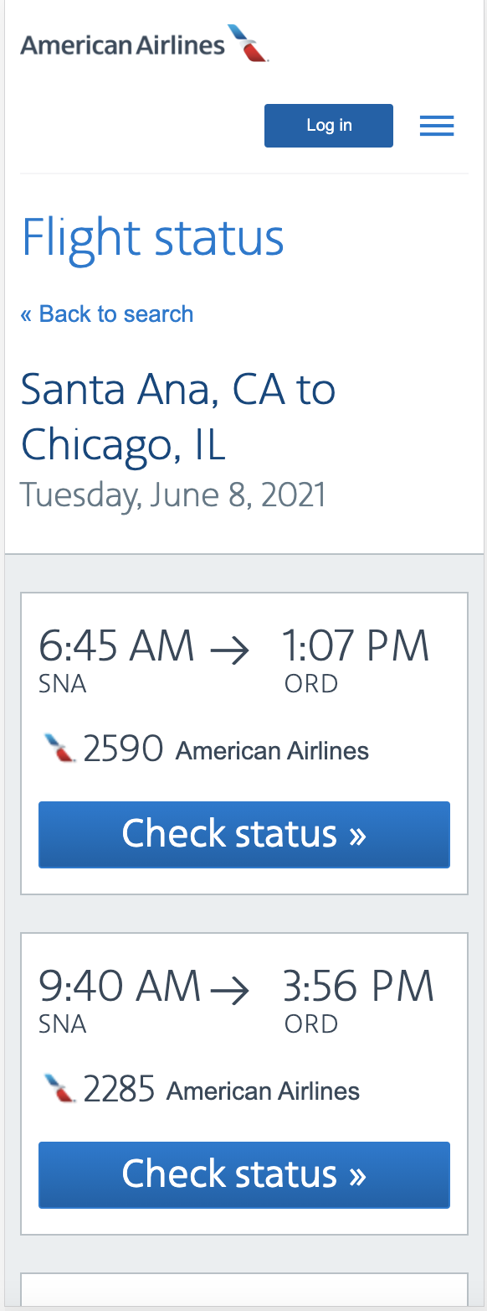
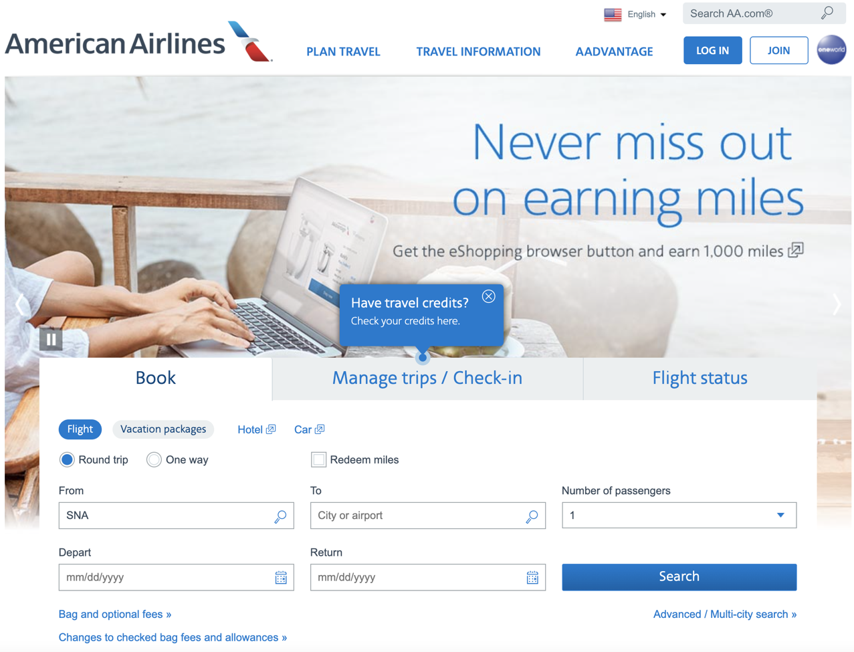
LARGE AIRLINE
Modernize reservation systems and deployment
CHALLENGE
METHOD
Instant
Legacy reservation management needed faster delivery and scalable operations.
Use IBM Garage practices to design, build and deploy an MVP.
Blue/green deployment capability; previously every 2 weeks
ARCHITECTURE
Refactor the monolith into microservices; use Cloud Foundry and GKE.
100%
DELIVERY
Implement Jenkins CI/CD with blue/green deployment.
Test automation goal
Source: supplied West Monroe case study.
58
Notes:
American Airlines
58
ORIGINAL SOURCE — COMPLETE VISIBLE COPY
© 2026 West Monroe Partners | Reproduction and/or distribution without West Monroe Partners’ prior consent is prohibited.
35
CLIENT STORIES
Our developers & Product Analysts got trained in IBM Garage methodologies to accelerate the transformation of American Airline’s application development. The Garage method excels at helping teams quickly design, build, and deploy an MVP to optimize the time to market. Operational excellence is key to the success of MVP. We emphasize on 100% test automation to get full code coverage.
LARGE AIRLINE
How can we modernize our legacy reservation management system?
Modernization Strategy & Build
Refactored large parts of the reservation systems from a monolith to microservices
Utilized Cloud Foundry (open source PAAS) to manage their application platform independently of their IBM infrastructure
Implemented Google Kubernetes Engine (GKE), a managed container service, to support horizontal scaling of their reservation system
Jenkins was used to set up end to end CI/CD pipeline shifting their delivery frequency from every 2 weeks to an instantaneous deployment capability using a blue/green approach.
Original source SHA256: c732e693a6370a0abdf3b54f34ff456304a4a25025303c508a48559f1bee73e6
WMDS foundation reference; synthetic labels. Source files and exact font identities are in layout-report.json. This Go layout profile requires PowerPoint qualification.

Slide 59
HEALTHCARE PROFESSIONAL ASSOCIATION
Create a roadmap beyond a 20-year-old COBOL core
54
CHALLENGE
The core application constrained innovation, customer experience and system reliability.
Business capabilities elaborated
WHAT WE DID
250
Define capabilities, reference architecture and a tactical roadmap.
Combine human-centered research with technology and change planning.
Establish governance and train teams in Agile, HCD and DevOps.
Business processes supported
“
We have been very happy with the services we get from WMP, most importantly the thought leadership we get from your on-site team.
45
Applications on roadmap
CHIEF INFORMATION OFFICER
Source: supplied West Monroe case study.
59
Notes:
CAP SCORES Strategy
59
ORIGINAL SOURCE — COMPLETE VISIBLE COPY
© 2026 West Monroe Partners | Reproduction and/or distribution without West Monroe Partners’ prior consent is prohibited.
36
CLIENT STORIES
We have been very happy with the services we get from WMP, most importantly the thought leadership we get from your on-site team.
— Chief Information Officer
54
Business Capabilities Elaborated
We discovered and documented business capabilities around which future services would be created, supporting 250 business processes
45
Related Apps to be Modernized
We defined the modernization roadmap and initial disposition approaches for 45 related applications
Client’s 20-year-old custom COBOL application is the “beating heart” of business operations, but the aging system and associated technologies have increasingly unpredictable negative impacts on customer/user experience and hamper ability to enhance digital experience. This solution prevented the client from developing new innovations due to complexity and technical debt. West Monroe was engaged to translate strategic objectives into an architecture and modernization roadmap to target cloud-based technologies and a microservices platform.
Healthcare Professional Association
How can we address aging tech, monolithic apps, and our waterfall methodology so we can
innovate faster?
Modernization Strategy & Build
Took a holistic approach to technology strategy and planning that incorporated program management, organizational change management, and human-centered design (HCD) alongside core technology disciplines
Developed architecture and guiding principles to address strategic goals, such as increased customer & member engagement as well as improved system performance and availability
Educated client team on HCD and developed customer research plan to gather feedback for more impactful requirements and prioritization of roadmap initiative
Partnered with Client to define governance structures that would allow them to train their team on Agile methodologies without compromising their ability to deliver
Delivered a tactical roadmap to begin a digital transformation and develop a microservice architecture platform
Educated client resources on concepts critical to program success such as Agile scrum, HCD, and DevOps
Delivered reference architecture to guide teams through the design and build of microservices, data platform, and sunsetting monolithic applications
Original source SHA256: c732e693a6370a0abdf3b54f34ff456304a4a25025303c508a48559f1bee73e6
WMDS foundation reference; synthetic labels. Source files and exact font identities are in layout-report.json. This Go layout profile requires PowerPoint qualification.

Slide 60
HEALTHCARE PROFESSIONAL ASSOCIATION
Resolve end-of-life risk and move a critical app to AWS
CHALLENGE
End-of-life technologies raised security concerns in a key customer-facing application.
“
I particularly appreciate all the thought leadership and discussion on various strategies helping us to move our agenda forward
WHAT WE DID
Assess architecture and investment; prioritize epics, stories and acceptance criteria.
Build in Agile increments while business users test in parallel.
Transfer knowledge and establish repeatable development patterns.
CHIEF INFORMATION OFFICER
“
The WMP team are dedicated, smart, and always top-notch professionals.
AWS
Unchanged
Project timeline and overall investment
Replatformed
VP, INTEGRATED SERVICES, LABORATORY QUALITY SOLUTIONS
Source: supplied West Monroe case study.
60
Notes:
CAP Result Form Modernization Strategy and Build
60
ORIGINAL SOURCE — COMPLETE VISIBLE COPY
© 2026 West Monroe Partners | Reproduction and/or distribution without West Monroe Partners’ prior consent is prohibited.
37
CLIENT STORIES
I particularly appreciate all the thought leadership and discussion on various strategies helping us to move our agenda forward
— Chief Information Officer
The WMP team are dedicated, smart, and always top-notch professionals.
— VP, Integrated Services, Laboratory Quality Solutions
End of life technologies put a spotlight on risks to a key customer-facing application, prompting a rebuild and replatform onto AWS. West Monroe was tasked with assessing the feasibility of their goal and investment required to do so. From there, West Monroe led the creation of the development backlog, developed the solution, led testing efforts, and supported the deployment.
Healthcare Professional Association
How can we resolve customer security concerns due to end-of-life technologies? How can we move to the cloud?
Modernization Strategy & Build
Reviewed current state application architecture and desired future state; created backlog of epics, user stories, and acceptance criteria; prioritized backlog to meet project object and timeline.
Followed an Agile development methodology to build the solution in logical increments with business teams performing end user testing in parallel.
Removed aging and end-of-life technology from a critical customer-facing application while making significant improvements to application security and workflow without changing the project timeline or overall investment required.
Performed knowledge transfer and transition activities to ensure a seamless deployment and operation of the new solution.
West Monroe guidance helped establish repeatable development patterns so that future projects can deliver consistent results in a faster timeframe.
Improved knowledge and understanding of the application functionality and its implementation through user stories and coding practices, which will make it easier to support and enhance the application in the coming years.
Original source SHA256: c732e693a6370a0abdf3b54f34ff456304a4a25025303c508a48559f1bee73e6
WMDS foundation reference; synthetic labels. Source files and exact font identities are in layout-report.json. This Go layout profile requires PowerPoint qualification.

Slide 61
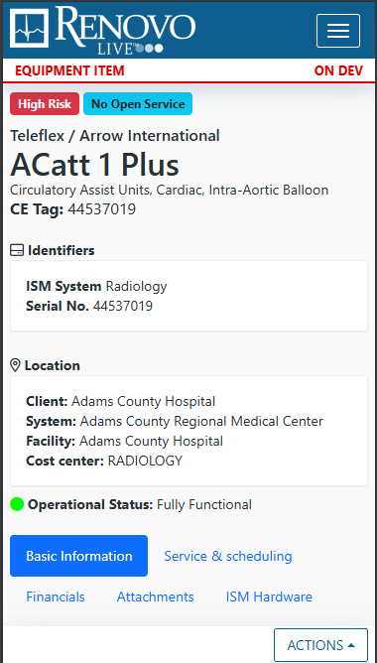
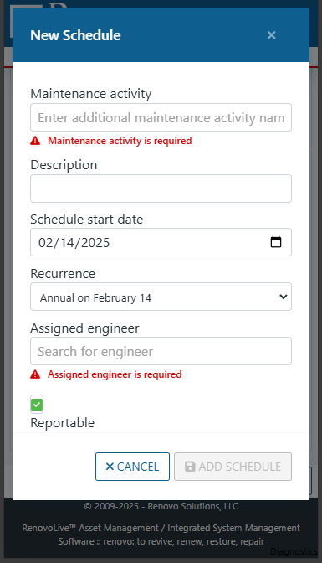
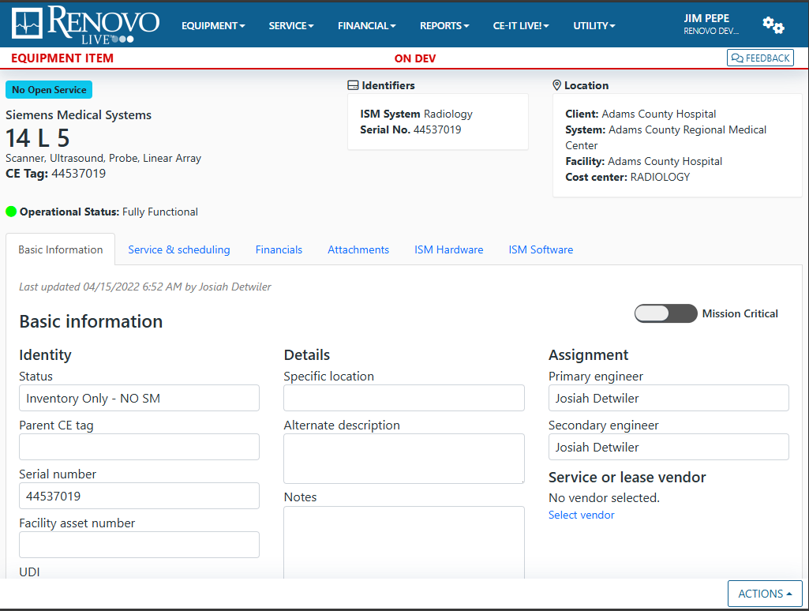
RENOVO SOLUTIONS
Modernize the platform without disrupting active users
RESULTS / SCOPE
CHALLENGE
Responsive
The application lacked mobile support; business logic in code and stored procedures created inconsistent data.
Mobile-ready user experience
WHAT WE DID
LTS
Centralize business rules and reusable code.
Create a responsive UI on supported technology.
Improve maintainability while supporting continuity for active users.
Supported technology foundation
Source: supplied West Monroe case study.
61
Notes:
Renovo Modernization
61
ORIGINAL SOURCE — COMPLETE VISIBLE COPY
© 2026 West Monroe Partners | Reproduction and/or distribution without West Monroe Partners’ prior consent is prohibited.
38
CLIENT STORIES
The application was running on outdated technologies which could not support a mobile environment and had data integrity issues due to logic being split between code and stored procedures.
Renovo Solutions
How can we modernize a platform running on legacy technologies without disrupting its active userbase?
Modernization Strategy & Build
Partnered with end users to streamline application flow and consolidate business logic, eliminating conflicting rule sets that caused data integrity issues
Implemented coarse-grained, reusable code to consolidate and deduplicate business rules
Converted multiple applications to mobile responsive designs
Updated multiple versions to bring software versions back up to long term support
Eliminated legacy code that was causing confusion and extended development times
Enabled reduced maintenance costs by centralizing logic and componentizing user interface elements
Original source SHA256: c732e693a6370a0abdf3b54f34ff456304a4a25025303c508a48559f1bee73e6
WMDS foundation reference; synthetic labels. Source files and exact font identities are in layout-report.json. This Go layout profile requires PowerPoint qualification.

Slide 62
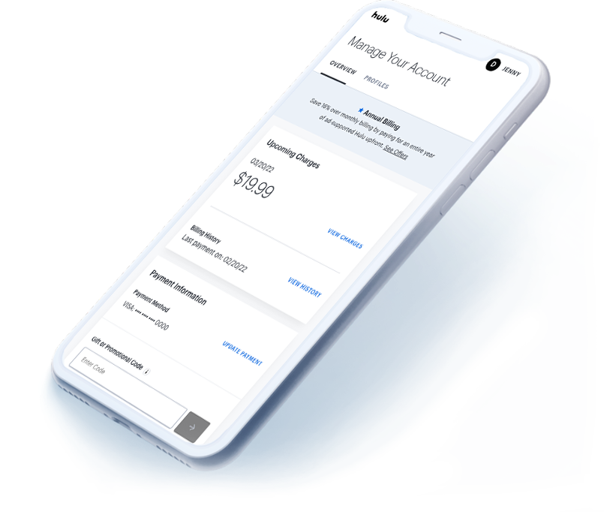
HULU · BILLING & SUBSCRIPTIONS
Create a shared domain model for billing
CHALLENGE
Teams needed consistent domain language and an architecture that could support future migration.
ALIGN
Align teams around a shared model and ubiquitous language.
BUILD
Centralize business logic behind APIs.
ENABLE
Improve test coverage, onboarding and communication.
Source: supplied West Monroe case study.
62
Notes:
Hulu Subscriptions
62
ORIGINAL SOURCE — COMPLETE VISIBLE COPY
© 2026 West Monroe Partners | Reproduction and/or distribution without West Monroe Partners’ prior consent is prohibited.
62
CLIENT STORIES
Hulu’s Billing & Subscriptions team wanted help simplifying the way the multitude of Hulu platforms manage and communicate information about user subscriptions
Hulu
Subscriptions –
Orchestrating multi-platform billing
Modernization Strategy & Build
Created a domain model to help developers and stakeholders create a shared understanding and ubiquitous language
Designed the future state architecture and migration plan to modernize the platform architecture over time
Update both the technology and the business logic for core APIs
Centralized the business logic for subscriptions services
Worked with Hulu teams to instill best practices to support the platform over time
Improved test coverage
Revamped onboarding materials to quickly ramp up new team members
Recommended improvements in communication throughout the billing & subscription group
Original source SHA256: c732e693a6370a0abdf3b54f34ff456304a4a25025303c508a48559f1bee73e6
WMDS foundation reference; synthetic labels. Source files and exact font identities are in layout-report.json. This Go layout profile requires PowerPoint qualification.

Slide 63
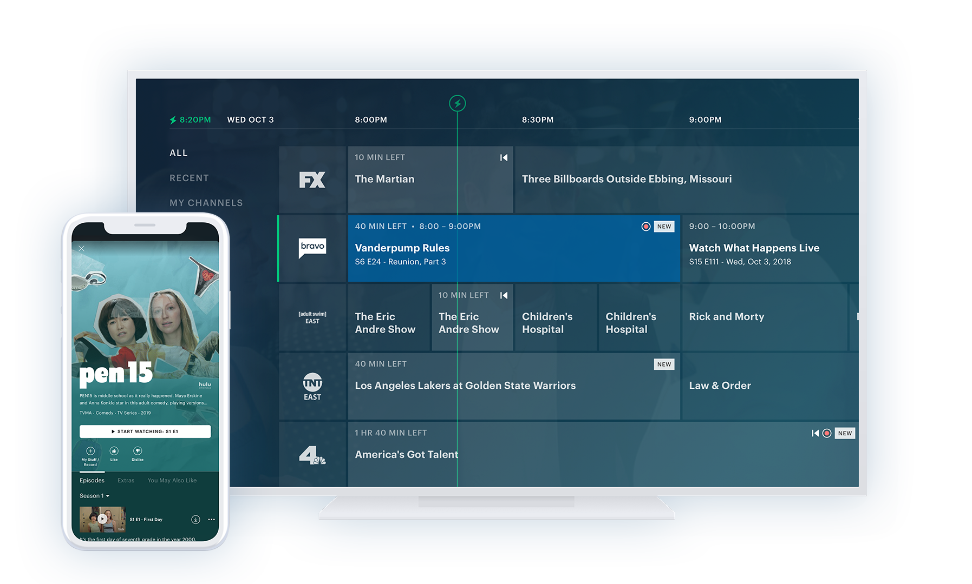
HULU · LIVE TV
Deliver Live TV on Apple platforms
CHALLENGE
Hulu needed to deliver Live TV on iOS and Apple TV with a modern application architecture.
Millions
Apple TV users reached
Swift
WHAT WE DID
Move Objective-C code to Swift.
Use reactive application state and automated CI feedback.
Combine co-located and remote delivery in Santa Monica and Seattle.
Modernized iOS / tvOS application
Source: supplied West Monroe case study.
63
Notes:
Hulu iOS
63
ORIGINAL SOURCE — COMPLETE VISIBLE COPY
© 2026 West Monroe Partners | Reproduction and/or distribution without West Monroe Partners’ prior consent is prohibited.
63
CLIENT STORIES
Hulu was approaching the launch of Hulu Live TV and sought out West Monroe to guide their development teams and ensure a timely launch for both their iOS app
and Apple TV app.
Hulu
Native iOS &
Apple TV Design & Build
Modernization Strategy & Build
Our team co-located with the Hulu team in Santa Monica while working with their remote iOS team in Seattle. The two worked together to re-write their iOS app while building out their Apple TV app to support the launch of Hulu Live TV.
As part of the re-write, both apps were updated to use Swift instead of Objective-C. A reactive framework was introduced to better manage internal app state.
A significant update was also made to the iOS and tvOS CI pipelines to provide a faster, automated feedback loop for integration tests.
The team successfully rolled out the app to millions of Apple TV users and was able to make quick and efficient updates.
Original source SHA256: c732e693a6370a0abdf3b54f34ff456304a4a25025303c508a48559f1bee73e6
WMDS foundation reference; synthetic labels. Source files and exact font identities are in layout-report.json. This Go layout profile requires PowerPoint qualification.

Slide 64
IDENTITY & ACCESS MANAGEMENT PROVIDER
Turn technical debt into a capacity opportunity
30K
CHALLENGE
A growing application estate required a practical, prioritized remediation strategy.
Annual developer hours identified
WHAT WE DID
$5–15M
Analyze 1.2 million lines of code and interview stakeholders for 25+ hours.
Identify 25 initiatives and build a two-year roadmap.
Prioritize developer capacity and revenue opportunities.
Potential ARR over three years
“
I'm very excited about the tech debt [remediation] project coming forward because I do believe there is much value that will be delivered.
DIRECTOR, TECHNICAL OPERATIONS
Source: supplied West Monroe case study.
64
Notes:
Exostar Tech Debt Remediation
64
ORIGINAL SOURCE — COMPLETE VISIBLE COPY
© 2026 West Monroe Partners | Reproduction and/or distribution without West Monroe Partners’ prior consent is prohibited.
64
CLIENT STORIES
I'm very excited about the tech debt [remediation] project coming forward because I do believe there is much value that will be delivered.
— Director, Technical Operations
30K
Annual Developer Hours
Identified 30K annual developer hours in additional capacity to be gained through implementation of tech debt remediation plans
$5-15M
Top-line ARR Growth Potential
Identified potential for additional $5-$15M in top-line ARR growth over next 3 years through increased investments in product innovation via increased developer capacity
A leading provider of security and identity and access management (IAM) software was faced with challenges growing the business through product innovation due to challenges with technology debt. West Monroe analyzed the product architecture and source code via automated scans and conducted stakeholder interviews to identify opportunities to increase developer efficiency, reduce code complexity, and increase capacity for innovation. This approach identified critical pain points and actionable remediation activities with quantified value
Identity & Access Management Provider
What development opportunities can we capitalize upon to drive efficiency and top-line growth?
Modernization Strategy & Build
Conducted a full-day workshop to gain a comprehensive understanding of the business's current state and align project scope
Held over 25 hours of stakeholder interviews to review the code base in detail and identify key areas for improvement
Analyzed more than 1.2 million lines of code using advanced scans and technology to create detailed dependency maps
Identified 25 initiatives for addressing technical debt and developed a framework to evaluate the business impact of each initiative
Created a comprehensive 2-year roadmap for all initiatives, including detailed action plans and analysis of costs, duration, and resource requirements.
Original source SHA256: c732e693a6370a0abdf3b54f34ff456304a4a25025303c508a48559f1bee73e6
WMDS foundation reference; synthetic labels. Source files and exact font identities are in layout-report.json. This Go layout profile requires PowerPoint qualification.

Slide 65
CONSTRUCTION SOFTWARE PROVIDER
De-risk the PRO App relaunch with a product-first plan
~$5M
CHALLENGE
The client wanted to modernize the PRO App, reach a new user group and align the roadmap to near-term objectives.
Initial investment de-risked
WHAT WE DID
Potential
Use direct end-user input to prioritize epics.
Improve usability, maintenance cost and productivity.
Identify reusable modular AI assets and future productivity opportunities.
Productivity benefits require implementation
“
The team was able to come up to speed quickly, identify areas of improvement for the solution along with creating thorough documentation to support the application going forward. The team was also able to understand the business quickly and work with end users to identify future needs.
CHIEF INFORMATION OFFICER
Source: supplied West Monroe case study.
65
Notes:
SAFe Built
65
ORIGINAL SOURCE — COMPLETE VISIBLE COPY
© 2026 West Monroe Partners | Reproduction and/or distribution without West Monroe Partners’ prior consent is prohibited.
65
CLIENT STORIES
The team was able to come up to speed quickly, identify areas of improvement for the solution along with creating thorough documentation to support the application going forward. The team was also able to understand the business quickly and work with end users to identify future needs.
— Chief Information Officer
$5M
Investment
De-risked
The project de-risked an initial $5M investment
Client was seeking help to modernize their PRO App and relaunch it with a new user group. They also wanted help to evaluate their existing product strategy & roadmap against near-term business objectives.
Construction Company Software Provider
How can we modernize our app and relaunch it in the market with a new user group?
Modernization Strategy & Build
Our modernization effort prioritized features that reduced maintenance cost, increased usability, and improved end-user productivity. The team took a Product-first mindset and relied on direct input from end users to prioritize epics.
We rationalized the PRO App to identify modular AI assets that can be re-used and deployed in various parts of the user Journey to improve the overall experience.
This project de-risked an initial ~$5 million investment and helped identify opportunities that, when implemented, could yield a significant improvement in productivity
Original source SHA256: c732e693a6370a0abdf3b54f34ff456304a4a25025303c508a48559f1bee73e6
WMDS foundation reference; synthetic labels. Source files and exact font identities are in layout-report.json. This Go layout profile requires PowerPoint qualification.

Slide 66
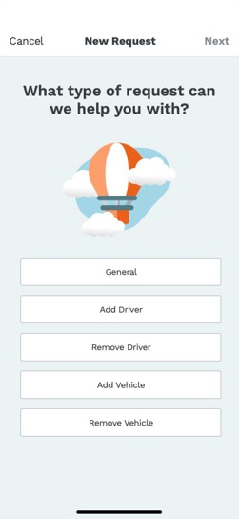
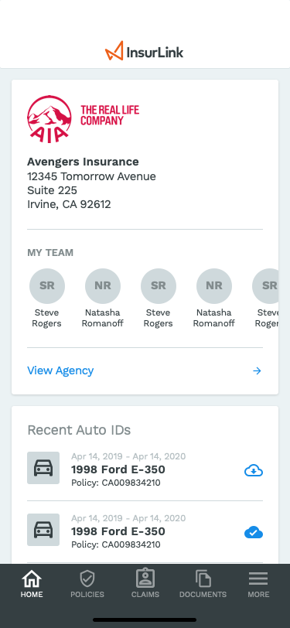
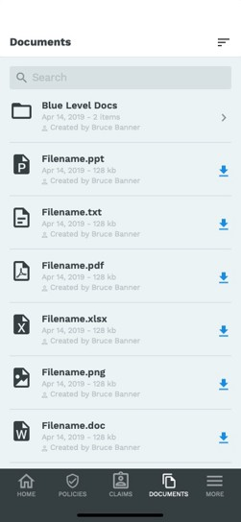
INSURANCE MANAGEMENT SOFTWARE
Reduce agent effort and improve renewal performance
RESULTS / SCOPE
CHALLENGE
68%
Agents needed to offload data entry and give customers a clearer service experience.
Agent time savings
WHAT WE DID
+5%
Research personas and map customer journeys.
Prototype improved workflows across web and native apps.
Shift data entry to customers to free agent time.
Renewals
Source: supplied West Monroe case study.
66
Notes:
Vertafore
66
ORIGINAL SOURCE — COMPLETE VISIBLE COPY
© 2026 West Monroe Partners | Reproduction and/or distribution without West Monroe Partners’ prior consent is prohibited.
66
CLIENT STORIES
68%
Time Savings for Agents
+5%
Increased Renewals
Client's end user insurance agents were becoming data entry specialists, uploading documents and data required to provision insurance policies. This was slowing down the time to close or renew policies. Further, the existing product suite failed to engage users, lacking a modern mobile experience that allowed users to easily find content.
Insurance Management Software Provider
How can we modernize our codebase and experience to engage our users in a different way? How can insurance agents close/renew policies more quickly?
Modernization Strategy & Build
Conducted persona identification, product discovery, user journey mapping, and prototyping to evaluate and test approaches for simplifying agent interaction, ultimately finding that offloading data entry to customers was preferred and saved agent time
Modernized client's software by prioritizing key features, streamlining workflows, and integrating advanced technologies, resulting in enhanced performance, user experience, and significant improvements in operational capabilities and customer satisfaction
Assembled a multi-disciplinary team to build both web and native mobile applications, supporting modern agent/customer interaction and driving efficiency and innovation.
Original source SHA256: c732e693a6370a0abdf3b54f34ff456304a4a25025303c508a48559f1bee73e6
WMDS foundation reference; synthetic labels. Source files and exact font identities are in layout-report.json. This Go layout profile requires PowerPoint qualification.

Slide 67
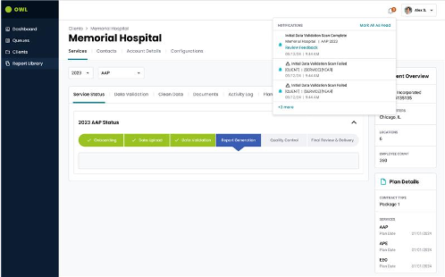
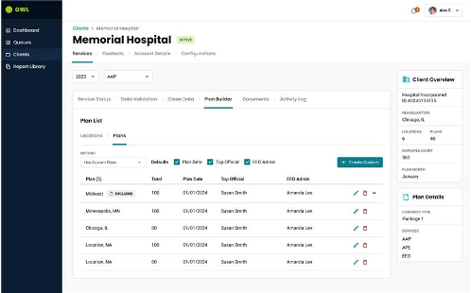
HR COMPLIANCE SOFTWARE
Improve reporting today and prepare for future AI
RESULTS / SCOPE
CHALLENGE
65%
The reporting experience needed faster performance and a platform for future product capability.
Report time reduction
WHAT WE DID
Use 35+ interviews to guide experience and platform design.
Mobilize an 18-person team on Azure and AI foundations.
Plan future GenAI and predictive capabilities; these are not realized outcomes.
+$30K
Average client savings from time saved
Source: supplied West Monroe case study.
67
Notes:
Outsolve
67
ORIGINAL SOURCE — COMPLETE VISIBLE COPY
© 2026 West Monroe Partners | Reproduction and/or distribution without West Monroe Partners’ prior consent is prohibited.
67
CLIENT STORIES
65%
Time Savings for Consultants
Reduction in total report generation duration, saving consultants time
+$30K
Avg. Savings per Customer
Based on the time savings gained through the changes our team implemented
Client is a leading provider of affirmative action and compliance solutions which are backed by the advanced capabilities of a proprietary plan management platform. The legacy on-premise platform requires a technical redesign and modernization to address lengthy report processing time, limited integration with third-party systems (e.g., CRM, HRIS, etc.), duplicative functionality and complex user workflows, and security vulnerabilities arising from local desktop database calls.
HR COMPLIANCE Software Provider
How can we prepare for future acquisitive growth and expansion of our enterprise customer base?
Modernization Strategy & Build
Conducted 35+ interviews with internal users to document existing functionality & pain points
Assembled an 18-member agile product development team to design and implement the next generation plan management system to accelerate client’s time-to-market
Developed a roadmap to reduce existing technical debt by rewriting legacy systems using modern, cloud-based technologies (i.e., Microsoft Azure, OpenAI, etc.), including architecture to support future GenAI and Predictive Analytics use case implementation (i.e., predicting billing, cross-sell/upsell, RevOps)
Designed and built a new platform that will simplify the plan management process, leverage AI/ML to automate highly manual tasks, and provide the foundation for future growth, using modern cloud infrastructure to automate current processes, enable high availability, and drive faster report processing
Optimized platform costs by leveraging cloud-native technologies (e.g., data storage, analytics, etc.) that only incur costs when in use without impacting application scalability
Original source SHA256: c732e693a6370a0abdf3b54f34ff456304a4a25025303c508a48559f1bee73e6
WMDS foundation reference; synthetic labels. Source files and exact font identities are in layout-report.json. This Go layout profile requires PowerPoint qualification.

Slide 68
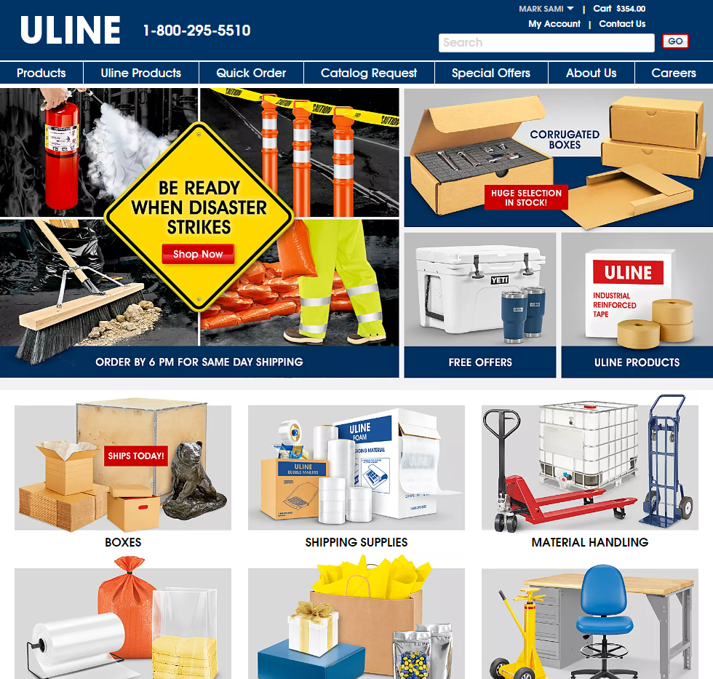
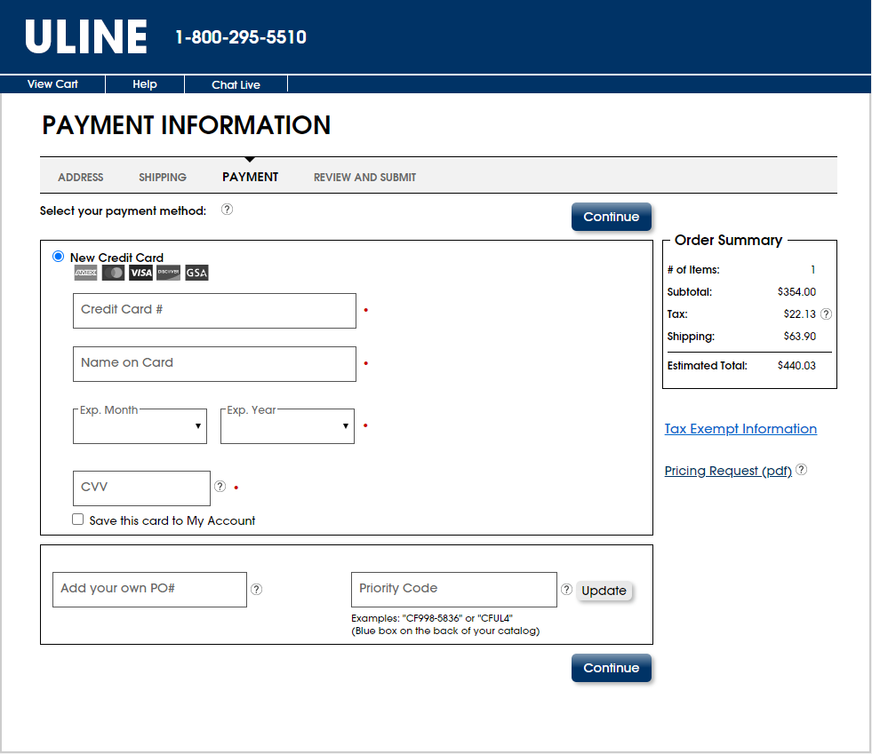
PACKAGING & SHIPPING COMPANY
Scale engineering and services as the business grows
CHALLENGE
Pandemic-era revenue doubled, increasing demand on software delivery and platform capacity.
ALIGN
Build scalable engineering and Agile practices.
BUILD
Develop Java / Spring microservices.
ENABLE
Use DataStax and application-agnostic services for reuse.
Source: supplied West Monroe case study.
68
Notes:
Uline
68
ORIGINAL SOURCE — COMPLETE VISIBLE COPY
© 2026 West Monroe Partners | Reproduction and/or distribution without West Monroe Partners’ prior consent is prohibited.
68
CLIENT STORIES
Client doubled in revenue during the pandemic and its systems were struggling to support the rapid growth. They needed a reliable partner that could scale their engineering team to meet deadlines.
Large Packaging/Shipping Materials Provider
How can we build a modern platform to replace our legacy apps?
Modernization Strategy & Build
We worked to identify portions of the client’s modernization roadmap to help accelerate adoption of a modern services architecture to enable more flexible user interfaces across multiple mediums
We helped architect a custom Java Spring microservices tier and integrate into new and legacy applications with a modern DataStax environment
West Monroe was able to embed teams alongside Uline’s teams and hit the ground running
The collective team was able to revamp development processes that ran in a more agile fashion and work across the full spectrum of Uline applications to modernize the underlying data and services to be application agnostic.
Original source SHA256: c732e693a6370a0abdf3b54f34ff456304a4a25025303c508a48559f1bee73e6
WMDS foundation reference; synthetic labels. Source files and exact font identities are in layout-report.json. This Go layout profile requires PowerPoint qualification.

Slide 69
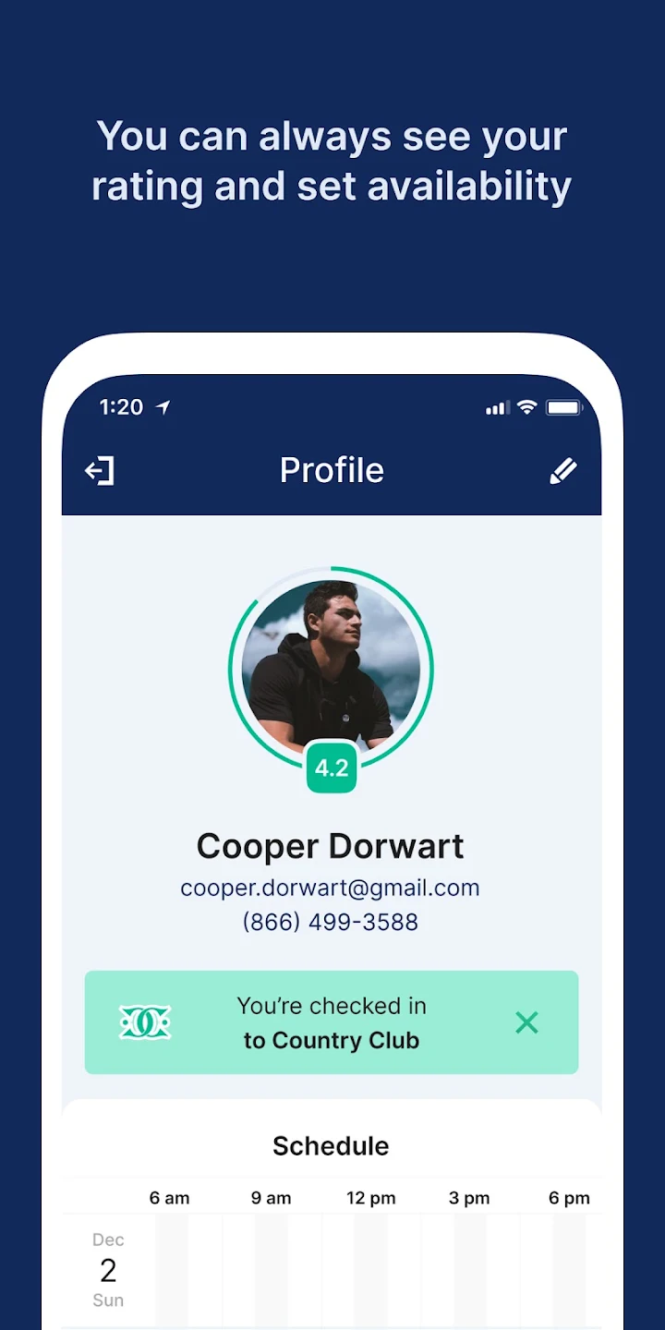
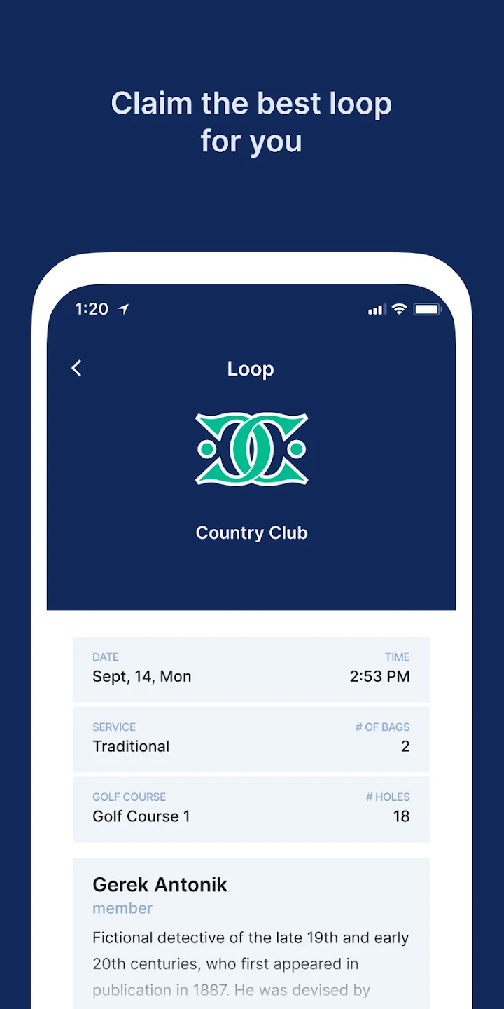
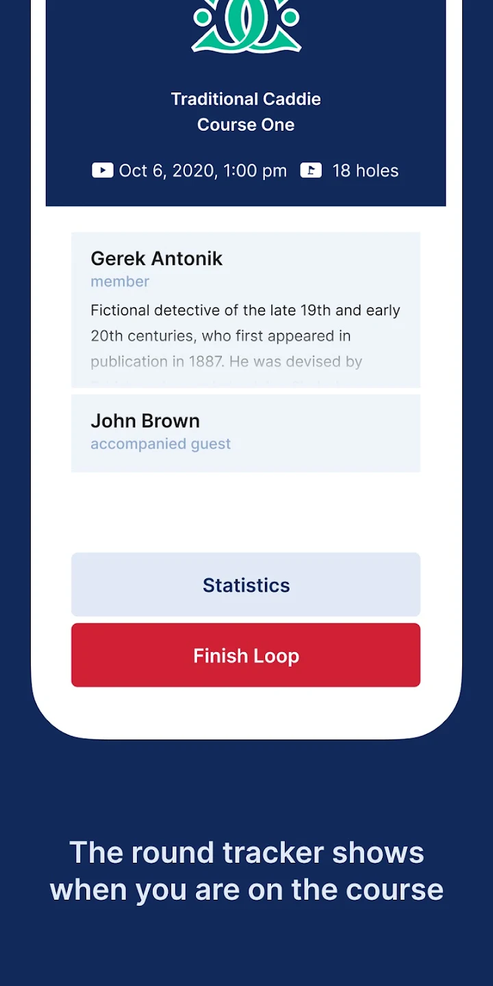
GOLF OWNER & OPERATOR
Restore booking speed and support
CHALLENGE
The caddie booking system had performance issues and relied on unsupported technology.
10×
Performance improved
~25
WHAT WE DID
Prioritize about 25 improvement opportunities; implement fixes over 10 sprints.
Add reusable tests, CI/CD gates and long-term-supported technology.
Provide ongoing nearshore support.
Opportunities prioritized
Source: supplied West Monroe case study.
69
Notes:
Troon Golf ClubUp Modernization
69
ORIGINAL SOURCE — COMPLETE VISIBLE COPY
CLIENT STORIES
10X
Performance Gains
Once complete with our team’s changes, the application yielded 10x performance gains.
The application was no longer able to scale, and the underlying technology was reaching versions no longer supported making it difficult to grow and maintain.
Golf Club Owner/Operator
How can we fix critical performance and security issues in our critical caddie booking system?
Modernization Strategy & Build
Performed a deep technical analysis of code, databases, and infrastructure
Established reusable tests and metrics to identify performance bottlenecks and gauge effectiveness of improvements
Recommended remediations with estimates, then worked with Client to prioritize ~25 technical opportunities based on effort vs. value
Implemented fixes iteratively over 10 sprints and now providing long-term application support
Updated multiple versions to bring software versions back up to long term support
Added CI/CD with gate keeping to ensure standards and best practices were met going forward
Enabled nearshore team to support and maintain the application at much reduced rates over the long term
© 2026 West Monroe Partners | Reproduction and/or distribution without West Monroe Partners’ prior consent is prohibited.
69
Original source SHA256: c732e693a6370a0abdf3b54f34ff456304a4a25025303c508a48559f1bee73e6
WMDS foundation reference; synthetic labels. Source files and exact font identities are in layout-report.json. This Go layout profile requires PowerPoint qualification.

Slide 70
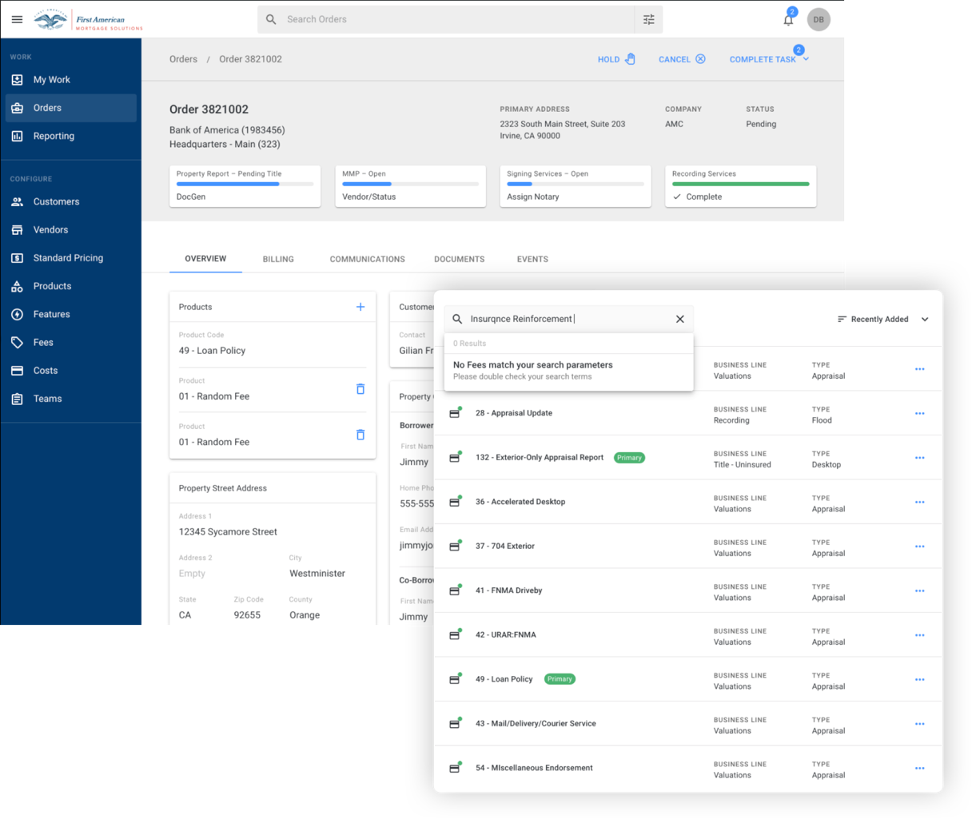
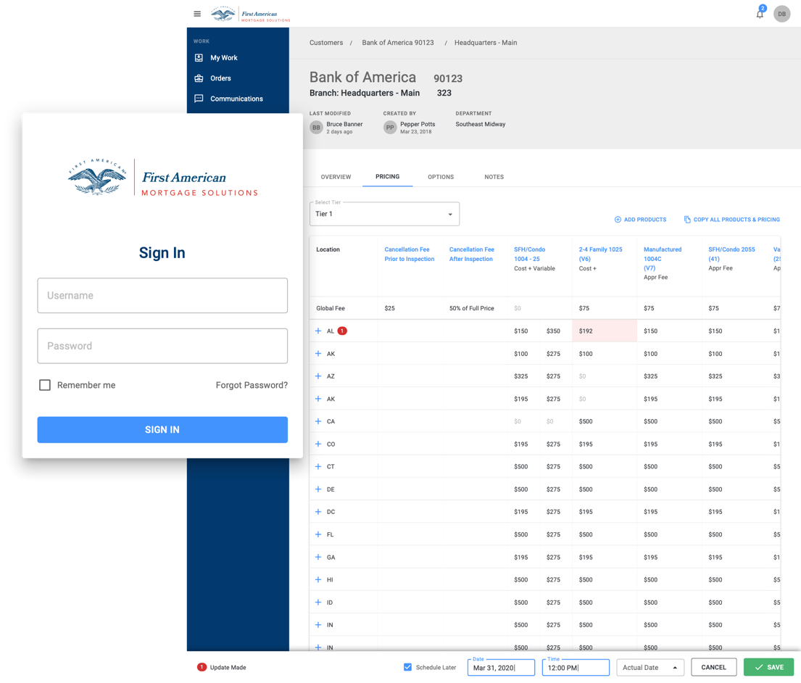
LARGE P&C INSURANCE PROVIDER
Unify five applications into one workflow platform
RESULTS / SCOPE
CHALLENGE
5 → 1
Fragmented legacy applications created switching, training and support overhead.
Apps consolidated
WHAT WE DID
Consolidate workflows on a cloud platform.
Reduce multitasking and simplify training.
Improve order, support and pricing processes.
Unified
Workflow and cloud platform
Source: supplied West Monroe case study.
70
Notes:
First American
70
ORIGINAL SOURCE — COMPLETE VISIBLE COPY
© 2026 West Monroe Partners | Reproduction and/or distribution without West Monroe Partners’ prior consent is prohibited.
70
CLIENT STORIES
5
Legacy Apps Merged to 1
Our solution allowed the client to retire five legacy applications, with all workflows being supported through the new platform.
Client’s application footprint included several legacy, Windows-only, native enterprise applications. These applications required users to multi-task between applications to get their work done. Client brought in West Monroe to re-platform them to a cloud-first tech stack and integrate workflows across applications.
Large Property & Casualty Insurance Provider
How can we modernize our tech stack and not require our users to multi-task between apps?
Modernization Strategy & Build
Reimagined the customer experience by harnessing technology, data, creativity, and innovation to develop a unified product that meets the client's needs and focuses on enhancing user workflows
Converted the existing solution to a cloud-based platform and conducted a deep-dive analysis to document and modernize complex workflows, ensuring a seamless transition to modern technology
Integrated 5 applications into a single cohesive solution by utilizing best practice UX patterns and modern UI, minimizing the need for extensive training on the new application
Simplified processes for customers by improving access to support and pricing specials, and streamlining the process for completing product orders, thereby transforming the overall business operations
Original source SHA256: c732e693a6370a0abdf3b54f34ff456304a4a25025303c508a48559f1bee73e6
WMDS foundation reference; synthetic labels. Source files and exact font identities are in layout-report.json. This Go layout profile requires PowerPoint qualification.

Slide 71
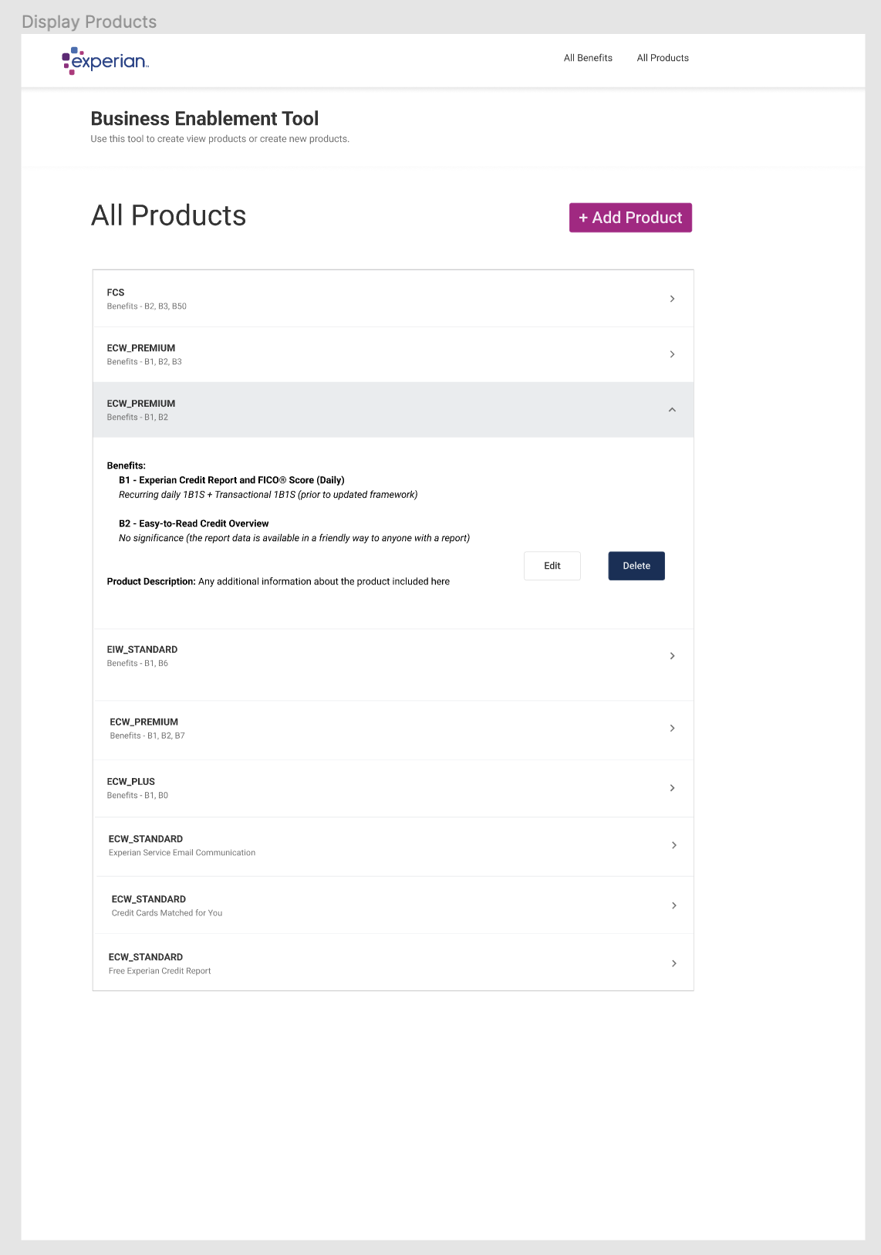
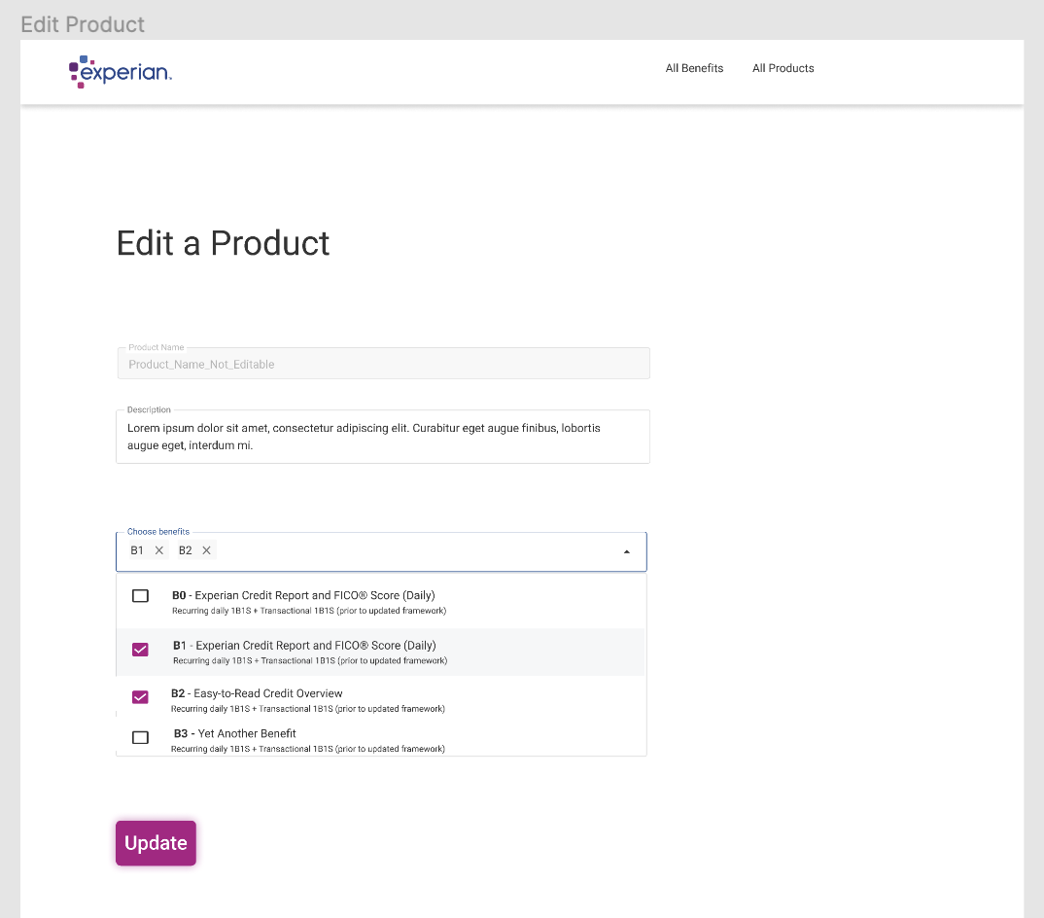
CREDIT REPORTING COMPANY
Publish offers in under 24 hours
CHALLENGE
Offer changes took six to eight weeks, slowing personalization and experimentation.
6–8
Weeks to publish, previously
<24
WHAT WE DID
Enable demographic personalization.
Embed a Product Owner and A/B testing.
Accelerate offer publication through a modern workflow.
Hours to publish, now
Source: supplied West Monroe case study.
71
Notes:
Outsolve
71
ORIGINAL SOURCE — COMPLETE VISIBLE COPY
© 2026 West Monroe Partners | Reproduction and/or distribution without West Monroe Partners’ prior consent is prohibited.
71
CLIENT STORIES
24hr
Post-Project Offer Publication Time
Reduced the time for publishing and updating offers from 6-8 weeks to under 24 hours, enabling rapid A/B testing and iteration
The client sought to replace their legacy offer management system with a dynamic solution tailored to user demographics. West Monroe embedded a Product Owner to collaborate with the client’s team, designing and building a system that personalizes offers based on user data, significantly improving the offer experience.
Large Credit Reporting Agency
How can we modernize our offer publication and update experience?
Modernization Strategy & Build
West Monroe assisted the client in replacing their outdated legacy offer management system with a modern, dynamic solution.
A Product Owner from West Monroe was embedded within the client's team to facilitate seamless collaboration and integration.
Together, they designed and developed a sophisticated system that personalizes offers by leveraging detailed user demographic data.
This tailored approach significantly enhanced the offer experience, boosting both accuracy and sales effectiveness for the client.
Original source SHA256: c732e693a6370a0abdf3b54f34ff456304a4a25025303c508a48559f1bee73e6
WMDS foundation reference; synthetic labels. Source files and exact font identities are in layout-report.json. This Go layout profile requires PowerPoint qualification.

Slide 72
COMMUNITY BANK
Identify IT savings and retire redundant applications
RESULTS / SCOPE
$2.77M
CHALLENGE
The bank needed clearer technology priorities and an architecture-led rationalization plan.
15% IT reductions identified
PLAN
6
Benchmark IT spend and define guiding architecture principles.
Apps retired
BUILD
Create a roadmap, governance and stronger data / analytics access.
$350K
TRANSITION
Realized annual savings from retirements
Support the technology steering committee throughout the project.
Source: supplied West Monroe case study.
72
Notes:
NASB Application Rationalization
72
ORIGINAL SOURCE — COMPLETE VISIBLE COPY
© 2026 West Monroe Partners | Reproduction and/or distribution without West Monroe Partners’ prior consent is prohibited.
72
CLIENT STORIES
15%
Identified IT Cost Reductions
Identified redundant apps, unlocking $2.77M in savings (15% of tech spend), enabling Client to simplify its tech landscape
6
Mid-tier Apps Retired
Recommended RPA tools and self-service reporting to streamline workflows, resulting in retirement of 6 apps and $350K in yearly savings
Client, a Community Bank in Kansas, faced shifts in their business model due to changes in the Financial Services Industry and interest rates. They engaged West Monroe to assess their technology landscape, identifying risks, scalability issues, and improvement opportunities. West Monroe also rationalized applications in Accounting and Compliance and developed a future state architecture and roadmap as part of the Innovation Strategy & Roadmap initiative.
Community bank
How can we better position our technology for sustainability and efficiency?
Modernization Strategy & Build
Established a maturity framework to assess the client's current state across digital capabilities including governance, strategy, SDLC, data engineering, security, and infrastructure
Conducted a comprehensive review of the Bank's technology landscape, including in-depth interviews with key stakeholders to understand application relevance to business operations
Performed an IT spend and resource benchmark and identified recommendations to address risks, scalability issues, and gaps in the technology portfolio, processes, and organization
Developed a roadmap with key dependencies, milestones, and high-level cost estimates, along with future state solution architecture for Accounting and Compliance processes
Recommended initiatives that Increase focus on data & analytics capabilities to enable business users to efficiently access data to enable data-driven decision making, enhance IT governance and organization structure through implementing formal processes, and create and deploy technology solutions based on consistent guiding principles and architecture patterns
Provided advisory support for the Tech Steering Committee throughout the project duration
Original source SHA256: c732e693a6370a0abdf3b54f34ff456304a4a25025303c508a48559f1bee73e6
WMDS foundation reference; synthetic labels. Source files and exact font identities are in layout-report.json. This Go layout profile requires PowerPoint qualification.

Slide 73
WORKPLACE SAFETY & COMPLIANCE PROVIDER
Modernize occupational health as a separate domain
CHALLENGE
“
A dated monolith made releases risky and domain upgrades difficult.
The WM team has provided great value in the organization and knowledge they bring to the table.
WHAT WE DID
Completed: occupational health .NET Core microservice + Azure SQL.
Ongoing: React replaces internal and client ASP.NET pages.
Planned: Azure Data Factory migration + downstream updates.
SR. DIRECTOR, PRODUCT MANAGEMENT
“
The West Monroe resources that have been assigned to this engagement have been outstanding.
50+
Features identified
DIRECTOR, SOFTWARE ENGINEERING
Source: supplied West Monroe case study.
73
Notes:
DISA
73
ORIGINAL SOURCE — COMPLETE VISIBLE COPY
© 2026 West Monroe Partners | Reproduction and/or distribution without West Monroe Partners’ prior consent is prohibited.
73
CLIENT STORIES
The West Monroe resources that have been assigned to this engagement have been outstanding.
— Director, Software Engineering
50+
Features Identified for Modernization
The features span ordering/fulfillment processes and enabling functions like client settings across multiple applications and tech stacks
The WM team has provided great value in the organization and knowledge they bring to the table.
— Sr. Director, Product Management
Client specializes in drug testing, employee background and occupational health screening, transportation compliance, and substance abuse training. Their dated monolithic architecture results in large, risky releases and presents challenges in upgrading specific domains.
Workplace Safety & Compliance Provider
How can we expand our occupational health offering while modernizing our architecture?
Modernization Strategy & Build
Performed an initial architecture deep dive phase to identify pain points and formulate an approach ahead of the build phase
Streamlined the implementation approach by instituting a more Agile design and development process than that of other vendors, significantly lowering the time to produce working, high-quality code
Split the occupational health domain apart from the on-prem monolithic back-end by creating a new .NET Core microservice and SQL database hosted in Azure
Currently revamping their current internal-facing and client-facing experiences, replacing ASP.NET web pages with React in the process
Will leverage Azure Data Factory to perform a one-time data migration to retire occupational health data in the legacy on-prem SQL Server database and have the Azure SQL database become the source of truth, updating downstream systems to pull from the new microservice
Original source SHA256: c732e693a6370a0abdf3b54f34ff456304a4a25025303c508a48559f1bee73e6
WMDS foundation reference; synthetic labels. Source files and exact font identities are in layout-report.json. This Go layout profile requires PowerPoint qualification.

Slide 74
ACCOUNT NOMINATION
Bring one consequential application or process
QUALIFY THE CATALYST
NOMINATION PROMPT
QUALIFY THE CHOICE
Decision window
One app, one process
Real alternatives
A catalyst creates a real decision window within 12–24 months.
Where does it constrain growth, operations, risk, cost, experience or AI readiness?
More than one modernization path is genuinely open.
Thesis and scope
Source-backed uncertainty baseline
QUALIFY THE UNKNOWN
Connected app and process view
QUALIFY THE ACCESS
Opaque logic
Experts and evidence
Disposition and target comparison
Rules, dependencies, integrations, exceptions or workarounds are poorly understood.
First-wave and business-case outline
Business and technology owners provide source, artifacts, operators and experts.
Proposed sprint returns require delivery and commercial validation. Bring one account, application and process to the modernization and Evolve team for qualification.
74
Notes:
The sprint establishes a baseline so AI-enabled gains can be measured rather than promised.
Some nominations will lead to retirement, packaged replacement, or a non-Evolve approach.
That is a successful decision if it is well supported.
Duration, price, owners, routing, and entry criteria still require confirmation before release.
ORIGINAL SOURCE — COMPLETE VISIBLE COPY
One consequential application or process
NOMINATION PROMPT
Where does one consequential application or process constrain growth, operations, risk, cost, customer experience, or AI readiness?
Bring a real decision window and enough access to test the question.
QUALIFICATION CONDITIONS
1
A catalyst creates a decision window within 12 to 24 months.
2
Important rules, dependencies, integrations, exceptions, or workarounds are poorly understood.
3
More than one modernization path is genuinely open.
4
Business and technology owners can provide source, artifact, operator, and expert access.
MODERNIZATION OPTIONS SPRINT RETURNS
Subject to delivery and commercial validation
1
Agreed modernization thesis and scope
2
Source-backed current-state and uncertainty baseline
3
Connected view of the application and business process
4
Disposition and target-direction comparison
5
First-wave, cutover, measurement, and business-case outline
Bring one account, one application, and one business process to the modernization and Evolve team for qualification.
© 2026 West Monroe Partners | Reproduction and/or distribution without West Monroe Partners’ prior consent is prohibited.
51
Original source SHA256: c732e693a6370a0abdf3b54f34ff456304a4a25025303c508a48559f1bee73e6
WMDS foundation reference; synthetic labels. Source files and exact font identities are in layout-report.json. This Go layout profile requires PowerPoint qualification.

Slide 75
INTERNAL CONTENT PLACEHOLDER
Case studies —
content to be developed
Prepare this section before using it in a client presentation.
75
Notes:
ORIGINAL SOURCE — COMPLETE VISIBLE COPY
© 2026 West Monroe Partners | Reproduction and/or distribution without West Monroe Partners’ prior consent is prohibited.
75
Original source SHA256: c732e693a6370a0abdf3b54f34ff456304a4a25025303c508a48559f1bee73e6
WMDS bound template. Content classification: supplied_content. Frozen source and binding provenance are recorded in layout-report.json and binding-report.json.

Slide 76
INTERNAL PLACEHOLDER SECTION
Off-the-shelf modernization offerings
01
Offer catalog — TBD
02
Buyer & catalyst fit
03
Scope & deliverables
04
Next phase
Explain the lifecycle handoff and supporting proof after approval.
Add approved offer names and owners; the catalog is unfinished.
Confirm entry criteria and the common buyer need each offer answers.
Define approved scope, timing, outcome and commercial model.
76
Notes:
Source deck: Software Modernization Walking Deck_04132026.pptx.
Insert source slides 9 through 11, 13 through 14, and 15 through 31 unchanged after this divider.
Omit source slide 12 because it is the old contact call to action.
Preserve source order, formatting, metrics, client descriptors, caveats, and notes.
The source is internal and verify-before-external-reuse.
Some outcomes may be modeled or identified rather than realized, and notes may contain names not visible on slides.
Transition: After a selected proof example, bring the audience back to one specific account action.
ORIGINAL SOURCE — COMPLETE VISIBLE COPY
INTERNAL PICK-DECK GUIDE
Off-the-Shelf Modernization Offerings
Placeholder for a modular offer catalog that makes it easier to match common buyer needs to a defined scope, timeline, and outcome.
SECTION PLACEHOLDERS
01
Offer catalog (TBD)
02
Buyer + catalyst fit
03
Scope + deliverables
04
Path to next phase
PLACEHOLDER SECTION — Add approved offer names, owners, timing, commercial model, entry criteria, and proof.
© 2026 West Monroe Partners | Reproduction and/or distribution without West Monroe Partners’ prior consent is prohibited.
Original source SHA256: c732e693a6370a0abdf3b54f34ff456304a4a25025303c508a48559f1bee73e6
WMDS bound template. Content classification: supplied_content. Frozen source and binding provenance are recorded in layout-report.json and binding-report.json.

Slide 77
INTERNAL OFFER PLACEHOLDER
Intellio Evolve capability development
9-month access and support — scope and approved offer content pending.
77
Notes:
ORIGINAL SOURCE — COMPLETE VISIBLE COPY
© 2026 West Monroe Partners | Reproduction and/or distribution without West Monroe Partners’ prior consent is prohibited.
77
Intellio Evolve capability development and 9 month access/support
Original source SHA256: c732e693a6370a0abdf3b54f34ff456304a4a25025303c508a48559f1bee73e6
WMDS bound template. Content classification: supplied_content. Frozen source and binding provenance are recorded in layout-report.json and binding-report.json.

Slide 78
ASSOCIATED MATERIALS — RESTRICTED CLIENT WORKING DRAFT
Build knowledge capture, then sustain
The Code Insights & Enablement Pod develops internal capacity to use Intellio Evolve and self-lead legacy-portfolio knowledge capture.
MONTHS 1–3 — $235,000 FIXED PRICE
MONTHS 4–12 — FEE TBD AFTER PHASE 1
Insights & Enablement Pod
Sustainment & transition
Evolve guidance, coaching and hands-on enablement for client-led knowledge capture.
TEAM — Technical Lead + Nearshore Senior Engineer full-time; Oversight / SME as needed.
OPTIONAL DISCOVERY — Portfolio assessment, backlog and modernization path. Separate monthly capacity rate.
Office hours, light advisory/training, product support and usage guidance; enhancements and upgrades as capacity allows.
TEAM — Technical Lead + Nearshore Senior Engineer 8 hrs/week each; Oversight / SME as needed.
OPTIONAL EXECUTION — Dedicated coding, testing and validation pod. Separate monthly capacity rate.
Working draft: Evolve access, cloud/model costs, sustainment capacity, optional discovery and execution remain separable contract components. Validate commercials before external reuse.
78
Notes:
Purpose: Show the default 12-month path and two optional expansion paths without implying that the base pod performs full discovery or modernization execution.
Sources: Plaud recording ac1680f492e61866bac7014b78fb3f54, especially 11:45–20:59; user-provided staffing screenshot /Users/rscott/Desktop/Screenshot 2026-09-16 at 3.55.07 PM.png; 2026-09-16-associated-materials-engagement-model-slide.md.
Commercial guardrails: Do not describe the base model as 24x7 support, managed operations, unlimited rescanning, unlimited application onboarding, or guaranteed response times. The client remains responsible for access, source and build artifacts, SME participation, acceptance, production approval, and deployment unless scoped otherwise. The Senior Architect allocation in sustainment is held to 0.5 day per week as requested.
Confidentiality: Restricted, client-derived material. Account-context-only. Sanitize and approve before reuse.
ORIGINAL SOURCE — COMPLETE VISIBLE COPY
78
© 2026 West Monroe Partners | Reproduction and/or distribution without West Monroe Partners’ prior consent is prohibited.
ASSOCIATED MATERIALS | ENGAGEMENT MODEL
A three-month Intellio Evolve Code Insights & Enablement Pod builds the knowledge capture capability, followed by sustainment and transition
RESTRICTED CLIENT WORKING DRAFT
MONTHS 1–3
MONTHS 4–12
Intellio Evolve Code Insights & Enablement
Build Associated Materials’ internal capacity to use Intellio Evolve and self-lead its knowledge capture of legacy portfolio apps
Intellio Evolve Sustainment & Transition
Advisory support on Associated Material’s continued knowledge capture including Evolve product support and usage guidance
Modernization Discovery (Optional if needed in future)
Analyze the legacy application portfolio, conduct discovery, build modernization backlog, and define a full-scale modernization path across architecture, process, technology, and delivery.
MONTHLY CAPACITY RATE
Modernization Execution (Optional if needed in future)
Provide a dedicated pod to write code, test, and validate quality with stakeholders executing modernization end to end.
MONTHLY CAPACITY RATE
We can also help build your internal modernization capability while adding capacity and expertise to drive concrete modernization initiatives in future.
Fees are intentionally excluded. Evolve access, cloud and model costs, sustainment capacity, discovery, and execution remain separable contract components.
THE TEAM
FIXED PRICE FOR ALL 3 MONTHS: $235,000
THE TEAM
INCLUDED FOCUS
Office hours and light advisory and training support
Intellio Evolve guidance and coaching
Product enhancements and upgrades as capacity allows
Fee: To be determined once first phase of Intellio Evolve Code Insights & Enablement is complete
Technical Lead
Full-Time
Senior Engineer (Nearshore)
Full-Time
Oversight / SME
As needed
Technical Lead
8 hrs/week
Senior Engineer (Nearshore)
8 hrs/week
Oversight / SME
As needed
Original source SHA256: c732e693a6370a0abdf3b54f34ff456304a4a25025303c508a48559f1bee73e6
WMDS foundation reference; synthetic labels. Source files and exact font identities are in layout-report.json. This Go layout profile requires PowerPoint qualification.

Slide 79
INTELLIO EVOLVE — INTELLIGENCE TOOLS COMPARISON
Turn software intelligence into business-aligned action
BUYER NEED | CODE INTELLIGENCE TOOLS | EVOLVE + EXPERT PRACTITIONER
Portfolio & cloud readiness | Portfolio and cloud intelligence | Business-prioritized portfolio plan
Architecture & dependencies | Architecture and data flows | Expert-validated architecture
Functional understanding | AI rules and specifications | SME-validated functional model
Business value alignment | Scoring and decision evidence | Value thesis and decision rights
Target state & roadmap | Roadmap and target-state inputs | Approved target state and roadmap
Execution & governance | Ecosystems and handoffs | Accountable delivery and transfer
Depth: 1 baseline, 2 enhanced, 3 comprehensive—not complete capability. CAST/alternatives represent software intelligence; Evolve includes practitioner guidance and execution support.
79
Notes:
Purpose: Make the subset relationship visible. CAST Highlight is strongest at portfolio assessment; CAST Imaging is strongest at deep application intelligence. Intellio Evolve adds source-backed modernization understanding and decision-ready artifacts. The combined Evolve and West Monroe offer closes the value gap by adding expert architectural opinion, business-value alignment, bespoke gap analysis, approved scope and sequencing, and accountable support through execution. The intended buyer takeaway is: CAST gives me strong analysis assets, but Evolve and West Monroe tell me what to do with them and help me execute.
Sources: 02-evolve-vs-cast.md; 2026-09-14-cast-software-and-cast-ai-competitive-research.md; 2026-09-16-blitzy-cast-intellio-evolve-competitive-brief.md; current-product-capabilities.md.
Claim guardrails: This compares CAST product outputs with the combined Evolve and West Monroe offer. CAST has services and partners, so do not claim CAST cannot support delivery. CAST Imaging includes AI summaries and business-rule extraction. Do not claim portfolio rationalization parity, broader technical mapping, or autonomous modernization for Evolve. West Monroe implementation remains separately scoped.
ORIGINAL SOURCE — COMPLETE VISIBLE COPY
79
© 2026 West Monroe Partners | Reproduction and/or distribution without West Monroe Partners’ prior consent is prohibited.
Portfolio assessment, cloud readiness
and rationalization
Business-prioritized portfolio plan
Semantic architecture, dependencies
and data flows
Expert-validated architecture
and change strategy
AI summaries, business rules
and technical specifications
SME-validated functional model
Business context, technical scoring
and decision evidence
Value thesis, priorities
and decision rights
Roadmaps, blockers and
target-state inputs
Approved target state
and sequenced roadmap
Services, partner ecosystems
and delivery handoffs
Accountable delivery, governance
and capability transfer
THE INTELLIO ADVANTAGE
Intelligence tools help you understand the estate.
Intellio Evolve combines software intelligence with human-augmented practitioner expertise to determine what to change—and carry those decisions into execution.
Intelligence tools produce substantial portfolio and application intelligence. The remaining challenge is converting that intelligence into business-approved architecture, scope, sequencing, and implemented change.
Dots indicate relative comparative strength—not complete capability. The intelligence-tools column reflects representative software capabilities; Evolve reflects intelligence combined with practitioner-led guidance and execution support.
INTELLIO EVOLVE | INTELLIGENCE TOOLS COMPARISON
Code Intelligence tools create strong software intelligence.
Intellio Evolve turns it into business-aligned insights and modernization action.
CODE INTELLIGENCE
CAST and representative alternatives
EVOLVE
Intelligence + expert practitioner
RELATIVE DEPTH
Baseline
Enhanced
Comprehensive
THE BUYER GAP
BUYER NEED
Portfolio & cloud readiness
Architecture, dependencies & data
Functional understanding & specs
Business value alignment
Target architecture & roadmap
Execution support & governance
Original source SHA256: c732e693a6370a0abdf3b54f34ff456304a4a25025303c508a48559f1bee73e6
WMDS foundation reference; synthetic labels. Source files and exact font identities are in layout-report.json. This Go layout profile requires PowerPoint qualification.

Slide 80
INTERNAL OFFER PLACEHOLDER
Standard modernization rationalization
Approved scope and offering detail pending.
80
Notes:
ORIGINAL SOURCE — COMPLETE VISIBLE COPY
© 2026 West Monroe Partners | Reproduction and/or distribution without West Monroe Partners’ prior consent is prohibited.
80
Standard mod rationalization
Original source SHA256: c732e693a6370a0abdf3b54f34ff456304a4a25025303c508a48559f1bee73e6
WMDS bound template. Content classification: supplied_content. Frozen source and binding provenance are recorded in layout-report.json and binding-report.json.

Slide 81
RATIONALIZATION & MODERNIZATION STRATEGY — ~4–8 WEEKS
Connect application decisions to future business workflows
OBJECTIVE | WORK | DECISION-READY OUTPUT
Prioritize the portfolio | Confirm apps, ownership, costs, roadmaps and planned change | Portfolio fact base
Assess value and risk | Evaluate health, dependencies and architecture fit with owners | Business value, health and risk profiles
Reconstruct the process | Map workflows, handoffs, exceptions, pain and app touchpoints | Current-state workflow map
Define dispositions | Create and socialize choices; identify modernization targets | Application disposition register
Reimagine future work | Design business-fit workflows, architecture, interim states and waves | Workflow vision, roadmap and conceptual architecture
Executive decision: approve strategy, refine scope or begin execution. Outputs carry into delivery as priorities, process vision and architecture guardrails.
81
Notes:
Working draft based on the Patterson Eaglesoft pursuit brief, the West Monroe modernization lifecycle working model, Intellio Evolve strategy material, and the user-provided AI-native PDLC working deck. The 4–8 week range and high-level 7R framing are planning assumptions, not commercial commitments.
ORIGINAL SOURCE — COMPLETE VISIBLE COPY
© 2026 West Monroe Partners | Reproduction and/or distribution without West Monroe Partners’ prior consent is prohibited
4
RATIONALIZATION & MODERNIZATION STRATEGY
Rationalization connects application decisions to reimagined business workflows, a modernization roadmap, and conceptual architecture
A focused ~4–8 week effort reconstructs how work gets done today, reimagines the future-state workflow, and aligns application dispositions to value, health, risk, and enterprise architecture
OBJECTIVES
OUTPUTS
01
Prioritize the application portfolio
Confirm in-scope applications and understand costs, roadmaps, ownership, and planned changes
02
Assess value, health, and risk
Assess business value, technical health, risk, dependencies, and architecture fit through owner interviews and technology analysis
03
Reconstruct current-state business processes
Map workflows, handoffs, pain points, exceptions, and application touchpoints with business and application owners
04
Define application dispositions
Create and socialize initial dispositions; identify the applications best suited for modernization
05
Reimagine future-state business workflows
Design workflows tailored to how the business operates, then translate them into modernization targets, architecture, interim states, and a sequenced roadmap
Decision-ready rationalization outputs
Portfolio fact base and current-state workflow map
Business value, technical health, and risk profiles
Application disposition register
Reimagined workflow and modernization roadmap
Conceptual future-state architecture
EXECUTIVE DECISION
Approve strategy • Refine scope • Begin execution
Rationalization defines what to modernize and how the business should work in the future
The outputs become the starting context, priorities, process vision, and guardrails for modernization execution
Original source SHA256: c732e693a6370a0abdf3b54f34ff456304a4a25025303c508a48559f1bee73e6
WMDS foundation reference; synthetic labels. Source files and exact font identities are in layout-report.json. This Go layout profile requires PowerPoint qualification.

Slide 82
RATIONALIZATION ACTIVITY PLAN
Build evidence and a decision-ready strategy in 6–8 weeks
WORKSTREAM ACTIVITY | W1 | W2 | W3 | W4 | W5 | W6 | W7 | W8 | PRIMARY OUTPUT
Scope + decision criteria |  |  |  |  |  |  |  |  | Scope and decision criteria
Costs + ownership + roadmap |  |  |  |  |  |  |  |  | Application portfolio fact base
Business value + strategic fit |  |  |  |  |  |  |  |  | Business value profile
Technical health + dependencies |  |  |  |  |  |  |  |  | Technical health and risk profile
Owner interviews + pain points |  |  |  |  |  |  |  |  | Validated owner insights
Initial app dispositions |  |  |  |  |  |  |  |  | Application disposition register
Architecture alignment |  |  |  |  |  |  |  |  | Architecture principles and constraints
Targets + modernization waves |  |  |  |  |  |  |  |  | Prioritized modernization roadmap
Target + interim architecture |  |  |  |  |  |  |  |  | Conceptual future-state architecture
Executive strategy review |  |  |  |  |  |  |  |  | Approve / refine / begin execution
Blue = scheduled. W1–4 core; W5–8 strategy deepening as needed. Outputs become delivery priorities, architecture guardrails and decision criteria.
82
Notes:
The activity plan intentionally shows overlap. The core path can close in approximately four weeks, while deeper slice validation, dependency analysis, or planning detail can extend the work through Week 8. The register is an initiative and epic view for program definition, not a detailed implementation backlog.
ORIGINAL SOURCE — COMPLETE VISIBLE COPY
© 2026 West Monroe Partners | Reproduction and/or distribution without West Monroe Partners’ prior consent is prohibited
5
RATIONALIZATION ACTIVITY PLAN
A 6–8 week rationalization engagement builds evidence, validates dispositions, and converts priorities into an actionable modernization strategy
Core assessment: Weeks 1–4 Strategy deepening: Weeks 5–8 as needed
ACTIVITY
CORE ASSESSMENT
STRATEGY DEEPENING
PRIMARY OUTPUT
Workstream activity
W1
W2
W3
W4
W5
W6
W7
W8
What the work produces
Confirm scope, portfolio, and decision criteria
Scope and decision criteria
Collect application costs, roadmaps, ownership, and planned changes
Application portfolio fact base
Assess business value and strategic fit
Business value profile
Assess technical health, risk, and dependencies
Technical health and risk profile
Interview application owners and validate pain points
Validated owner insights
Define and socialize initial application dispositions
Application disposition register
Align dispositions to enterprise architecture direction
Architecture principles and constraints
Prioritize modernization targets and waves
Prioritized modernization roadmap
Define future-state architecture and interim phases
Conceptual future-state architecture
Executive review and modernization strategy decision
Approve, refine, or begin execution
Rationalization outputs carry directly into modernization execution as prioritized targets, architecture guardrails, sequencing, and decision criteria
Original source SHA256: c732e693a6370a0abdf3b54f34ff456304a4a25025303c508a48559f1bee73e6
WMDS foundation reference; synthetic labels. Source files and exact font identities are in layout-report.json. This Go layout profile requires PowerPoint qualification.

Slide 83
INTERNAL FIRST-CALL GUIDE
FOR INTERNAL USE
Build a focused first-call proposal
START WITH FIVE SLIDES
SUGGESTED FIRST-CALL FLOW
TAILOR THE DEPTH
Use this path as a starting point. Tailor the proof and depth to the buyer's catalyst and role. This is a suggested story, not a required full-deck sequence.
01
Opener
1.
Match the buyer and catalyst.
Set the context for the conversation
2.
Explain why modernization matters now.
02
Economics shift
Why modernization economics changed
3.
Choose relevant proof and depth.
03
West Monroe perspective
4.
Tailor the story to the buyer's role.
How we approach the opportunity
04
Lifecycle
Show the relevant modernization phase
05
Relevant proof or offer
Select one matching case study or offer
INTERNAL ONLY — THIS FIVE-SLIDE PATH IS A STARTING POINT; REMOVE INTERNAL GUIDES BEFORE EXTERNAL USE.
83
Notes:
Source deck: Software Modernization Walking Deck_04132026.pptx.
Insert source slides 9 through 11, 13 through 14, and 15 through 31 unchanged after this divider.
Omit source slide 12 because it is the old contact call to action.
Preserve source order, formatting, metrics, client descriptors, caveats, and notes.
The source is internal and verify-before-external-reuse.
Some outcomes may be modeled or identified rather than realized, and notes may contain names not visible on slides.
Transition: After a selected proof example, bring the audience back to one specific account action.
ORIGINAL SOURCE — COMPLETE VISIBLE COPY
INTERNAL PICK-DECK GUIDE
Sample First-Call Proposal
Use this five-slide path as a starting point, then tailor the proof and depth to the buyer's catalyst and role.
SUGGESTED FLOW
01
Economics shift
02
Why modernization now
03
West Monroe perspective
04
Lifecycle + relevant proof
PLACEHOLDER SECTION — Recommended path: opener, economics, perspective, lifecycle, and one relevant case study or offer.
© 2026 West Monroe Partners | Reproduction and/or distribution without West Monroe Partners’ prior consent is prohibited.
Original source SHA256: c732e693a6370a0abdf3b54f34ff456304a4a25025303c508a48559f1bee73e6
WMDS bound template. Content classification: supplied_content. Frozen source and binding provenance are recorded in layout-report.json and binding-report.json.

